Slide 1
Texture Level of Detail Strategies for Real-Time Ray Tracing
Colin Barré-Brisebois (SEED, Electronic Arts) @ZigguratVertigo cbb@ea.com seed.ea.com
Notes:
Good afternoon everyone and welcome to this talk.
My name is Colin, and I work at SEED. In case you don’t know who SEED is, we’re an R&D group inside Electronic Arts, and our focus is on longer term disruptive innovation for our games, with sometimes artifacts along the way as such.
Today I will talk about two techniques for managing texture level of detail with ray tracing.

Slide 2
Before we begin
A nice NVIDIA & SEED collaboration
NVIDIA Co-Authors Tomas Akenine-Möller Jim Nilsson Magnus Andersson Robert Toth Tero Karras
Collaboration started during inception of Microsoft’s DirectX Raytracing & NVIDIA RTX
Aaron Lefohn: “Hey Colin, Tomas and his team are also looking at this problem. Maybe you guys should team-up!” Thanks Aaron ☺
Notes:
Before we begin I would like to acknowledge that the result of this paper and presentation comes from a really great collaboration with Tomas Akenine-Moller’s group at NVIDIA Research and SEED, that happened as both groups were fiddling with the prototype ray tracing hardware.
This ”texture LOD problem” evolved from discussions with Tomasz Stachowiak previously at SEED, to my questionable table corner napkin math (of which I’ll spare you the details), to Aaron Lefohn mentioning that Tomas and his team were also looking at this problem.
In the end, actual proper math by Tomas, but also with Jim, Magnus, Robert and Tero. So thanks to my co-authors for the paper and helping with this presentation.

Slide 3
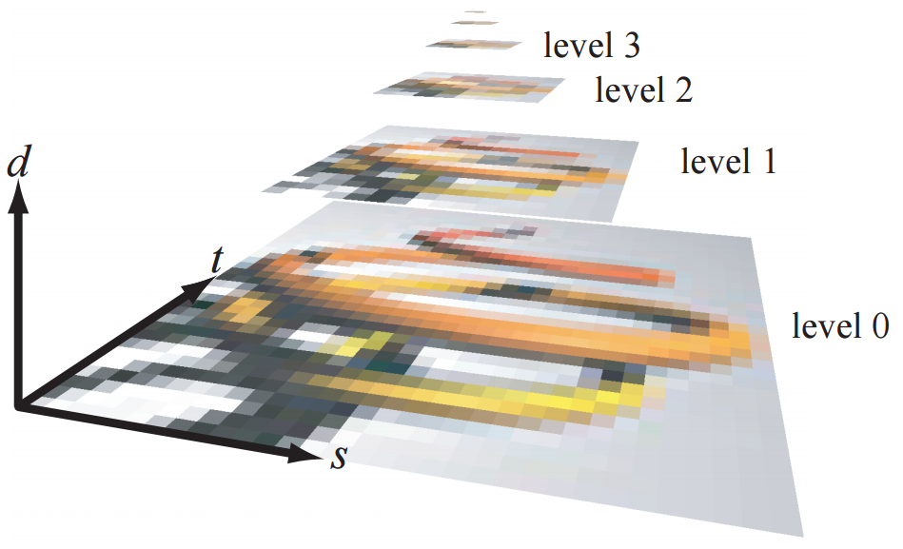
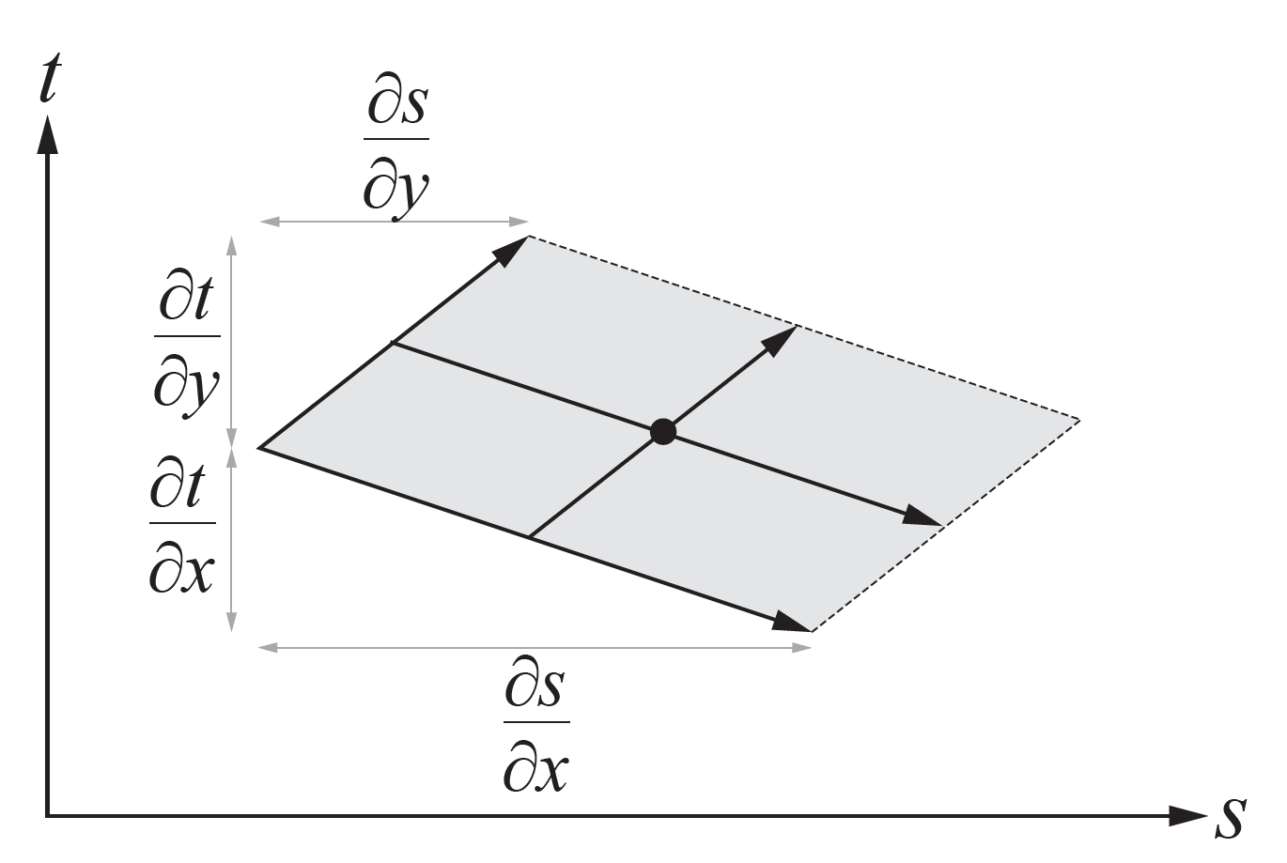
Motivation
Texturing is vital to most graphics applications
Want to avoid aliasing when sampling textures
Well-known mechanism: mip mapping [Williams83]
Requires footprint to select which mip level(s) λ to sample
For rasterization → 2x2 pixel quad
Differentials are simply/generally the horizontal and vertical differences within a quad
Footprint size is estimated from the differentials
Notes:
So we can all agree that texturing is a vital aspect of most graphics applications.
I mean, most if not all game materials these days sample several textures, at different texel-to-pixel ratio.
As a discretized representation of color on an object, we want to avoid aliasing when sampling these textures.
So far we have a well-known mechanism here, which is mipmapping. Invented by the late-and-great Lance Williams in 1983, this seminal idea of pyramidal sampling has been supported by hardware for several GPU generations.
To be able to select which mip level, Lambda in the equation here, for proper pixel-to-texel ratio, you have to compute a footprint which represents this ratio.
With rasterization, this differential-based footprint is computed with the 2x2 pixel quad, basically the horizontal and vertical differences in that quad. The equation below from literature computes this footprint, and then choosen to sample the mip pyramid.
So, with rasterization, the GPU handles this for you...

Slide 4
WHAT ABOUT RAY TRACING?
Rasterization can handle screen-space texturing
But not for ray-traced reflections and refractions...
No concept of pixel quad
Could sample all textures bilinearly at mip 0 and use temporal anti-aliasing...
Visual implications
Performance implications
Notes:
Unfortunately with ray tracing there is no concept of pixel quad.
You could consider building your own pixel quad through primary visibility, but that will only work for the first hit, and not reflections and refractions.
An alternative approach that developers have taken is to sample all textures at mip0, and just rely on temporal anti-aliasing to clean-up the final image.
This can work, but always sampling mip0 is quite costly and not really a solution for AAA games, again with materials sampling several textures up to 4K. Sampling mip0 has visual implications, as one can see from this reflective hemisphere.

Slide 5
Notes:
In case this wasn’t clear, and I’m sorry for making your eyes bleed, but here’s how the checkerboard walls look like when sampled at mip0 on this hemisphere.

Slide 6
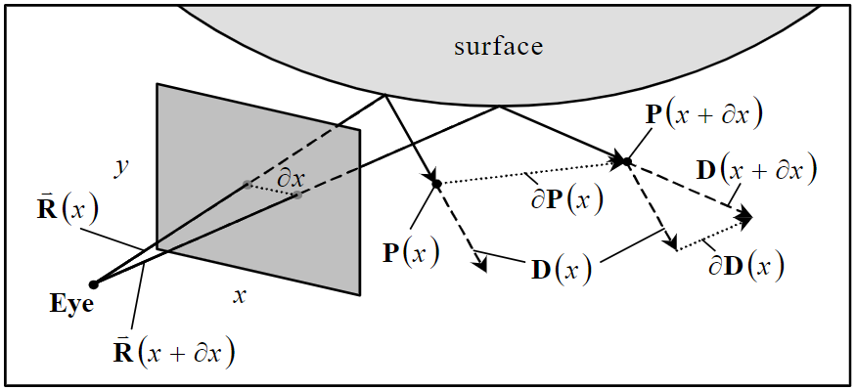
TexturE FILTERING for ray tracing
Not as straightforward
Can shoot primary rays in 2x2 quads in screen space and compute differentials
However, after that, the rays can diverge and the differentials do not make sense
Two methods: Ray Differentials [Igehy 1999] and Ray Cones [Amanatides 1984]
Ray Differentials [Igehy 1999]
Ray Cones [Amanatides 1984]
Notes:
So texture filtering for ray tracing is important… but it’s not that straightforward, especially when considering secondary rays.
Like I said, one can create their own pixel quad differentials with primary rays, but after that the rays can diverge and the primary visibility differentials don’t make sense.
So the objective of this presentation is to illustrate two texture LOD approaches for real-time ray tracing, and compare the results: the well-known ray differentials, and ray cones.
For the sake of time I’ll briefly talk about ray differentials, since those are well understood. In the paper we present an improved formulation for real-time and when using with G-buffer. We also present a new method for computing barycentric differentials.
So instead of spewing a bunch of math and bore you out, I’ll just refer you to the paper. I’ll spend a bit more time on ray cones, improved to handle curvature at the first hit, which improves the overall quality substantially.

Slide 7
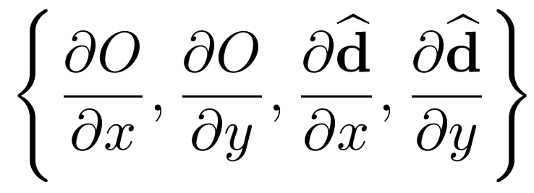
Ray differentials
[Igehy 1999]
Figure from Igehy
Estimate the footprint of a pixel by computing world-space derivatives of the ray, with respect to the image plane
A ray:
A ray differential (RD):
In [Akenine-Möller et al. 2019] we present an optimized approach for computing differential barycentric coordinates, and how to use RDs with a G-buffer as a first rendering pass RTRT: requires 12 floats in the ray payload
Notes:
So briefly, ray differentials estimate this footprint of a pixel by computing world-space derivatives of the ray with respect to the image plane.
In his paper Igehy presents how a ray differential is computed for an eye ray, and tracked through the scene. It relies on the chain rule to produce formulas for reflection and refraction, and uses interpolated triangle normals.
Here virtual offset rays are differentiated, so you don’t actually launch multiple rays.
For both reflection and refraction, the origin of each differential ray is known. You compute how much the surface position changes, with respect to (x, y) position on the image plane (∂p/∂x and ∂p/∂y).
Adding these offsets to the intersection point of the main ray gives approximate origins for the new rays.
In our paper we present an optimized approach for computing differential barycentric coordinates, and how to use ray differentials with a G-buffer as a first rendering pass.
In our case, 12 floats are carried in the ray payload for subsequent rays.

Slide 8
Ray differentials FROM THE G-BUFFER?
Pretty straightforward
Access the G-buffer to the right (x+1 , y) and above (x , y+1) the current pixel (x, y) and create a ray differential from these values.
Normal:
Distance: t
Eye ray:
reflect(): r
? if so, access the G-buffer at -1:0 instead and use the smallest difference in t. Repeat for other axis.
First hit
Direction
Notes:
For real-time ray tracing, and in the context of a hybrid rendering pipeline as you might have seen presented a few times at SIGGRAPH this year and GDC before, the eye rays are rendered using rasterization into a g-buffer.
When you combine ray differentials with a g-buffer, the ray differential for the eye rays can be created as usual, but the interaction at the first hit must use the content from the G-buffer
The general idea here is that you access the g-buffer on the left and above the current pixel, and you create ray differentials from these values
The first equation represents the ray differential of the ray origin at the first hit. Here we only show for dX, but have to do this for dY as well.
The second equation is the ray differential direction. Again you have to do this for dY as well. Also in the 2nd equation, R is the reflect function in HLSL
You could end up in a situation where you hit different surfaces when comparing to the pixel to the right and above.
The extra test here, with a small epsilon, figures out if you should symmetrically access the other direction. You can do this test for both axis.
This gives us all the components of the ray differential, which means that ray tracing with ray differentials can commence from the first hit.

Slide 9
Ray CONES
[Amanatides 1984]
Ray Cones estimate the footprint of a pixel via a cone’s distance, angle & spread
Used in offline / film [Christensen et al. 2018], but few implementation details in papers ☹
Our work derives and provides these details, with some approximations tailored for real-time RTRT: our approach requires a single float in the payload (spread angle)
Notes:
The second technique I want to talk about is Ray Cones. This is much older than ray differentials, as it was developed by Amanatides in 1984.
In their case ray cones estimate the footprint of a pixel with a cone, relying on distance, angle and spread.
We actually came about this similar approach without the litterature, which was definitely a ah-ha moment. One reason for this I think is because while this technique is used in offline and film, a few implementation details are provided in actual papers.
Our work basically derives and provides these details, with some approximations for real-time. I’ll talk about this in the next slides. In the end our take on this approach only requires a single float in the ray payload, which is cheaper than ray differentials.

Slide 10
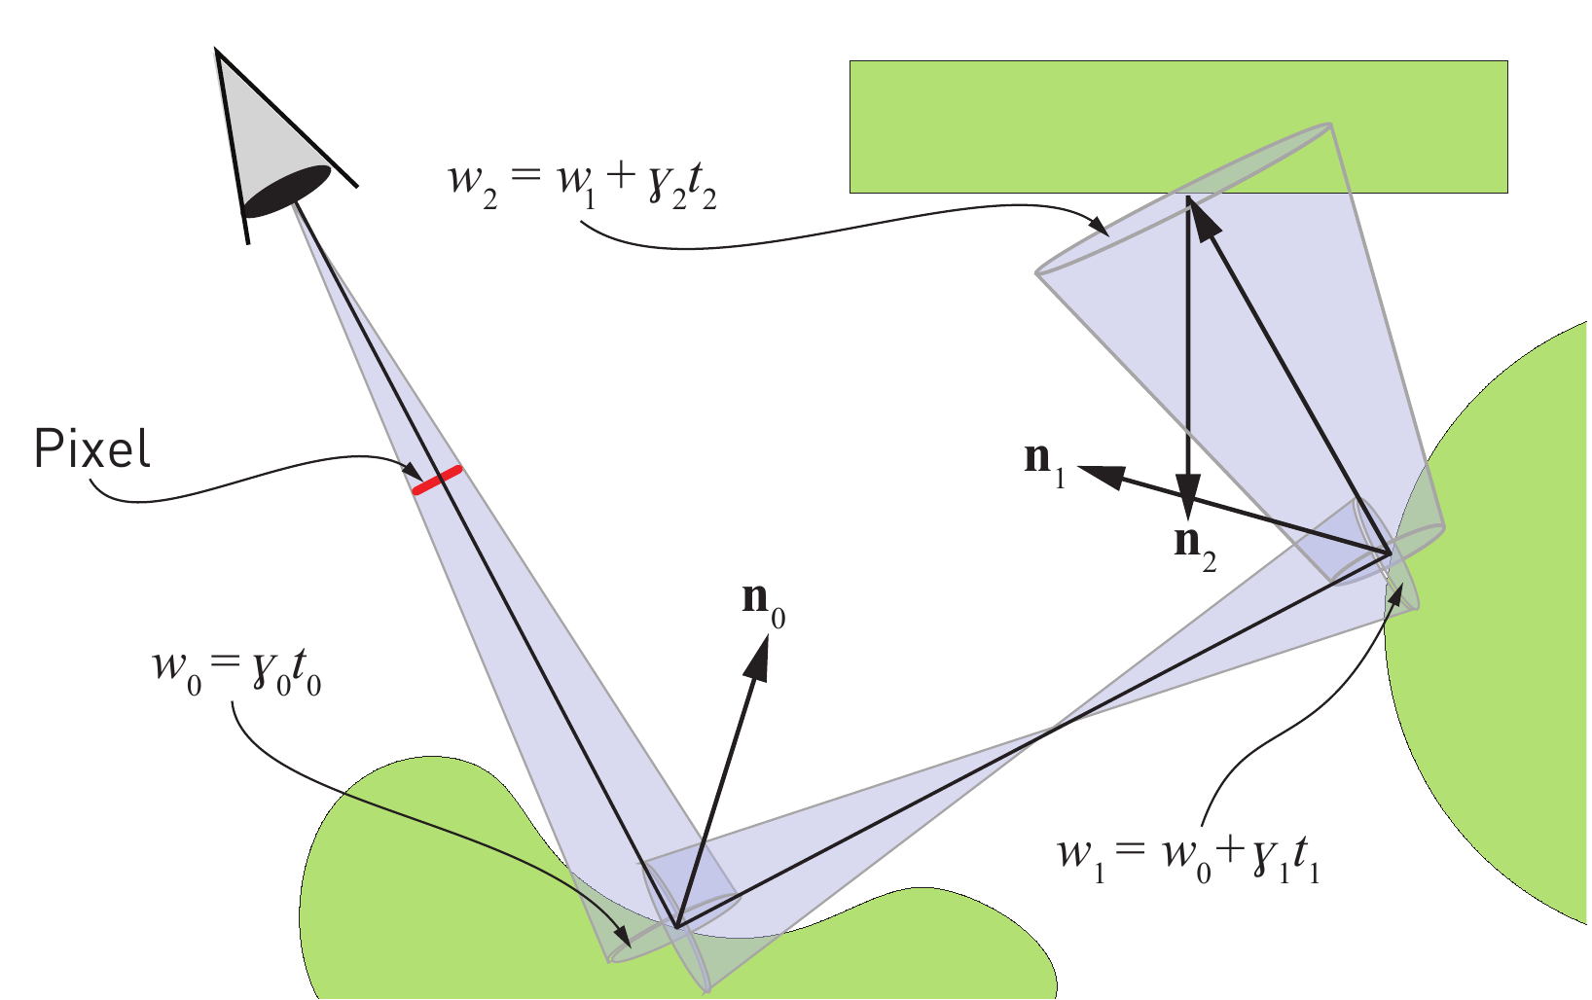
Ray Cone definition
A ray cone consists of 1) a ray (origin & direction), 2) a spread angle, $γ$ 3) a start width, $w$
General Idea: track a cone during reflections (and refractions) in the scene
The width $w$ of the cone at a hit is used when computing the mip level
Notes:
So what is a ray cone?
Well it consists of a ray with an origin and a direction, a spread angle, and a width.
The general idea here is to track those cone properties during reflections and refractions in the scene. At each intersection, you update the width of that cone based on the hit surface: concave, convex and the traveled distance t.
That width is represented by w0, w1, and w2 in the image, and is then used when computing the mip level at that hit.

Slide 11
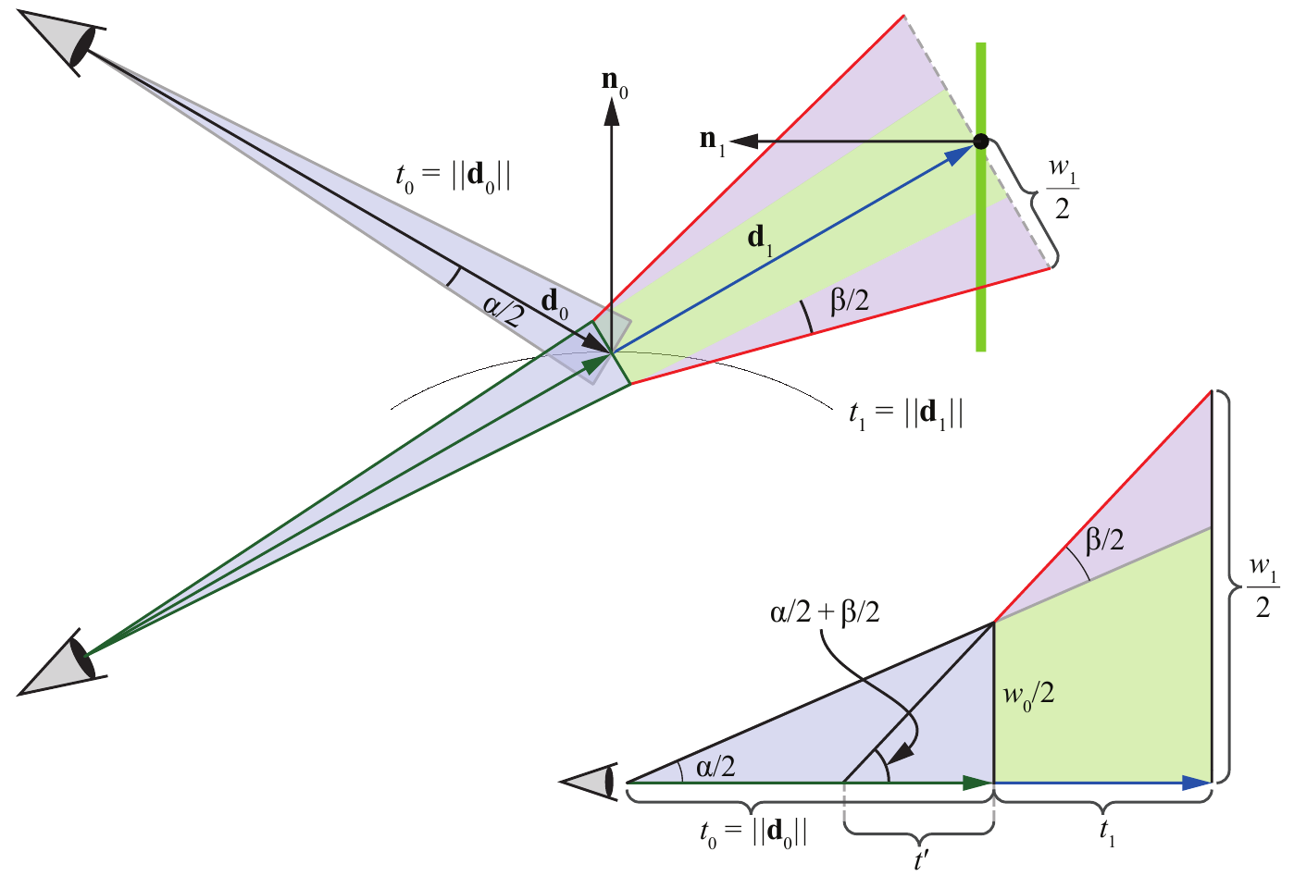
Reflection
After some simplification & approximations
Width of
cone at
second hit
Spread angle
of cone from
the eye
Distance from
first to second hit
$$w_{0}$$
Width of
cone at
first hit
Pixel spread
angle at
first hit
Notes:
After some simplification and approximations, in the paper we demonstrate that the width of the cone at the next hit can be approximated by the width of the cone at the first hit, plus the combination of the spread angle of the cone from the eye (alpha) and the pixel spread angle at first hit (beta), multiplied by the distance from the first to the second hit.
If you want to know how this is derived, check the paper.
In the end it just means updating that single value in the ray payload. Here the challenge is how to compute this pixel spread angle Beta at the first hit…

Slide 12
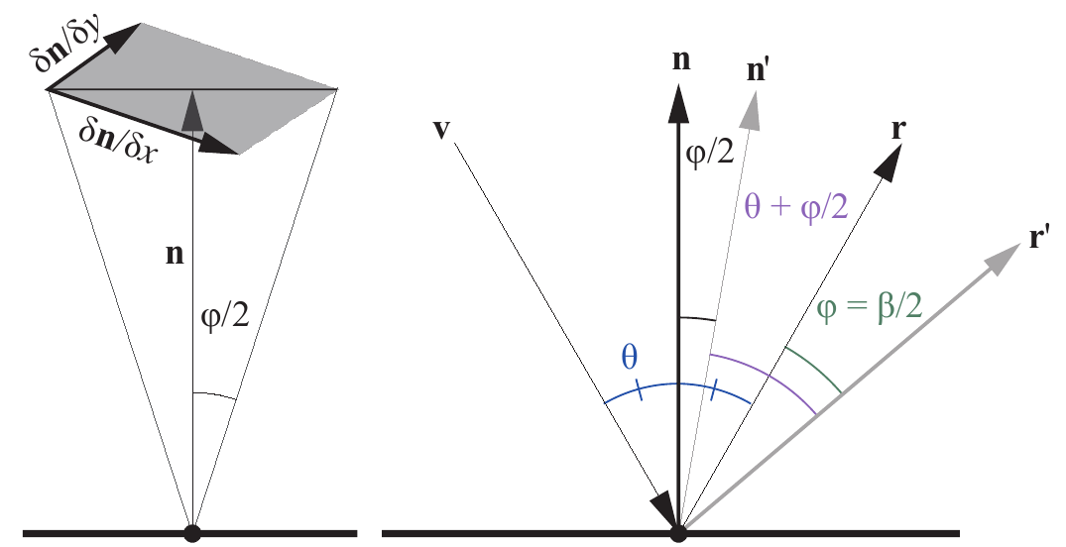
Pixel Spread angle
A single float to approximate convex or concave
This is not possible in theory: need two values to represent (anisotropic) curvature Approximation:
We use the normal n of the G-buffer Limitation: can only be computed at first hit
Notes:
And so this pixel spread angle Beta is inherently affected by the curvature of the hit surface.
To really represent curvature you need two values, since it’s anisotropic. In our case, we approximate this with one.
The jist of our approximation is that phi divided by 2 is the angular change of the normal.
This results in change in the reflected vector r, so Beta is twice as large. You can see this to the right.
But then if the ray hits a surface which is concave or convex the direction can change, and this is represented by the s-term.
The rationale behind this s-term is that partial derivatives of the position and the normal have approximately the same direction when the local geometry is convex and approximately opposite directions when it is concave.
So positive is convex, and a negative is concave.
This s-term is a heuristic, and relies on the normal of the g-buffer, which means we only compute it at the first it. Again check the paper for the full derivation.

Slide 13
Putting it ALL together
triangle LOD
$λ_{i}$is the mip level at bounce $i$
$Δ_{i}$triangle LOD (from texture resolution and texture coords), from [Ewins et. al. 1998]
$w_{i}$is the width of the cone
$n_{i}$ and $d_{i}$ are the normals and ray directions
Use $λ_{i}$as input to SampleLevel() to access correct mip level
Notes:
So putting it all together, the mip level lambda is used as input in the texture sample function, and computed using the log2 of the width of the cone, minus the log2 of the dot product of the normal and ray direction, added by the triangle LOD term.
This triangle LOD term comes from Ewins 1998, and takes changes in triangle vertices and texture coordinates into account.

Slide 14
Triangle LOD
Single LOD for entire triangle [Ewins et. al. 1998]
w = texture width h = texture height t = texture coordinates (UV) From world space positions p = triangle vertices triangle index is 0-1-2
Notes:
Interlude. So Ewins and otherspresented various approximations for texture LOD
They describe a crude approximation using a single LOD for an entire triangle. And this is what this equation is
Here, w and h are the texture width and height
T is the texture coordinate
Ta is twice the texel space area in screen space, and Pa is twice the triangle area in screen space
Pa can also be simplified and computed directly from world space positions
We exploit this, so now delta gives a one-to-one mapping between pixels and texels if the triangle lies on the z = 1 plane.
In this case, Delta can be considered as a base texture level of detail of the triangle.
For example, if a triangle becomes twice as large, then the base LOD will decrease by one.

Slide 15
Putting it ALL together
triangle LOD
$λ_{i}$is the mip level at bounce $i$
$Δ_{i}$triangle LOD (from texture resolution and texture coords), from [Ewins et. al. 1998]
$w_{i}$is the width of the cone
$n_{i}$ and $d_{i}$ are the normals and ray directions
Use $λ_{i}$as input to SampleLevel() to access correct mip level
Notes:
Again, putting it all together, this is what the final equation looks like
So a triangle LOD term, a distance-based term, and an orientation-based term.
This per-triangle LOD can be computed in advance for static models and accessed in the shader. In our work we actually just recompute it each time a closest hit on a triangle is found.

Slide 16
results
Notes:
Let’s look at some visual results.

Slide 17
VALIDATE AGAINST ground truth
Visualizing mip map selection
Notes:
To make sure our approach works, we validate against ground truth.
Here we consider PBRT to be the reference, and validate against their implementation of ray differentials.
A rainbow shows which mip level is selected. Overall its quite similar.
The three images to the right match quite well, but RayCones is a bit different, in particular in the recursive intersections.
You probably expected this difference as well, since reflections are assumed to be planar after the first bounce for this method.

Slide 18
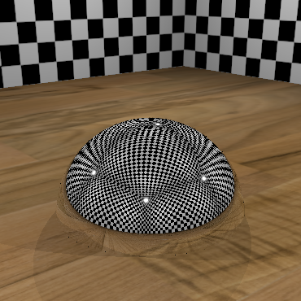
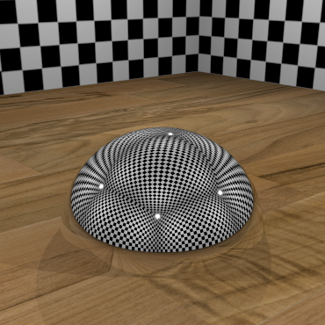
MIP 0
GROUND TRUTH @ 1024 SPP
Notes:
To the left, point sampled mip0 and to the right, ground truth at 1024 samples per pixel

Slide 19
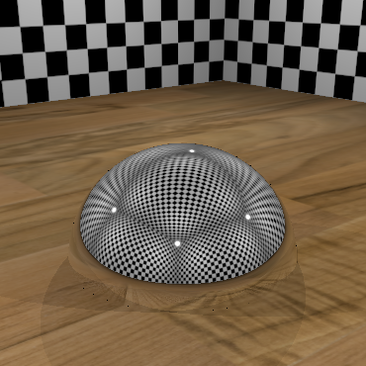
RAY CONES
GROUND TRUTH @ 1024 SPP
Notes:
Here with ray cones.
Looks pretty good!

Slide 20
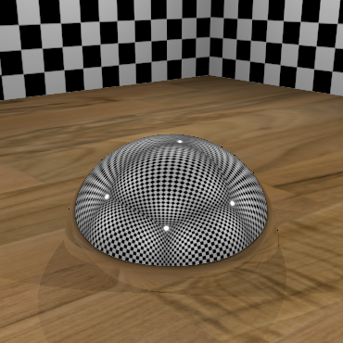
RAY DIFFERENTIALS
GROUND TRUTH @ 1024 SPP
Notes:
And now with ray differentials. A bit sharper than ray cones here.

Slide 21
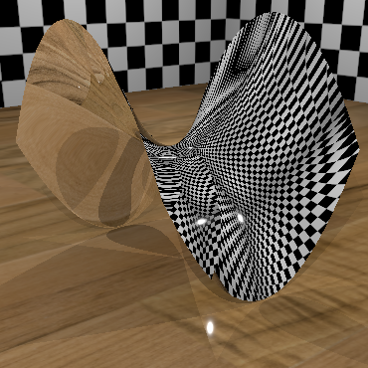
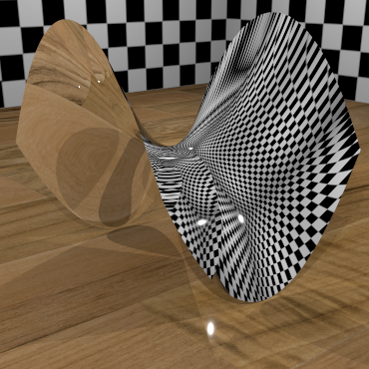
MIP 0
GROUND TRUTH @ 1024 SPP
Notes:
The same now, with one favorite aliasing shape for ray tracing: hyperboloid parabolla (or diabolic paraboloid ☺).
Mip 0, quite nasty in the curve there.

Slide 22
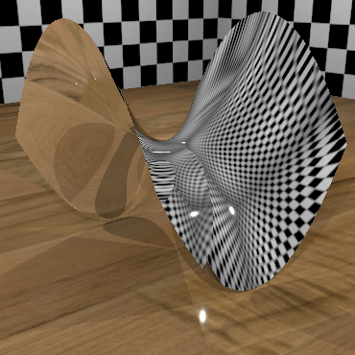
RAY CONES
GROUND TRUTH @ 1024 SPP
Notes:
Here with ray cones.
This is a difficult surface, since it’s both convex and concave in all points
You can see recursive reflections in the surface as well (to the left).

Slide 23
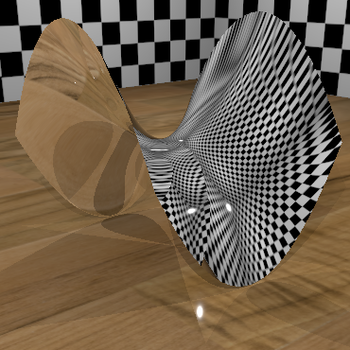
RAY DIFFERENTIALS
GROUND TRUTH @ 1024 SPP
Notes:
And with ray differentials, a bit sharper. Even at 1024 samples per pixel it’s still not perfect.
In the paper you can find more comparison images.

Slide 24
SEED’s PICA PICA uses ray cones
Notes:
But you’ll say: “But Colin… those are really simple materials”.
“Yiss…”
Actually our SEED DXR launch demo “PICA PICA” used ray cones for texture LOD.
This worked with our multi-layer material model, which supported stochastic sampling of 3 layers
I recommend you check seed.ea.com for more details on our hybrid rendering pipeline, reflections, and how we put it all together.
We also did a bunch of denoising in our demo, so texture LOD will not be your savior for making your stochastic sampling noise free.
But it definitely helps.

Slide 25
Notes:
Now let’s look at some results in motion
You can see the mip visualization
EWA is an elliptical weighted average filter, from Greene and Heckbert, which is often considered the method with best quality and reasonable performance.
EWA computes an elliptical footprint in texture space and samples the mipmap using several lookups with Gaussian weights.

Slide 26
Performance
3840x2160 resolution on RTX 2080 Ti
RayDiffs GB (with first pass using G-Buffer) adds about 2x the cost compared to RayCones
RayDiffs RT (with ray traced eye rays) adds about 3x the cost compared RayCones
Low mip0 cost due to very simple materials (single texture)
Notes:
Performance wise, ray differentials with the first pass using the g-buffer adds about 2x the cost compared to ray cones
Ray differentials with ray traced eye rays adds about 3x the cost compared to ray cones.
This is computed on a pretty beefy GPU, a 2080TI in 4K.
Here, mip0 sampling cost is low due to very simple materials in the test scenes in PBRT.

Slide 27
FUTURE IMPROVEMENTS
A few improvements come to mind
Ray Cones:
Triangle LOD doesn’t handle user-animated UVs. Need to solve for dynamic materials!
Highly deforming animated geometry: Could possibly compute triangle LOD in the VS
Improve sharpness compared to screen-space mip level selection
...
Notes:
The attentive listener will already think about several improvements.
Better handling of triangle LOD for animated materials comes to mind.
I’m sure you can think of other future improvements too.

Slide 28
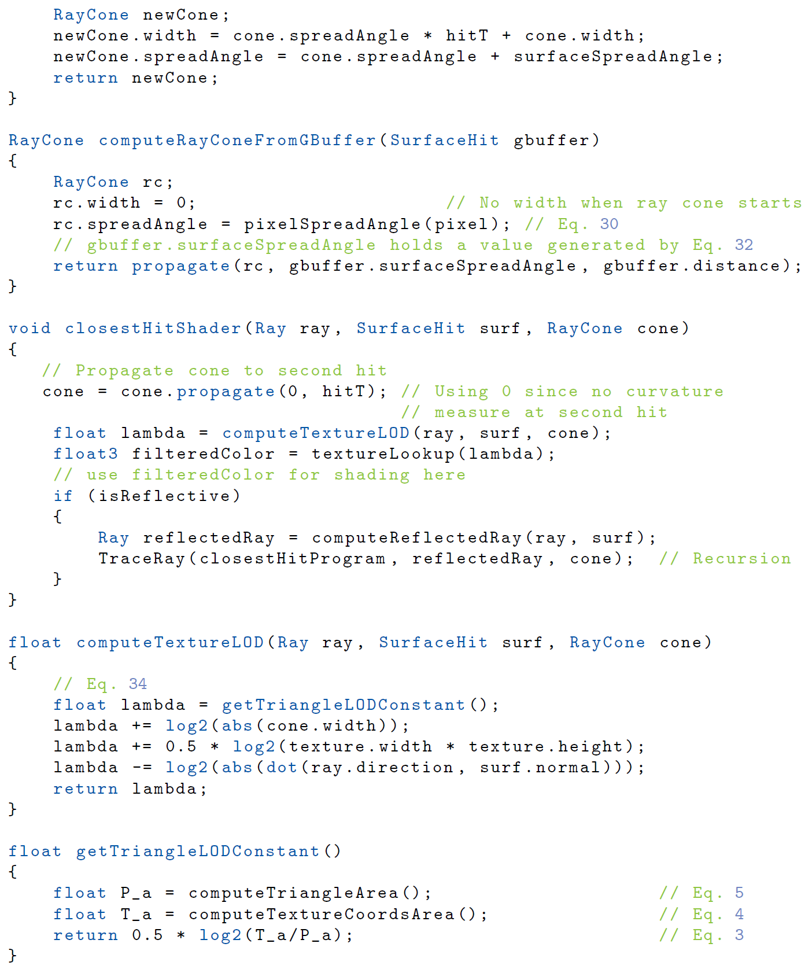
CODE
Available in the paper, and soon on github
Notes:
Here’s some code to achieve this.
But it’s all in paper
We also plan to release a demo soon in Falcor

Slide 29
Conclusion
Texture filtering is important for real-time ray tracing, just as it is for rasterization
Ray Cones and Ray Differentials are both viable. Code provided in the paper / online ☺
Ray Cones: → Faster than ray differentials → RTRT: less register pressure, as our approaches stores a single value in the payload
Ray Differentials: → More accurate than ray cones → Better after the first bounce → RTRT: requires 12 floats in the payload
For real-time considerations: → We chose Ray Cones for their simplicity, and low memory footprint. → For large scenes/games, filtering improves performance with T$ hits [Pharr 2018]
Additionally → See Simple Environment Map Filtering Using Ray Cones and Ray Differentials in Ray Tracing Gems.
Notes:
In conclusion, we can see that texture filtering is as important for ray tracing as it is for rasterization.
Our paper discusses two viable methods, and code is provided.
Overall we chose ray cones for their simplicity and low memory footprint, which keeps the payload small, which is important for performance and because you can use that memory for other stuff, and because they are faster than ray differentials. This is especially important since we have a ton of textures to sample.
On the flip side if you are willing to spend a bit more cycles here, don’t mind using more payload memory, and need a bit more accuracy, ray differentials can be an option too.
I also recommend checking the extension to this paper by Tomas in the book, on applying ray cones and ray differentials for environment map filtering.

Slide 30
THANKS
NVIDIA Co-Authors Tomas Akenine-Möller (main) Jim Nilsson Magnus Andersson Robert Toth Tero Karras
NVIDIA Aaron Lefohn Eric Haines Alex Hyder
Special Thanks Tomasz Stachowiak (brainstorming @ SEED)
Notes:
If you find this kind of R&D work interesting, you should know that SEED and NVIDIA are both hiring.
Want to thank my coauthors, but Eric Haines and Alex Hyder for inviting me to present this for the team
Again, Aaron, for initiating this great collaboration

Slide 31
References
Tomas Akenine-Möller, Jim Nilsson, Magnus Andersson, Colin Barré-Brisebois, Robert Toth, and Tero Karras, “Texture Level of Detail Strategies for Real-Time Ray Tracing,” chapter 20 in Ray Tracing Gems, edited by Eric Haines and Tomas Akenine-Möller, 2019.
Tomas Akenine-Möller and Jim Nilsson, “Simple Environment Map Filtering Using Ray Cones and Ray Differentials,” chapter 21 in Ray Tracing Gems, edited by Eric Haines and Tomas Akenine-Möller, 2019.
Per Christensen et al., “RenderMan: An Advanced Path-Tracing Architecture for Movie Rendering,” ACM Transactions on Graphics, vol. 37, no. 3, Article no. 30, August 2018.
Homan Igehy, “Tracing Ray Differentials,” Proceedings of SIGGRAPH, pp. 179—186, 1999.
John Amanatides, “Ray Tracing with Cones,” Computer Graphics (SIGGRAPH), vol. 18, no. 3, pp 129—135, 1984.
Matt Pharr, “Swallowing the elephant (part 5), blog post, July 16, 2018.
Lance Williams, “Pyramidal Parametrics”, Computer Graphics (SIGGRAPH) vol. 17, no 3, 1-11 1983
Ewins, J. P., Waller, M. D., White, M., and Lister, P. F. MIP-Map, “Level Selection for Texture Mapping”, IEEE Transactions on Visualization and Computer Graphics 4, 4 (1998), 317-329

