Slide 1

High-Quality Object-Space Dynamic Ambient Occlusion for
Characters using Bi-level Regression
SEED // Electronic Arts
Binh Huy Le Henrik Halen^{(*)} Carlos Gonzalez-Ochoa JP Lewis
^{(*)} presenter
https://www.ea.com/seed/news/i3d2019-dynamic-ao
Notes:
I am Henrik Halen, I am a rendering engineer working at a research division within Electronic Arts called SEED. While our group is geographically diverse, the authors of this paper are based in California

Slide 2
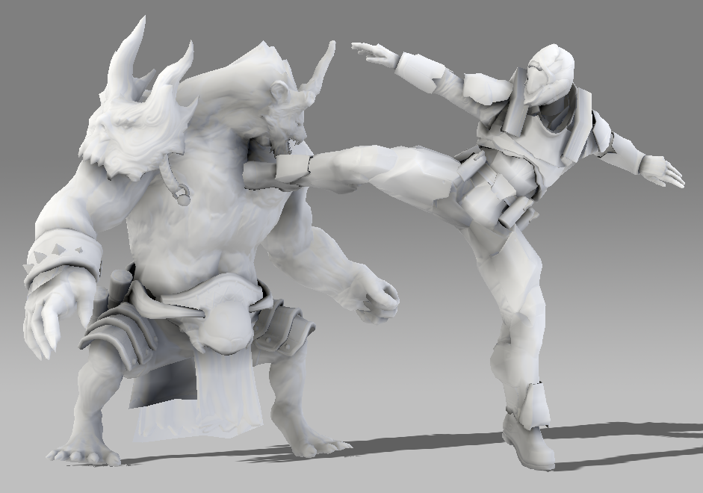
Ambient Occlusion (AO)
Notes:
This paper presents a method computing an approximation of ambient occlusion in object space, using a custom machine learning regression approach.

Slide 3
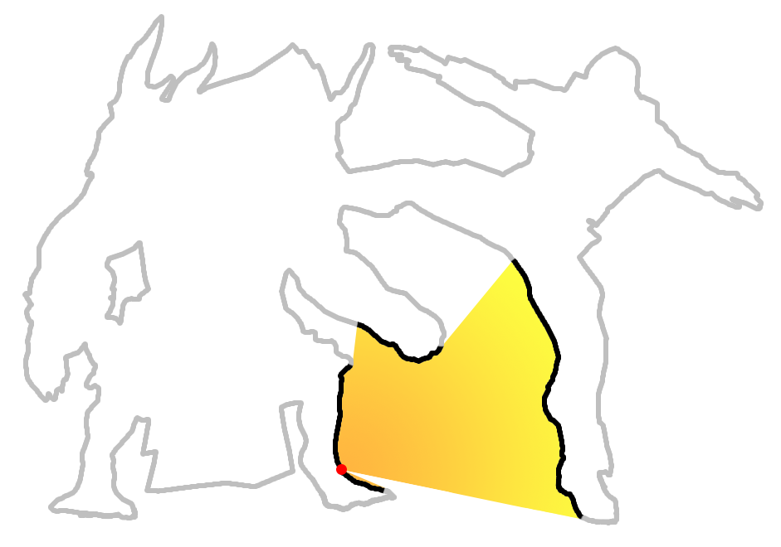
Ambient Occlusion (AO)
Exposure to ambient lighting
AO value at a point on 3D scene:
is its exposure to the ambient lighting,
or (1 – shadow) cast by the scene.
Notes:
The ambient occlusion for any given point in a 3D scene can be defined as it’s exposure to ambient lighting, or in other words the opposite of shadow cast from all other points in the scene.
Note: fig on the right visualizes points (black) cast shadow on red point

Slide 4
Ambient Occlusion (AO)
Exposure to ambient lighting
AO value at a point on 3D scene:
is its exposure to the ambient lighting,
or (1 – shadow) cast by the scene.
Expensive to compute:
O(n² × visibility_test)
for every point p do
for every point p’ do
test(p see p’?)
end for
end for
p’
p
Notes:
If done correctly this is an expensive problem to solve. Essentially for every given point in the scene, you need to know how occluded it is by all the other points.

Slide 5
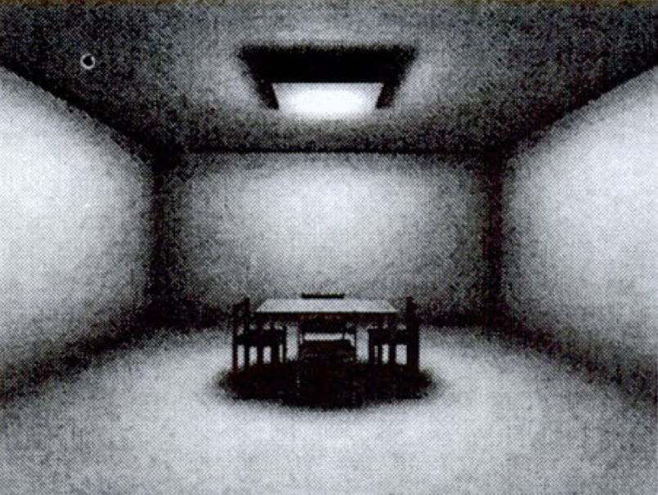
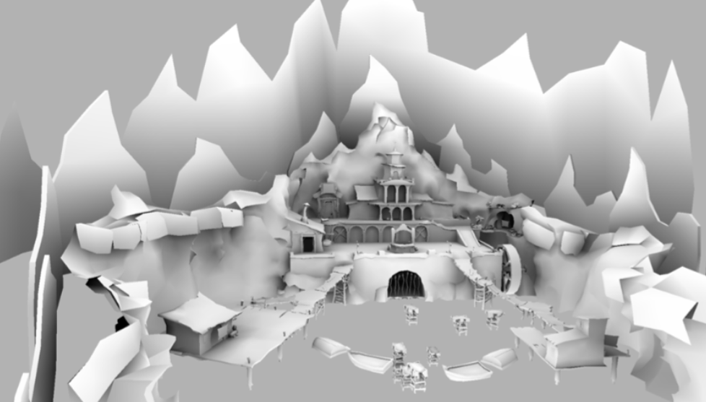
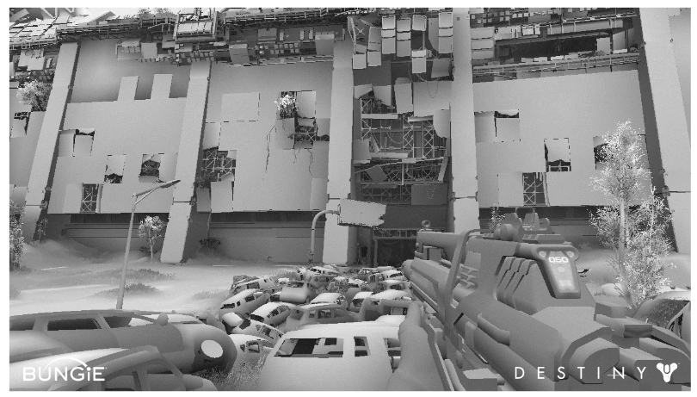
Previous Work: Baked AO
[Zhukov et al. 1998]
[Kavan et al. 2011], [Landis 2002]
[Sloan et al. 2013]
Precomputed
Only for static scenes
Notes:
Precomputed ambient occlusion has existed for quite some time. This can provide a high quality occlusion term, stored in for example textures, or per vertex of polygonal objects. However, since it’s baked, it can’t change in runtime, and as such does not work for dynamic objects or animated characters, and does not change depending on changes in the scene.
S. Zhukov, A. Iones, and G. Kronin. 1998. An ambient light illumination model. In Rendering Techniques ’98. 45–55.
Ladislav Kavan, Adam W. Bargteil, and Peter-Pike Sloan. 2011. Least Squares Vertex Baking. In Proceedings of the 22nd Eurographics Conference on Rendering (EGSR ’11). 1319–1326.
Peter-Pike Sloan, Jason Tranchida, Hao Chen, and Ladislav Kavan. 2013. Ambient obscurance baking on the GPU. In SIGGRAPH Asia 2013 Technical Briefs (SA '13).

Slide 6
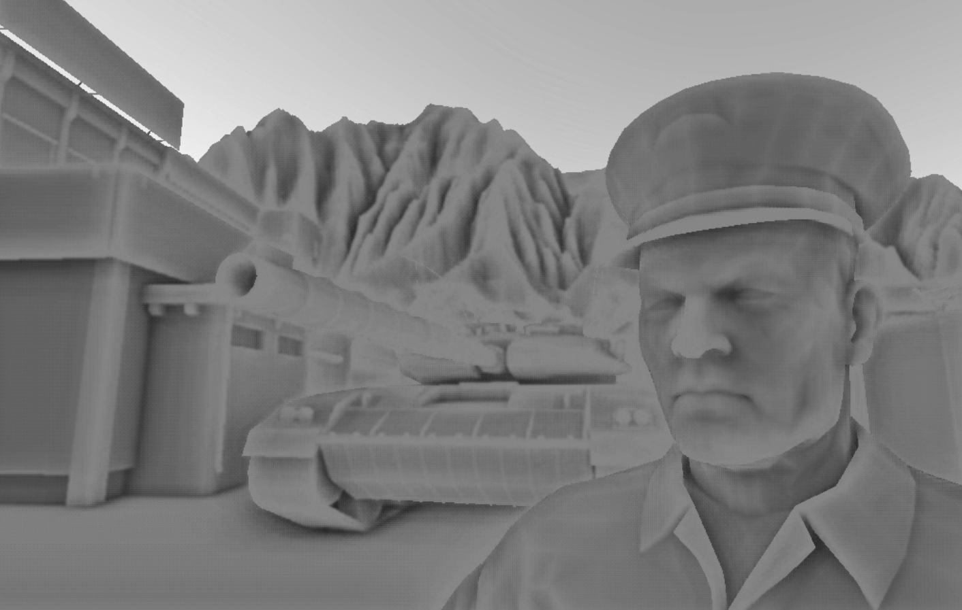
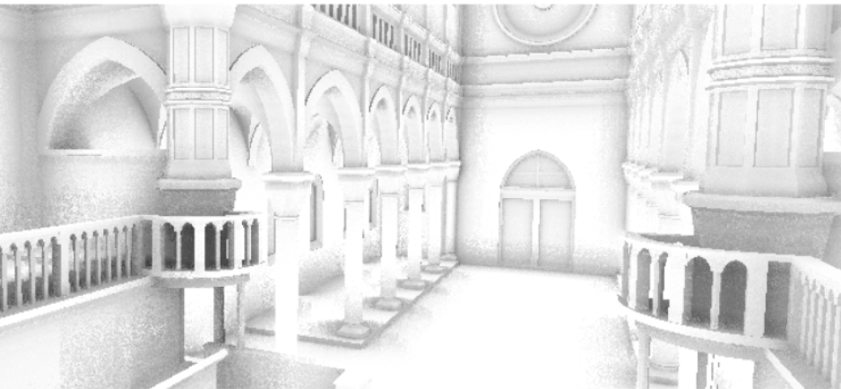
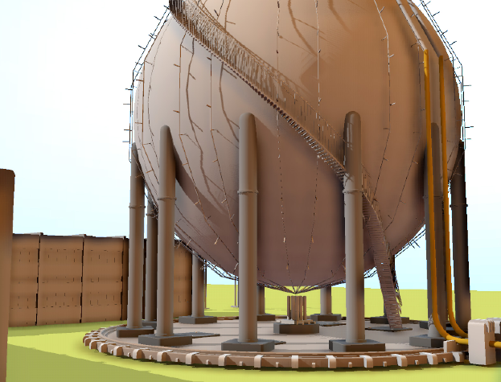
Previous Work: Screen-space AO
[Mittring 2007]
[Bavoil et al. 2008]
[Ritschel et al. 2009]
Fast, good for dynamic scenes
No global (long range) interaction
Artifacts with geometry
hidden from camera
Notes:
In contrast, a commonly used approach for games is real time screen space ambient occlusion. There are many different approaches to this, and work continues to improve quality. However, screen space ambient occlusion has a handicap in that has a lack of information to work with, it can only infer occlusion from what is visible on screen. This means that even for the state of the art methods, assumptions have to be made, and often those assumptions are incorrect.
Martin Mittring. 2007. Finding Next Gen: CryEngine 2. In ACM SIGGRAPH 2007 Courses (SIGGRAPH ’07). 97–121.
Tobias Ritschel, Thorsten Grosch, and Hans-Peter Seidel. 2009. Approximating dynamic global illumination in image space. In Proceedings of the 2009 symposium on Interactive 3D graphics and games (I3D '09).
Louis Bavoil, Miguel Sainz, and Rouslan Dimitrov. 2008. Image-space horizon-based ambient occlusion. In ACM SIGGRAPH 2008 talks (SIGGRAPH '08). ACM, New York, NY, USA, Article 22
NOTE: bottom right corner was rendered with Maya’s SSAO.
In contrast, a commonly used approach for games is real time screen space ambient occlusion. There are many different approaches to this, and continued work has continued to improve the quality of the results. However, screen space AO inherently has a lack of information to work with. It can only know what’s on screen. This not only presents problems where geometry that is outside of the view frustum should cast occlusion, but the algorithms also has to make guesses when geometry is within the frustum, but occluded from the camera. Depending on the technique the screen space search radius can present a situation where a compromise needs to be reached between performance and quality.

Slide 7
Previous Work: Object-space AO
[Kontkanen and Aila 2006]
[Kirk and Arikan 2007]
Data driven approach: train regression model from ray-traced AO
For animated character (but not general dynamic scenes)
Not good in generalization, mostly animation compression
(more details will be presented later in our comparisons)
Notes:
Alternative solutions suitable for dynamic geometry, and characters in particular, are object space solutions. The previous work in this area generally focuses on using regression for an accurate object space solution for Ambient Occlusion. These models use regression to train parameters using some form of high quality Ambient Occlusion as ground truth. This allows for a fast and accurate runtime model. The previous work in this area works well for matching ground truth for poses that are in the training set, and as such can be seen as a form of data compression, but they do not generalize well. Our model is an approach in this category.
Note: these works only focused on character but not general dynamic scenes.
However, characters make up most of dynamic scenes so the solutions are still useful.
Our work also focus on the same thing.
Generalization is the key limitation of these works.

Slide 8
Our Proposed Method
Data driven approach: fully automatic model training
Bi-level object space: high quality, global effects
Skinning-like model: fast, simple, GPU friendly, good generalization
Interpretability: adding character-character interaction, ground-character interaction after model trained
Skeleton animation
(bone transformations)
Per-vertex AO
Notes:
Our approach is a data driven approach, and includes a fully automated training setup.
It is a Bi-level object space approach which produces high quality global effects.
It’s a skinning-like model, which lends itself to fast, simple and GPU friendly implementation.
It handles poses well that are not in the training set, and it’s interpretability allow for modes of operation that have not been seen during training, such as character to character interaction and ground-character interaction.

Slide 9
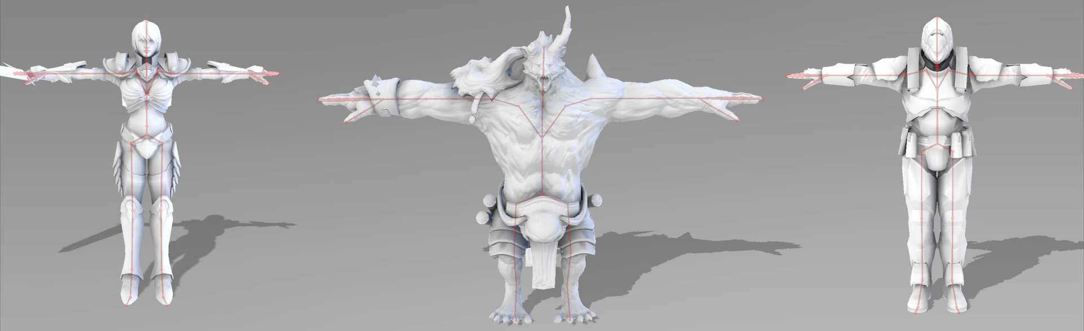
Training Data
Generate training data for each character model:
  Compute ground truth, per-vertex AO with ray tracing (Nvidia OptiX)
  Sample joint rotations (automatically): {Rx, Ry, Rz}^3
  Allow user-defined (artist-made) poses
Notes:
For training, we automatically generate training data by individually rotating each joint to a set number of positions.
The ground truth can be generated with whichever method you prefer, we use Nvidia optiX to provide high quality ray traced ambient occlusion for training.
The way we generate poses is purely for automation, but any set of poses can be used for the training, and as such artist generated poses can also be used.

Slide 10
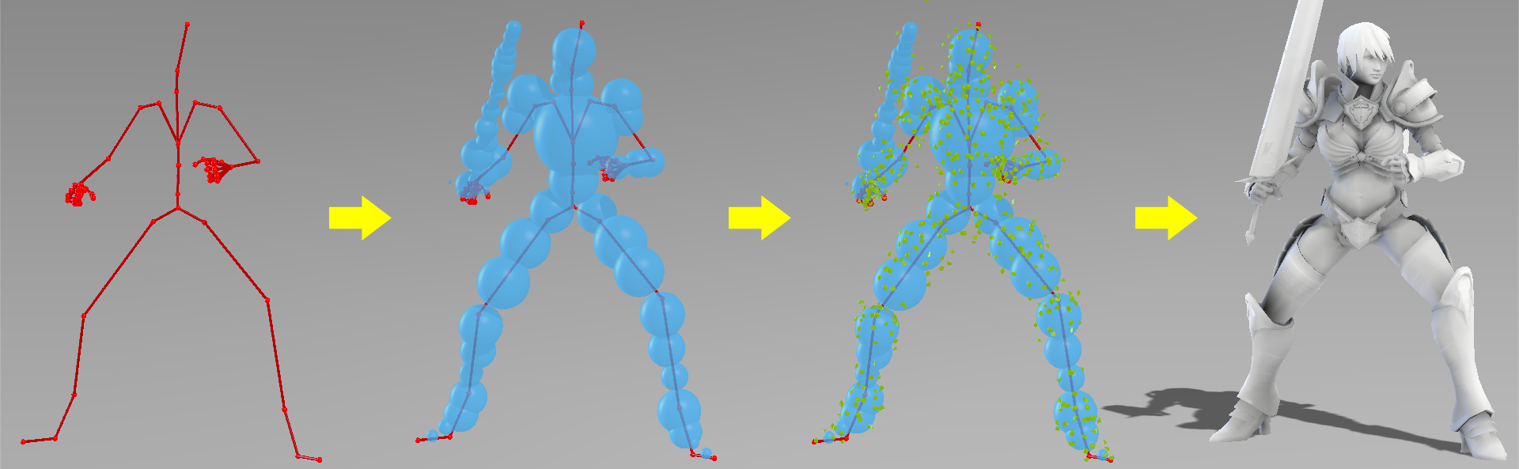
Model
Skeleton
(input)
Proxy Spheres
positions (rest)
radii
cast
shadow
Key Points
positions + normal (rest)
blending weights
linear interpolate
(weighted)
Per-vertex AO
(output)
transform
Parameters trained from data
Notes:
This is a high level description of the ambient occlusion model we are using.
On a very high level you can see our model as one that takes the state of the skeleton as input, and outputs per vertex ambient occlusion.
Essentially we have a skeleton, on that skeleton a number of proxy spheres are placed.
We also place what we call key points, which are represented as points with a position and a normal.
The proxy spheres cast occlusion onto the key points.
Each vertex receives occlusion from a number of key points.
So what we train here is the positions and radiuses of the proxy spheres. They positions and normal of the key points, and the weights per vertex for how each key point effects that vertex.
May hide this slide if presentation time is tight.
Do not need to talk about details (see in our paper).
Key message is: training is fully automatic.

Slide 11
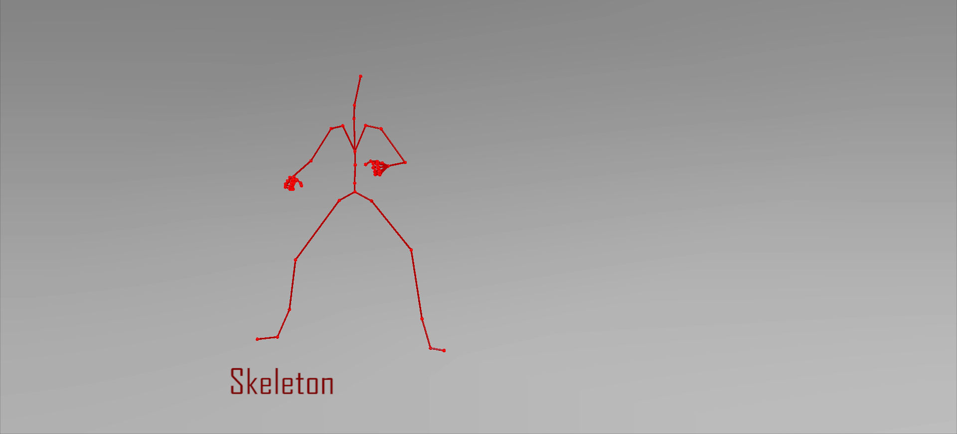
Model: with Animation
Notes:
The proxy spheres are rigidly skinned, while the key points don’t need to be rigid.

Slide 12
Model: Computing Diagram
Notes:
Our model contains two layers:
A dense, non-linear layer on top.
A sparse, linear layer at the bottom.

Slide 13
Model: Computing Diagram
Notes:
The input of the model is bone transformations (M).
They drive transformations of proxy spheres, resulting the changes in their centers (o tilde).
Notice that bone transformations are rigid so the radii of spheres (r) do not change

Slide 14
Model: Computing Diagram
Notes:
And bone transformations also drive transformations of key points,
resulting changes of their positions (c tilde)and normals (u tilde)

Slide 15
Model: Computing Diagram
Notes:
So on the non-linear layer at runtime, we have transformed proxy spheres and transformed key points.

Slide 16
Model: Computing Diagram
Dense connections
Global effect
Notes:
Each key point receives contributions from all spheres.
These Nonlinear dense connections carry global effects but it is costly.
Therefore, we only use small numbers of spheres and key points, typically about 50 spheres and 500 key points.

Slide 17


Model: Computing Diagram
Dense connections
Global effect
Shadow from spheres on key point k:
Normalized solid angle
Visibility ratio
Both can be computed in closed-form
[Sloan et al. 2007], [Mazonka 2012]
Notes:
The shadow cast on each key point is the sum of the shadows cast by all spheres onto that key point.
The shadow from any given sphere onto any key point is the product of the solid angle of there sphere, and a front/back visibility function.
For a point with a normal, the visibility ratio is defined as the ration of the sphere that is visible inside the hemisphere of the key point as defined by it’s normal.
Shadow cast on key point k is summed from all spheres h=1..s
Each shadow cast from a sphere to a key point is the product of solid angle and a front/back visibility function.
Notice these calculations have closed-form solutions. However, they are not differentiable in the whole range. Thus, difficult to train the model.
Therefore, we made some approximation.
Our approximated functions are shown in red curves.
See more details in our paper.

Slide 18
Model: Computing Diagram
Dense connections
Global effect
Our Approximated
Solid Angle
Our Approximated
Visibility Function
Differentiable in the whole range
Notes:
Now, both the solid angle function and the visibility functions have closed form solutions. However, these solutions are not differentiable in the whole range. We want to compute gradients using these functions during regression training, so these functions are unsuitable for our needs.
which makes them unsuitable for the regression training we use.
For that reason we created two approximate functions that closely match the closed for solutions, but are differentiable through the full range.
Shadow cast on key point k is summed from all spheres h=1..s
Each shadow cast from a sphere to a key point is the product of solid angle and a front/back visibility function.
Notice these calculations have closed-form solutions. However, they are not differentiable in the whole range. Thus, difficult to train the model.
Therefore, we made some approximation.
Our approximated functions are shown in red curves.
See more details in our paper.

Slide 19
Model: Computing Diagram
Dense connections
Global effect
Differentiable in the whole range
Notes:
The Red lines here represent our approximate functions

Slide 20
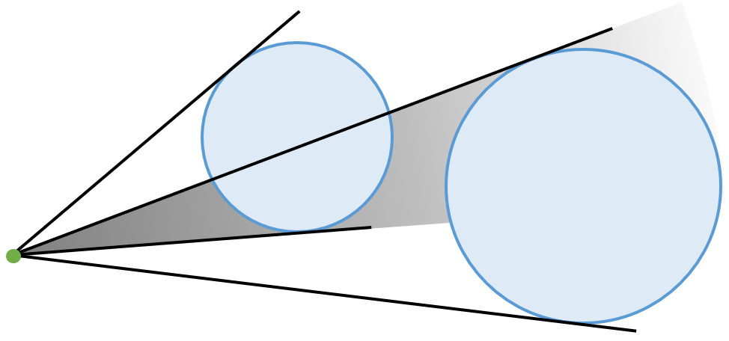
Model: Handling Double Shadowing
function
Double Shadowing
Our Reduced Double Shadowing
Notes:
Now, as the observant listener would have noticed, the solid angle projection onto the key points can produce over-shadowing when the solid angle of two or more spheres overlap from the point of view of a key point. To alleviate this we compute the output of the non-linear layer using a gamma-norm function. This works by emphasizing the contribution from the spheres with the largest shadow contribution, or in other words we sparsify the contribution vector similar to the maximum norm. While this is not an analytically correct solution, it saves us from the computationally heavy approach of doing multiple passes.

Slide 21
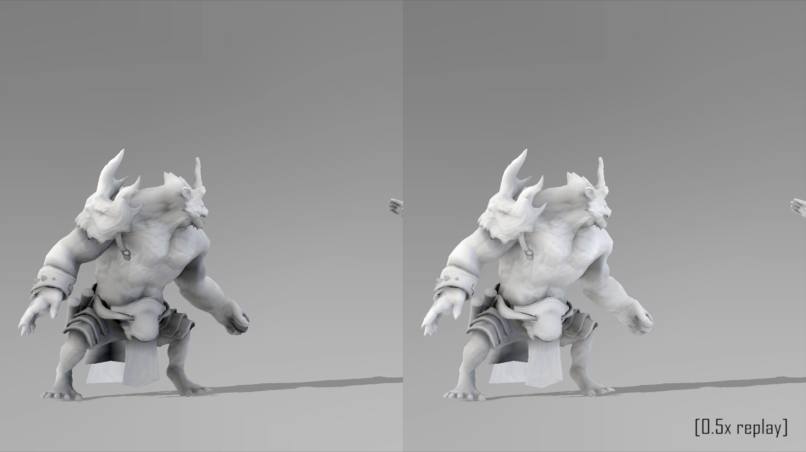
Double Shadowing Ours

Slide 22
Model (Computing Diagram)
Notes:
Once we have the AO calculated for each key point, in the linear layer we compute the final per-vertex AO as a linear combination of the shadow received by a number of key points.

Slide 23
Model (Computing Diagram)
Skinning-like
Sparse connections
Notes:
So each vertex only receives contribution from some local key points.
This sparse linear connect helps to reduce computing cost both during training and in runtime.
As can be seen in the formula we include both a weight, alpha, as well as a bias Beta in order to encode local detail at the vertex.
It is similar to skinning so it could be effectively implemented in GPU’s shaders.
We implement this as a sparse operation on the GPU as well.

Slide 24
Model Fitting
Minimize sum of squared errors:
Block coordinate descent, alternatively update:
  Non-linear layer: using Broyden–Fletcher–Goldfarb–Shanno (BFGS)
  Linear layer: using constrained linear least squares
Parameters to fit
  Rest positions and radii of spheres
  Rest position sand normals of key points
  Blending weights of key points
  Weights and biases for key point to vertex AO
(see more details in our paper)
Non-Linear Layer
Linear Layer
Notes:
The objective of our training is to minimize the error for all training poses with regard to a ground truth ambient occlusion.
The parameters we modify during fitting are broken down into the layer they are associated with.
We perform block coordinate descent to minimize the objective function:
For a number of iterations, we alternate between updating the parameters for the non-linear and linear layers separately
For the non-linear layer, we update the associated parameters using Broyden-Fletcher-Goldfarb-Shanno method. We choose BFGS because of it’s quadratic convergence rate and because it’s requirements for convergance fits our model nicely.
For the linear layer we use constrained least squares to update the weights and biases
The parameters we optimize for are as follows
For the Non-Linear layer, we update rest positions and radii of spheres, rest positions and normals of key points, as well as their skinning weights
For the linear layer we optimize the weights and biases for the linear combination of key point shadow onto final vertex ambient occlusion

Slide 25
Model Fitting
Minimize sum of squared errors:
Block coordinate descent, alternatively update:
  Non-linear layer: using Broyden–Fletcher–Goldfarb–Shanno (BFGS)
  Linear layer: using constrained linear least squares
Parameters to fit
  Rest positions and radii of spheres
  Rest positions and normals of key points
  Blending weights of key points
Non-Linear Layer
Linear Layer
  Weights and biases for key point to vertex AO
Notes:
The objective of our training is to minimize the error for all training poses with regard to a ground truth ambient occlusion.
The parameters we modify during fitting are broken down into the layer they are associated with.
We perform block coordinate descent to minimize the objective function:
For a number of iterations, we alternate between updating the parameters for the non-linear and linear layers separately
For the non-linear layer, we update the associated parameters using Broyden-Fletcher-Goldfarb-Shanno method. We choose BFGS because of it’s quadratic convergence rate and because it’s requirements for convergance fits our model nicely.
For the linear layer we use constrained least squares to update the weights and biases
The parameters we optimize for are as follows
For the Non-Linear layer, we update rest positions and radii of spheres, rest positions and normals of key points, as well as their skinning weights
For the linear layer we optimize the weights and biases for the linear combination of key point shadow onto final vertex ambient occlusion

Slide 26
Model Fitting
Bock Coordinate descent
 | Non-Linear Layer | Linear Layer
Method | Broyden-Fletcher-Goldfarb-Shanno | Least Squares
Parameters | Positions and radii of spheres Positions and normal of key points Key point weights | Vertex/keypoint Weights Biases
Notes:
The objective of our training is to minimize the error for all training poses with regard to a ground truth ambient occlusion.
The parameters we modify during fitting are broken down into the layer they are associated with.
We perform block coordinate descent to minimize the objective function:
For a number of iterations, we alternate between updating the parameters for the non-linear and linear layers separately
For the non-linear layer, we update the associated parameters using Broyden-Fletcher-Goldfarb-Shanno method.
For the linear layer we use constrained least squares to update the weights and biases
The parameters we optimize for are as follows
For the Non-Linear layer, we update rest positions and radii of spheres, rest positions and normals of key points, as well as their skinning weights
For the linear layer we optimize the weights and biases for the linear combination of key point shadow onto final vertex ambient occlusion

Slide 27
Non-Linear Layer Fitting
Notes:
For the non-linear layer we have the sphere parameters

Slide 28
Non-Linear Layer Fitting
Fit Sphere parameters:
Positions
Radii
Notes:
These parameters consist of positions and radii of the spheres

Slide 29
Non-Linear Layer Fitting
Notes:
Also for the non-linear layer, we update the key point parameters

Slide 30
Non-Linear Layer Fitting
Fit Key Point Parameters:
Position
Normal
Bone Weights
Notes:
Which are, positions, normals and skinning weights.

Slide 31
Linear Layer Fitting
Notes:
For the other part of block coordinate descent, we optimize the linear layer using least squares

Slide 32
Linear Layer Fitting
Fit Vertex Parameters:
Key Point Weight
Bias
Notes:
These parameters consist of the weights for how each key point effects each vertex, as well as a local bias

Slide 33
Model Fitting
Block coordinate descent allows for treating parameters from the other layer as fixed:
  Linear layer parameters fixed during Non-Linear BFGS
  Non-linear parameters fixed during Linear Least Squares solve
Allows for optimization by pre-computing the other layer’s parameters
  Observe 2 orders of magnitude speedup with caching
Implemented in parallel on CPUs and GPU
Notes:
In addition to the quadratic convergence rate of BFGS, our use of block coordinate descent allows us to perform further optimization of our training process.
When performing the update for the relevant layer, block coordinate descent allows us to fix the parameters of the other layer, which means we can precompute these parameters.
In our case, this precomputation allowed for a speedup of 2 orders of magnitude

Slide 34
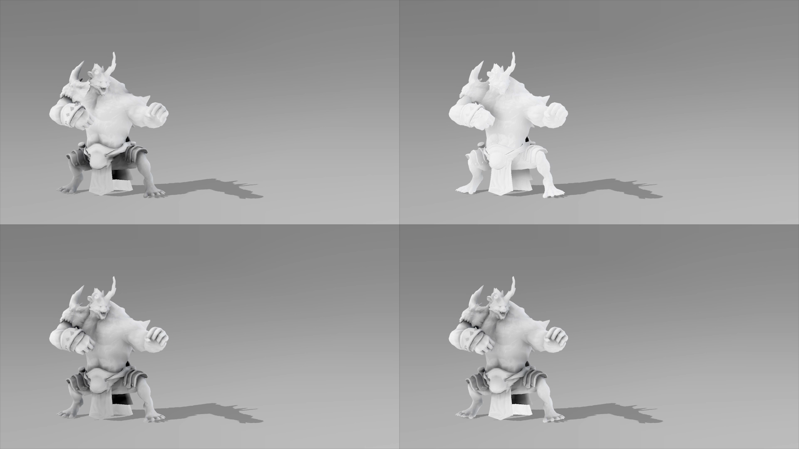
Results and Comparisons
Static Baked AO
Screen Space AO
Our AO
Ray Traced AO
Notes:
These first comparisons are related to different types of techniques. On top you can see the static baked AO, which cannot update when the pose changes. This is opposed to the most commonly used real time technique in screen space ambient occlusion. On the bottom we see our method as well as the ground truth ray traced ambient occlusion.

Slide 35
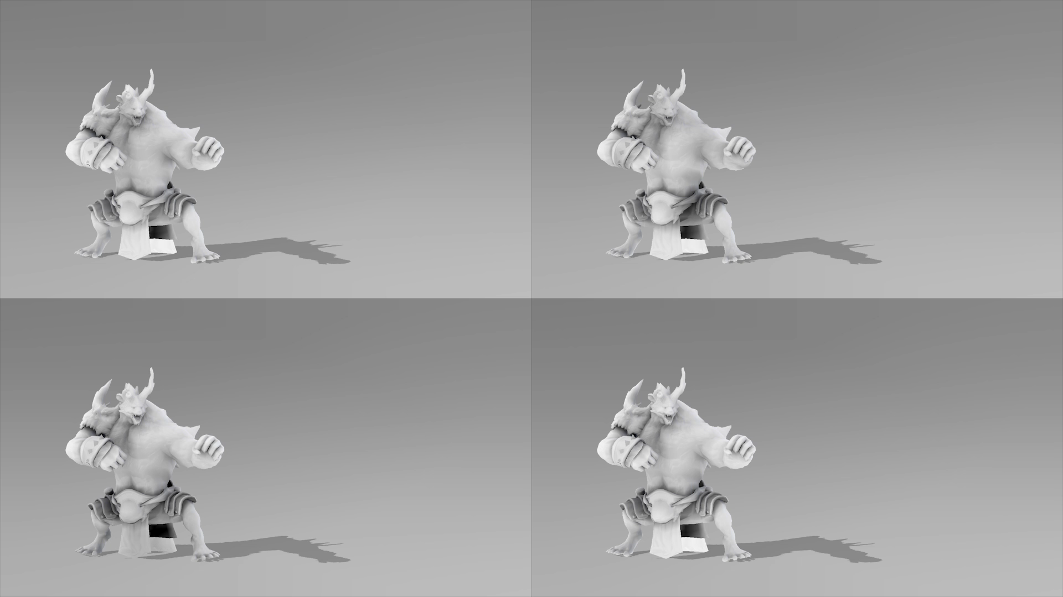
Comparisons: Fitting (training and testing on the same data)
[Kontkanen and Aila 2006]
[Kirk and Arikan 2007]
Our AO
Ray Traced AO
Notes:
These are some comparisons with other object space techniques. In these examples the runtime poses are the same as the poses in the training data.

Slide 36
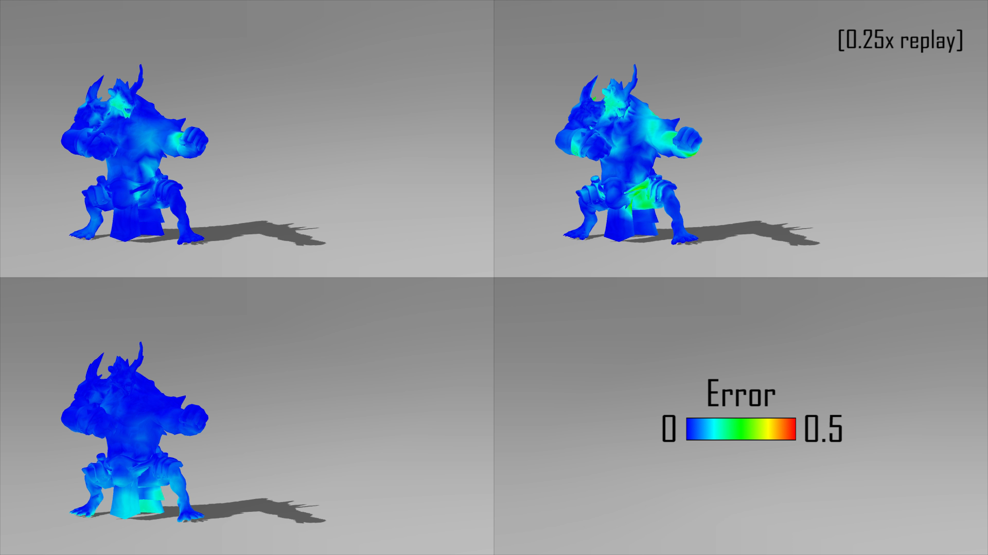
Comparisons: Fitting (training and testing on the same data)
[Kontkanen and Aila 2006]
[Kirk and Arikan 2007]
Our AO
Notes:
And here we can see the error visualized compared to the ground truth data.

Slide 37
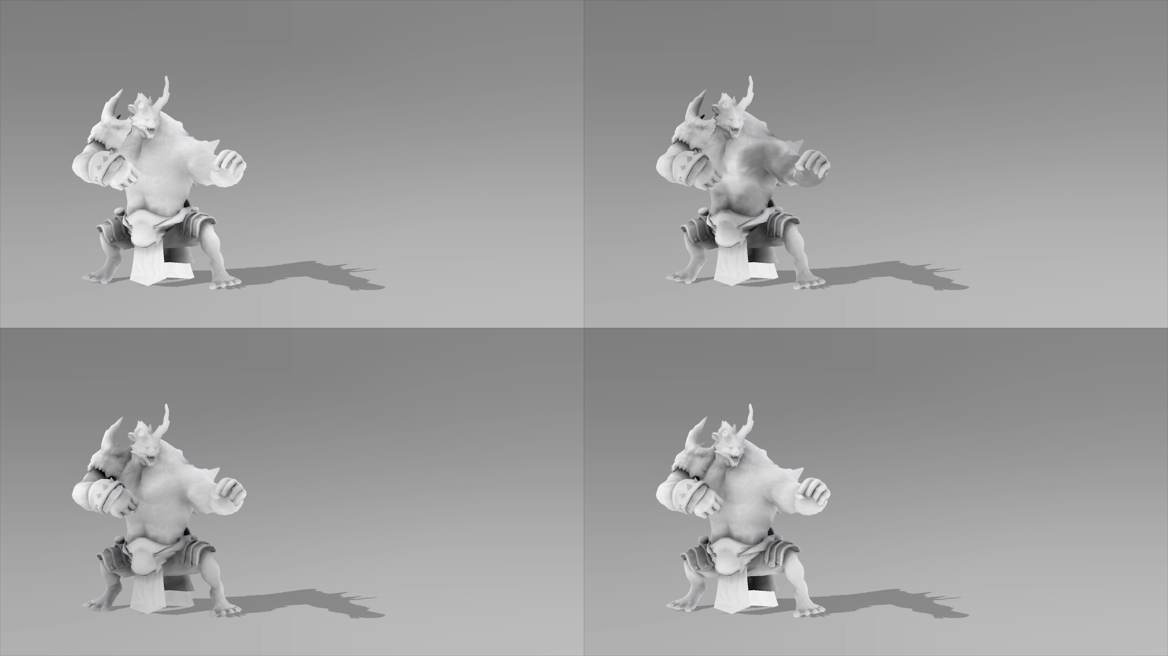
Comparisons: Generalization (testing on different data)
[Kontkanen and Aila 2006]
[Kirk and Arikan 2007]
Our AO
Ray Traced AO
Notes:
Can talk more about the differences here.
In these examples we show how well the method handles generalization, that is to say the poses are different from the training data. We can see in this case our model can still closely match the ground truth data.

Slide 38
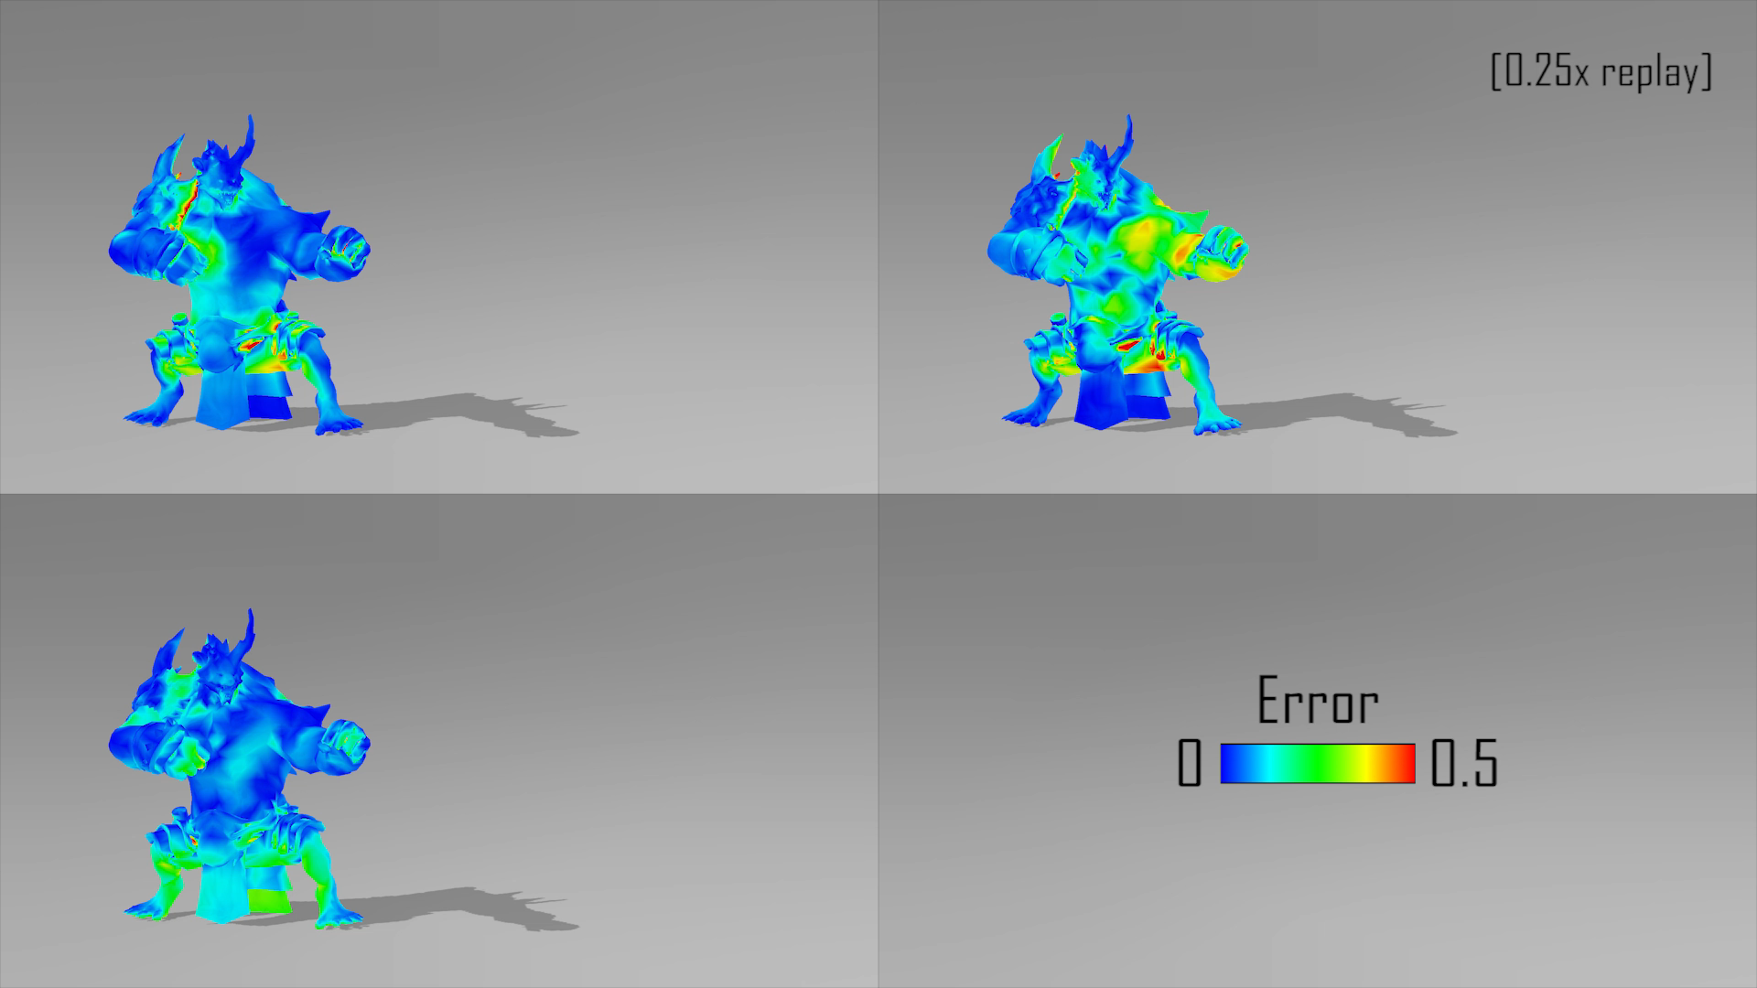
Comparisons: Generalization (testing on different data)
[Kontkanen and Aila 2006]
[Kirk and Arikan 2007]
Our AO
Notes:
We can see that the error compared is higher on all models for this generalized case

Slide 39
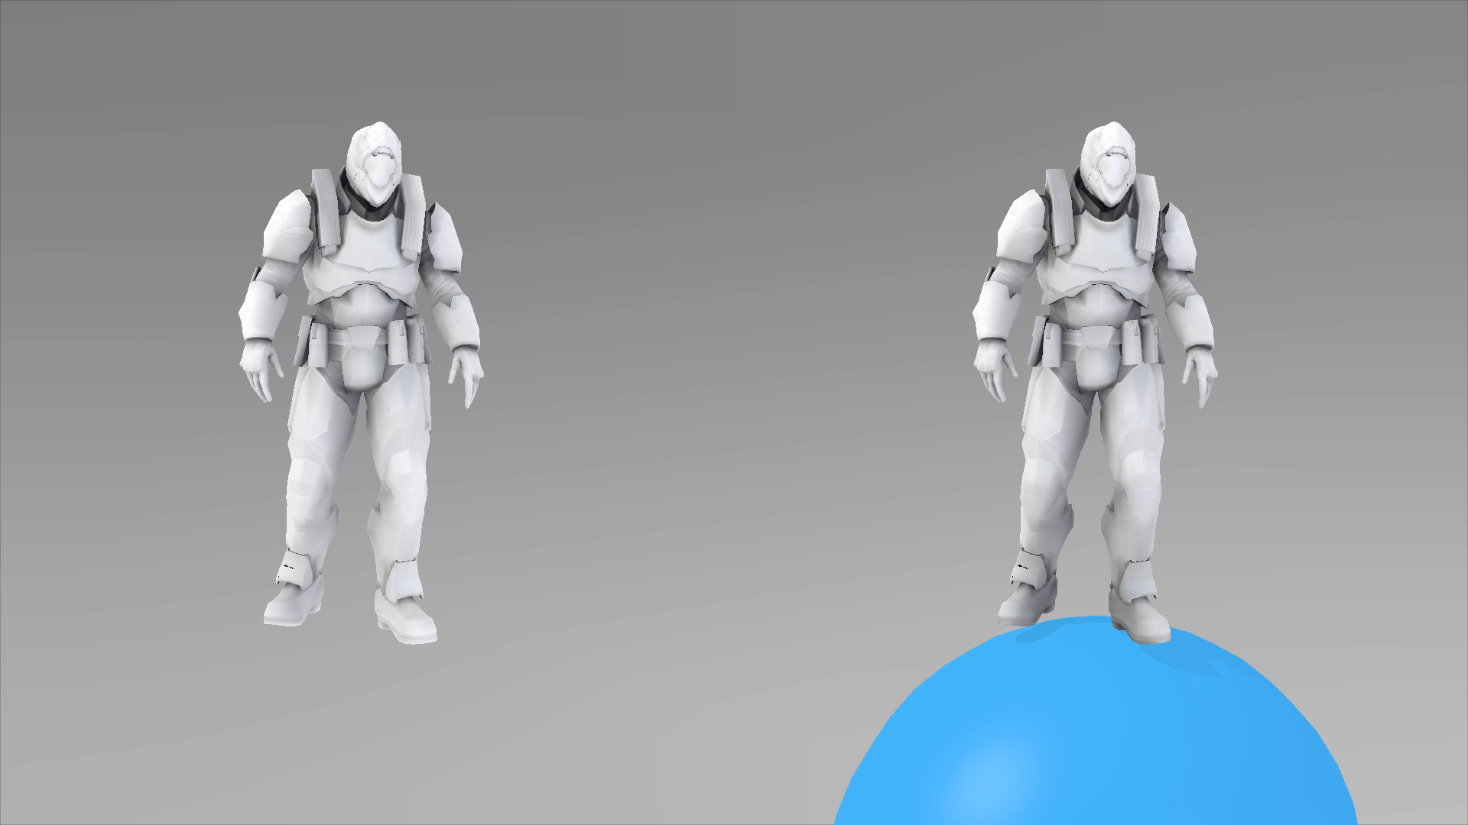
Interpretability: Adding Ground AO
Without Ground AO
With Ground AO
Notes:
Interpretability also allows us to case occlusion onto the character, with high quality, from any proxy sphere. This allows us to for example very easily add an occlusion term cast by the ground by attaching a proxy sphere that is always below the ground.
IMPORTANT NOTE, SHOULD MENTION: Can be done very quick, thanks to the Interpretability of our model.
Manually add a proxy sphere and connect x-y translation to root bone of the character.

Slide 40
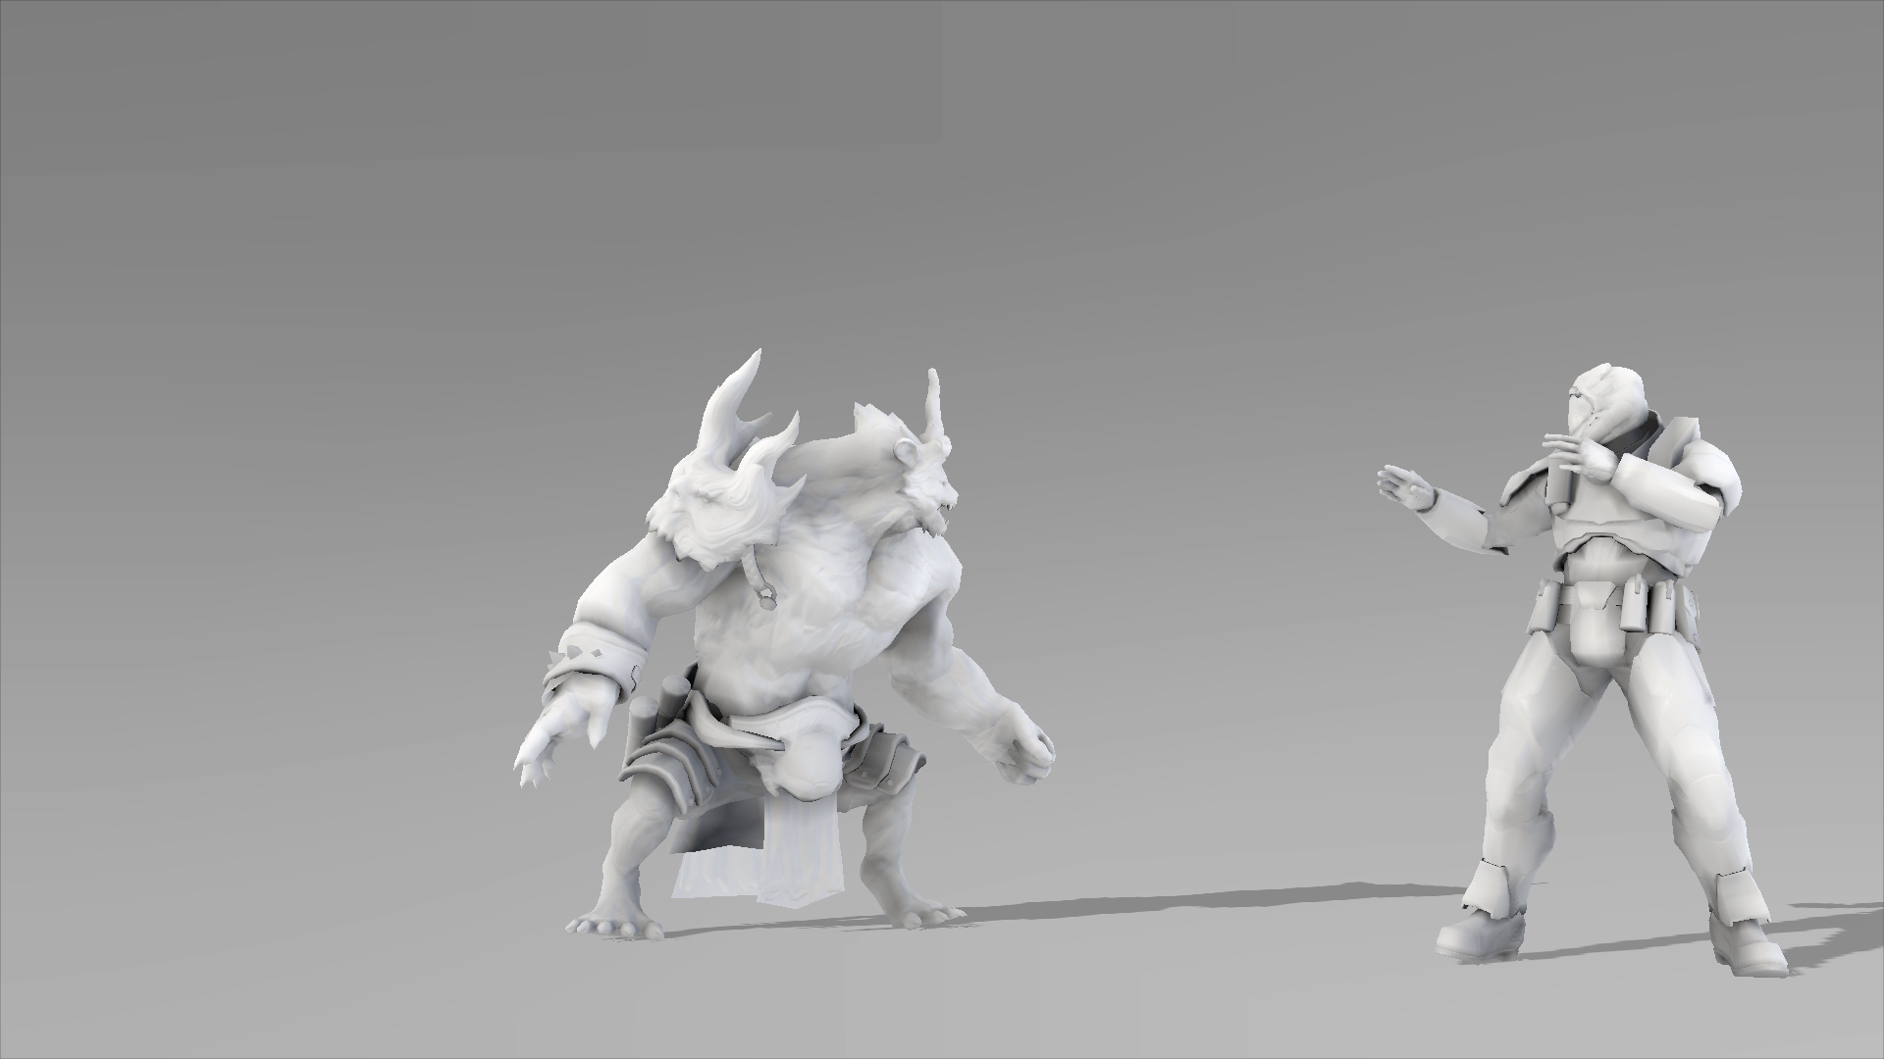
Adding Character-character Interaction
Notes:
This is an example of good interpretability of our model. We only train the model on individual characters, with no knowledge of interaction with other characters or objects. By connecting the proxy spheres of one character to the other, we can allow for ambient occlusion interaction. The system is robust enough to handle this in an agreeable way even though this interaction is not part of the training set.
Another example of Interpretability:
Train independent models for each character, connect proxy spheres to create shadow casting between characters.

Slide 41
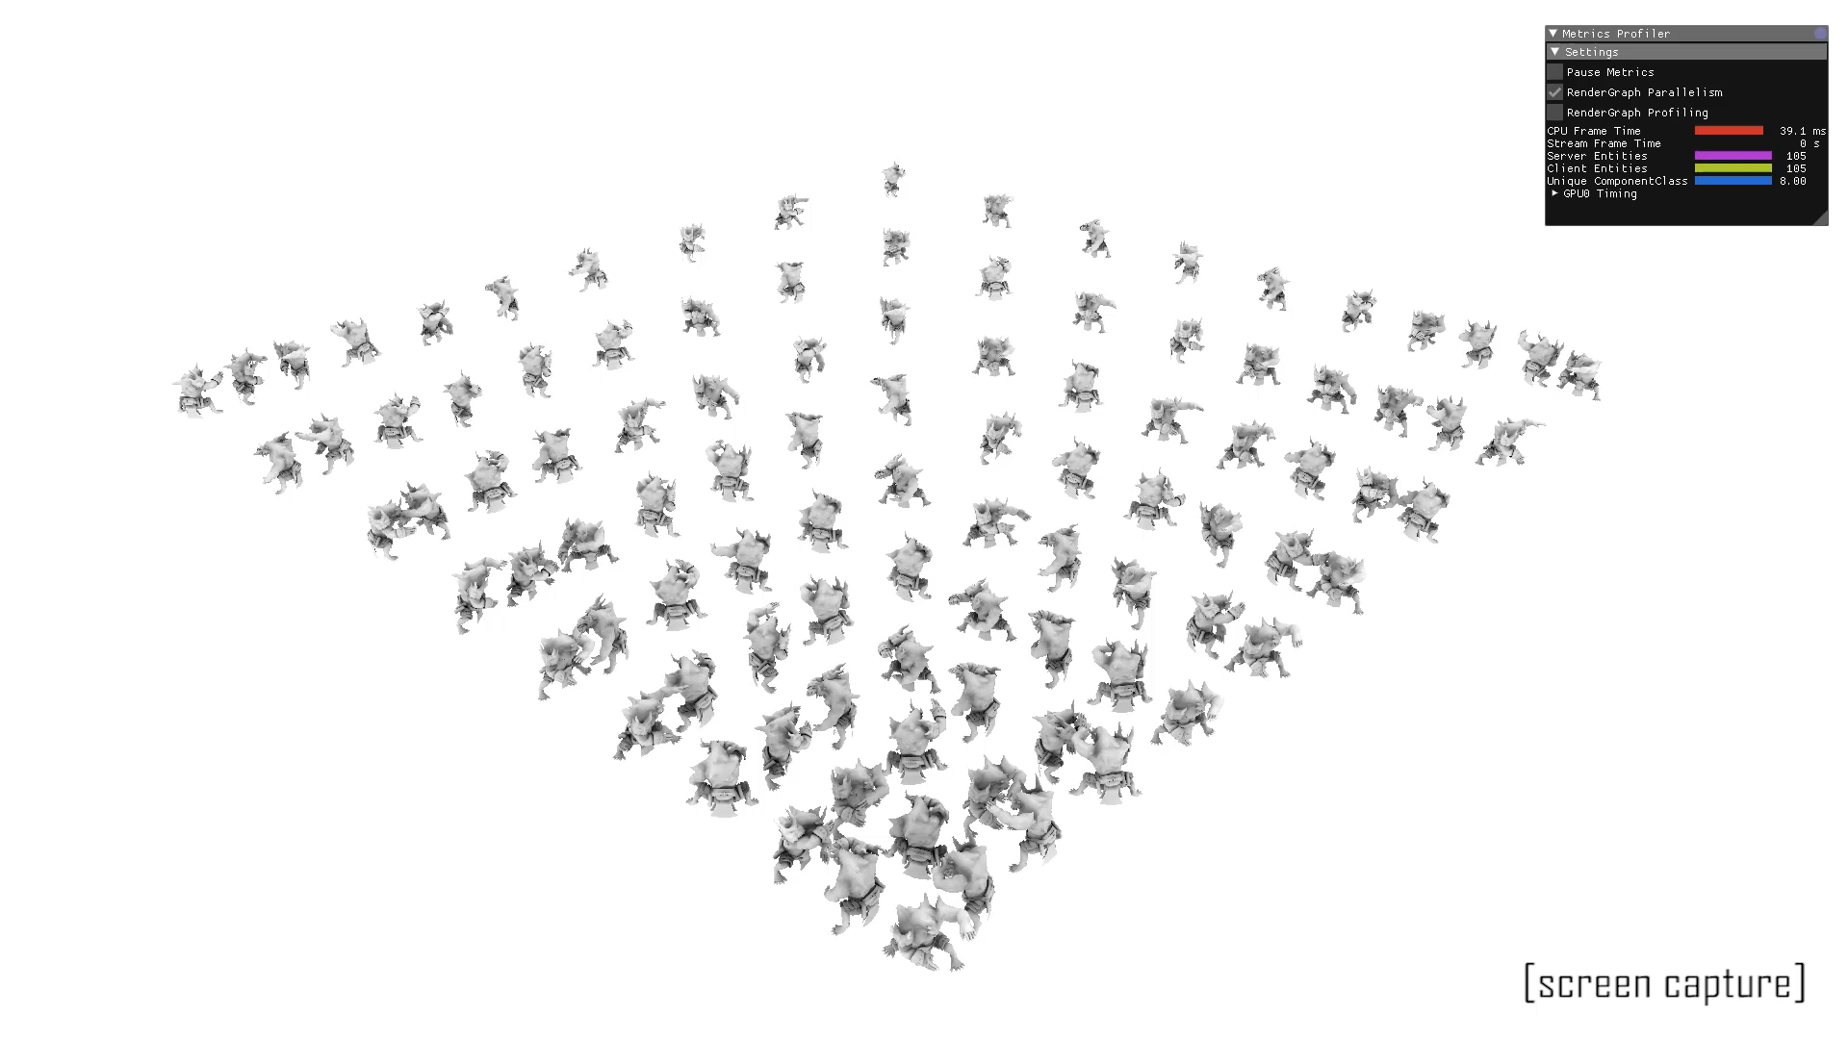
Implementation in Halcyon
Notes:
As an example of the real-time aspects of this model, we have a scene here with one hundred characters, where the nearest characters all cast occlusion onto each other. We can see that the characters that are more closely bunched up receive more general occlusion than the ones that are spaced out further. In this example the linear layer is computed on the GPU, however the non-linear layer is calculated on the CPU. Most of the frame time is taken up by this CPU calculation of the non-linear layer, so if this was moved to the GPU we predict things would be quite a bit faster.
100 characters
AO for each character casted from itself and 4 neighbors
AO effect on near characters v.s. distant characters

Slide 42
Conclusion
Data-driven, Object-space AO Model for Animated Characters
Fast and simple runtime model: no intersection test
Robust: good generalization, high quality
Interpretability: approximates shadowing with the ground and interaction with other characters
Future work: faster training, better automatic data sampling

Slide 43

SEED.EA.COM – We are hiring
We are a cross-disciplinary team within EA Worldwide Studios. Our mission is to explore, build and help define the future of interactive entertainment.

Slide 44
The End
SEED // Search for Extraordinary Experiences Division
We are a cross-disciplinary team within EA Worldwide Studios. Our mission is to explore, build and help define the future of interactive entertainment.
SEED.EA.COM – We are hiring

Slide 45

S E E D / / S E A R C H F O R E X T R A O R D I N A R Y E X P E R I E N C E S D I V I S I O N
S t o c k h o l m – L o s A n g e l e s – M o n t r é a l – R e m o t e
S E E D . E A . C O M
W e ‘ r e H i r i n g !

Slide 46
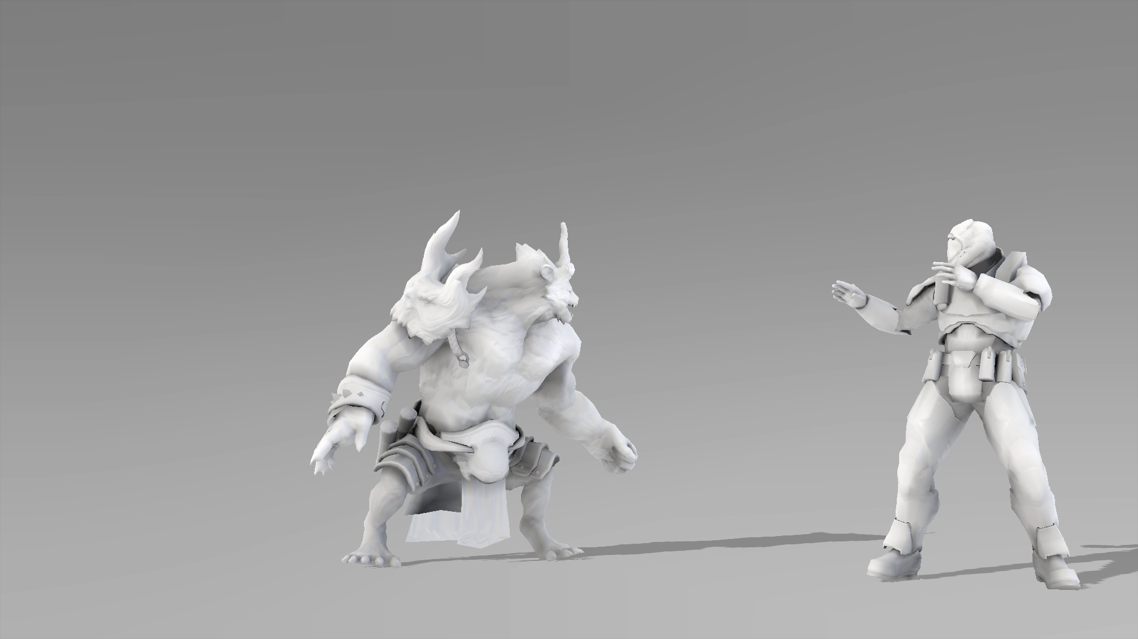
No Character-character Interaction
(proxy spheres of each character only cast shadows to key points of the same character)

Slide 47
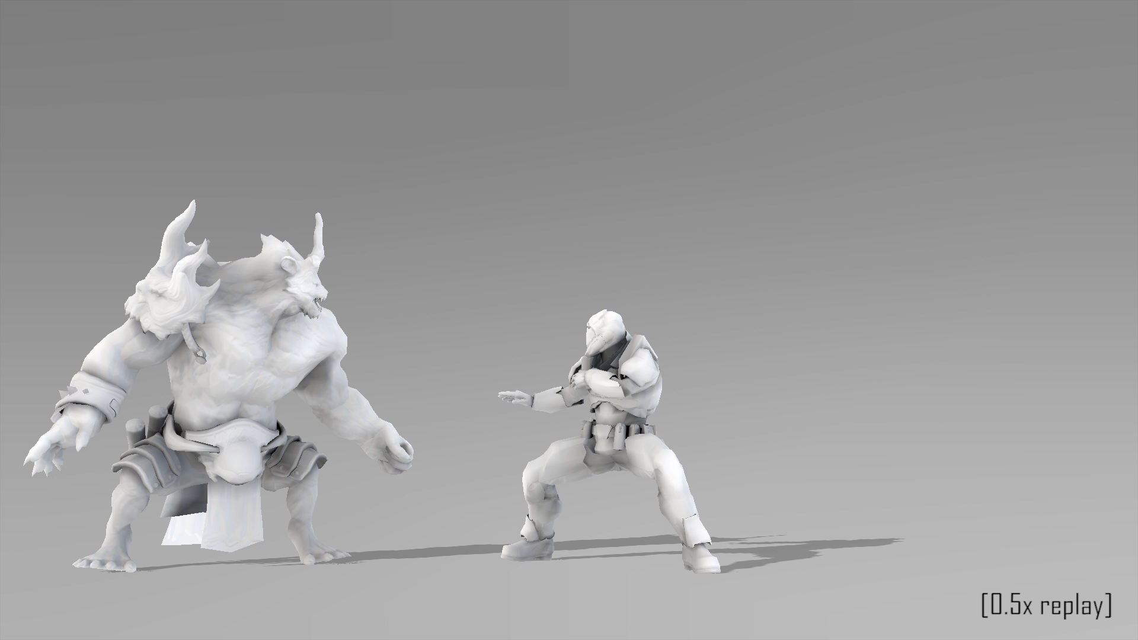
Interaction with Double Shadowing
(adding shadows from proxy spheres of character 1 to key points of character 2 and vice versa)

Slide 48
Our Interaction with Reduced Double Shadowing
(using sparse γ-norm)

Slide 49
Double Shadowing Ours

Slide 50
Data and Training
n : number of vertices
m : number of bones
f : number of training poses
size_{data} : size of training data
s : number of proxy spheres
p : number of key points
size_{model} : size of trained model
Notes:
In addition to the quadratic convergence rate of BFGS, our use of block coordinate descent allows us to perform further optimization of our training process.
When performing the update for the relevant layer, block coordinate descent allows us to fix the parameters of the other layer, which means we can precompute these parameters.
In our case, this precomputation allowed for a speedup of 2 orders of magnitude

Slide 51
// Bone transformations
// Spheres and key points
// Blending weights of key points
// Weights and biases of key points to vertex
// Per-vertex AO

Slide 52
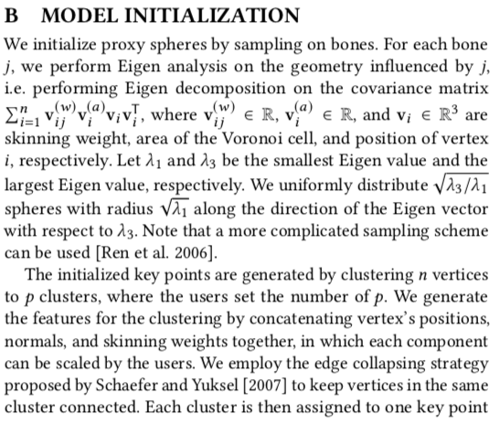
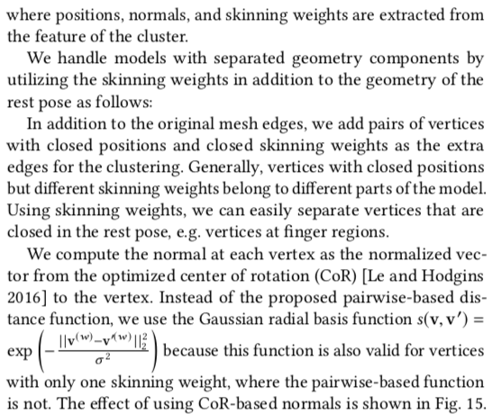

Slide 53
BFGS v.s. Conjugate Gradient
BFGS allows for quadratic convergence rate
Conjugate gradient (typical for NN) has linear convergence rate
However, BFGS methods are not guaranteed to converge unless the function has a quadratic Taylor expansion near an optimum
Our objective function is sum of squared errors, which is similar to quadratic, so BFGS is suitable

Slide 54
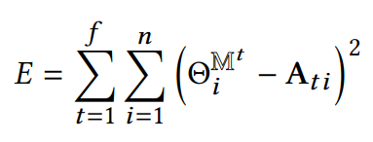
Model Fitting

Slide 55
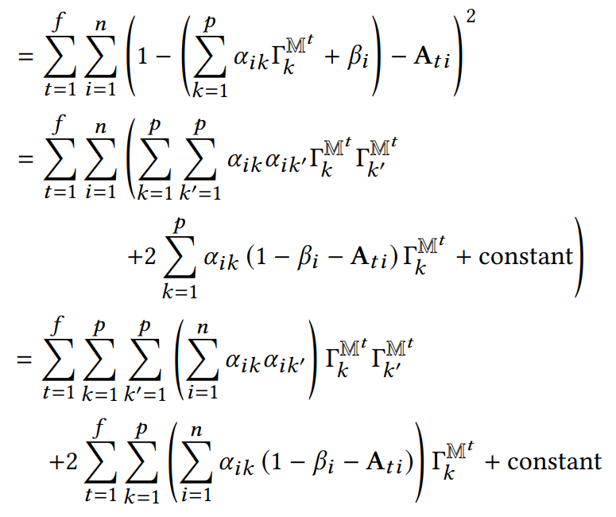
Model Fitting

Slide 56
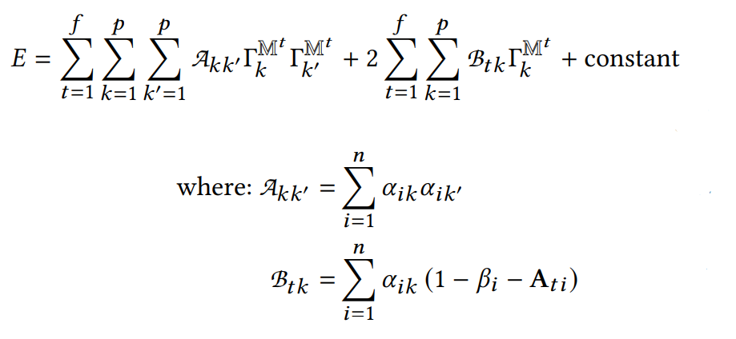
Model Fitting

Slide 57
Model Fitting
Precompute
Great speedup of training
Similar for Linear Layer

