Slide 1

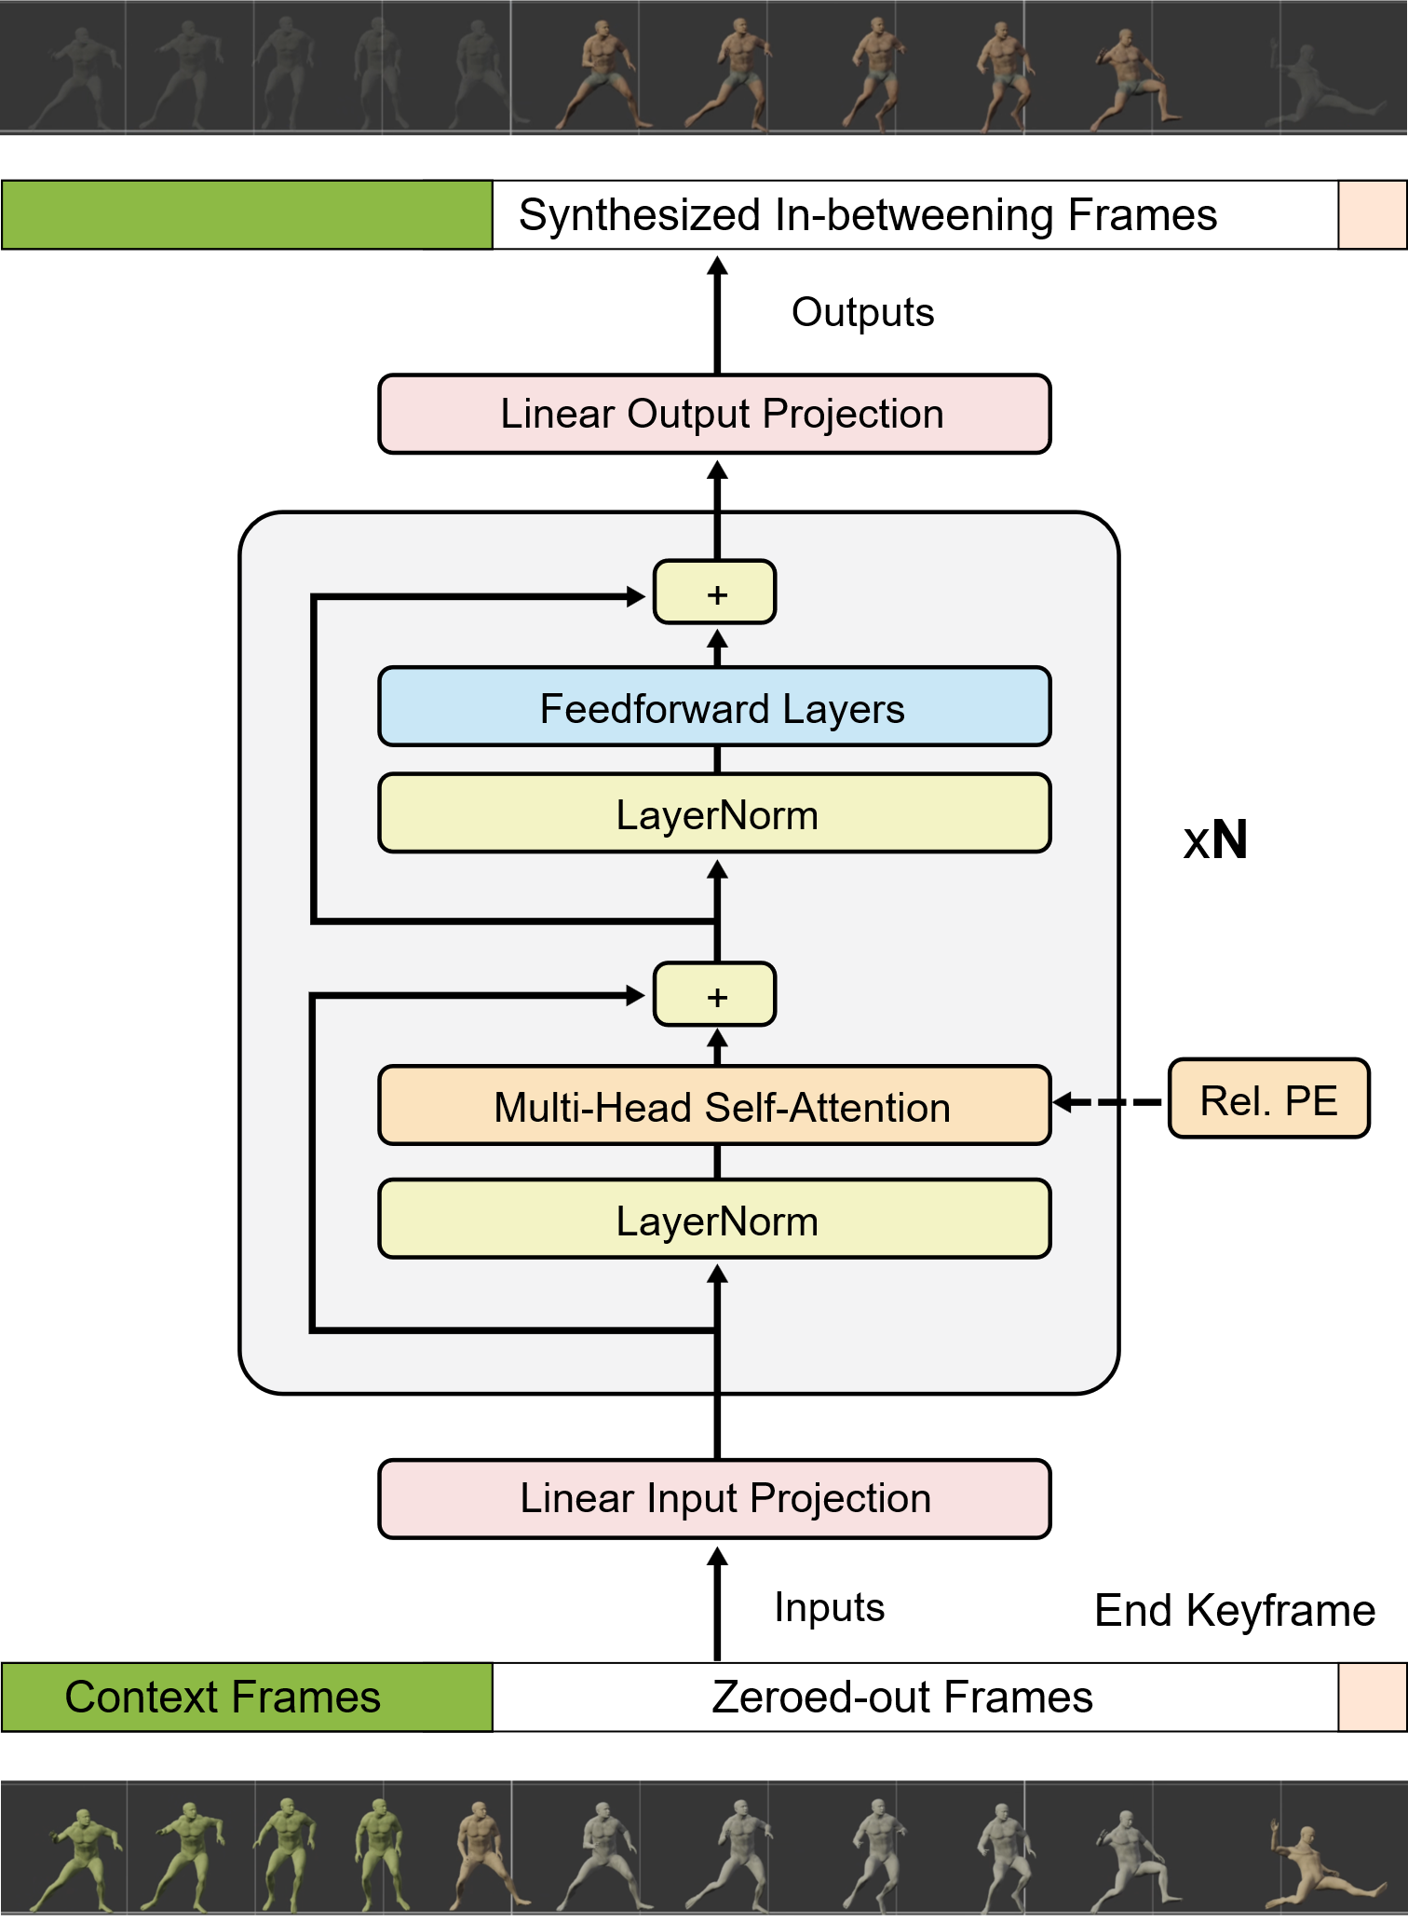
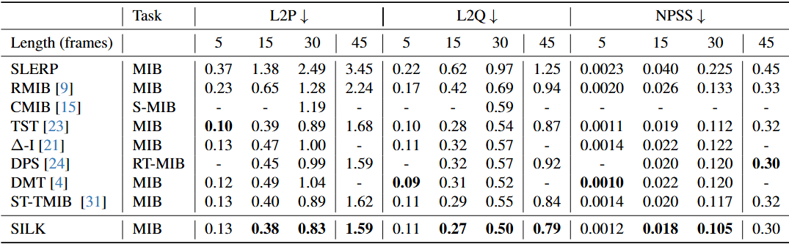
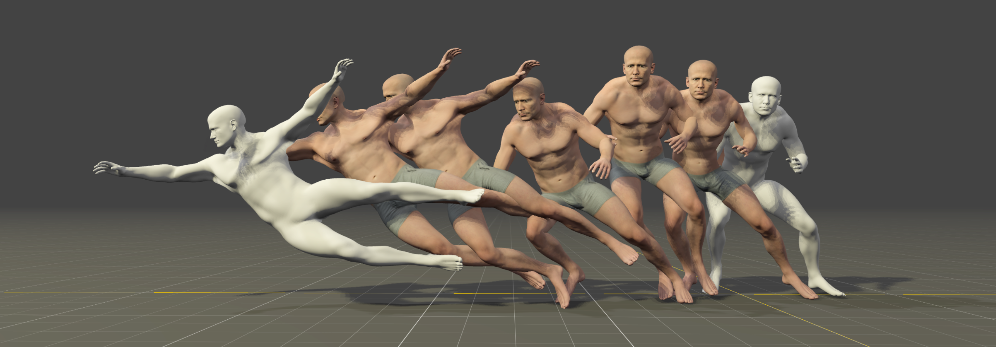
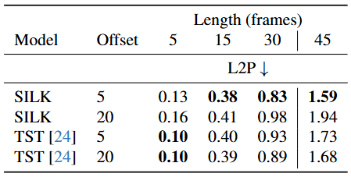
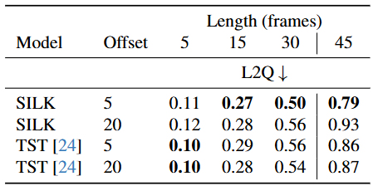
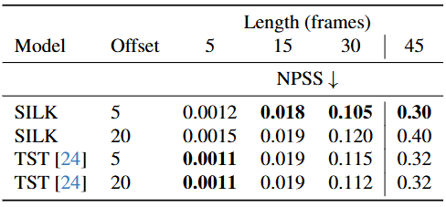

SILK: Smooth InterpoLation frameworK for motion in-betweening
Elly Akhoundi¹ Hung Yu Ling² Anup Deshmukh² Judith Butepage¹
¹SEED, Electronic Arts ²Electronic Arts
Why motion in-betweening?
Motion in-betweening is a crucial tool for animators, enabling intricate control over pose-level details in each keyframe. Our goal is to design a simple-but-powerful motion in-betweener.
What is SILK?
SILK is a single transformer that performs equal or better than previous complex models. Our key insights are:
Only relative position embeddings, nothing else (e.g., types)
Input is zero-masked, no need for motion interpolation
Data sampling matters! Increase window overlap is critical for simple models, but negligible for complex models.
Using trajectory space pose representation and velocity features on the input boosts performance
Quantitative Evaluations
Table 1. Comparing L2P, L2Q, and NPSS Metrics on the LaFAN1 Dataset.
Table 2. Comparing L2P, L2Q, and NPSS Metrics on the LaFAN1 Dataset using different offsets when sampling training data.
Summary
SILK achieves equal or better performance compared to state-of-the-art models by eliminating unnecessary architectural complexity. We show that using an appropriate pose representation and including velocity features improves performance. Crucially, our experiments identify the data sampling strategy as the key enabler for training simple models like SILK. We hope our work encourages further research on data sampling and other means to reduce model complexity in motion in-betweening.
References
[4] Dynamic Motion Transition: A Hybrid Data-driven and Model-driven Method for Human Pose Transitions. Chai et al. 2024.
[9] Robust Motion In-betweening. Harvey et al. 2020.
[23] Motion In-Betweening via Two-Stage Transformers. Qin et al. 2022.
Scan me for more visual results on our paper website!
Notes:
1

