Slide 1
High Dynamic Range color grading and display in Frostbite Alex Fry Rendering Engineer Frostbite Team, Electronic Arts

Slide 2
Contents
History, terminology & tonemapping
Frostbite legacy post process pipeline & issues
Considering how to support HDR TVs & our new pipeline
“Display mapping” & issues uncovered
LUT precision & decorrelation
Performance
HDR standards and platform support
Next steps
1

Slide 3
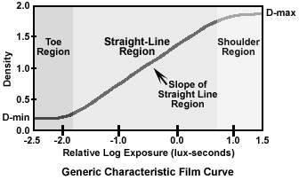
Brief history of film & terminology
Film density (of the negative) responds to light at different rates
3 main sections
Mid section (‘linear’)
Toe (slower response)
Shoulder (slower response)
Captures wide range of light values
Toe/Shoulder are main range reduction
Expose scene for mid section
Characteristic, familiar and pleasant look
1
Notes:
Basic explanation of film response to light.
Non-linear, captures wide range.
Looks nice.
Image credit: http://www.naturephotographers.net/articles0303/tw0303-4.gif
From http://www.naturephotographers.net/articles0303/tw0303-1.html

Slide 4
Tonemapping
Realtime games are fully CG digital images with no film to develop
But we do have limited range TVs
We need to perform similar range reduction
Tonemapping is the process of mapping a wide dynamic range onto something narrower whilst retaining most important detail
E.g. 16bit floating point down to 8bit or “HDR” to “LDR”
Preserve mid tones
“Filmic Tonemapping” does this while emulating film characteristics
“HDR” photos in many cameras are more accurately “tonemapped”
1
Notes:
Games are realtime CG with no film to develop
But we do need to broadcast our games on TVs
These TVs have a limited range not dissimilar to film/slide projectors
So we have similar requirements to perform range reduction
Tonemapping is just range reduction, done in such a way to preserve detail outside the display range.
Follow a similar process.
First we would expose the scene such that the most interesting parts are in the mid tones.
Then tonemap the rest of the range to best fit into the upper/lower regions of the SDR.

Slide 5
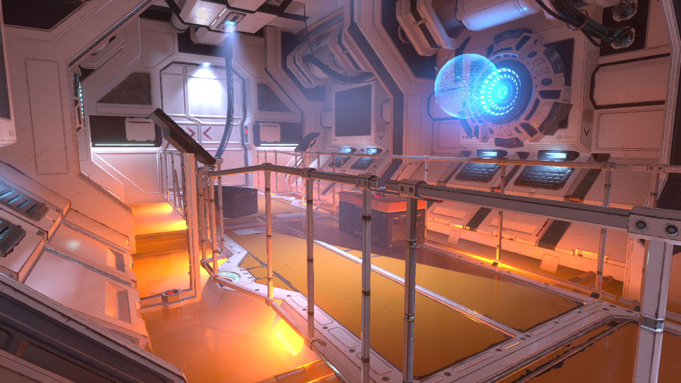
Tonemapping
Example image from Frostbite internal demo level
1
Notes:
Going to use this example image for our tests, screenshot from internal test level built by Joacim Lunde
-Good contrast -Wide dynamic range
-Some saturated colours
-Clearly suffering from lack of tonemapping in several parts (lights, hologram)

Slide 6
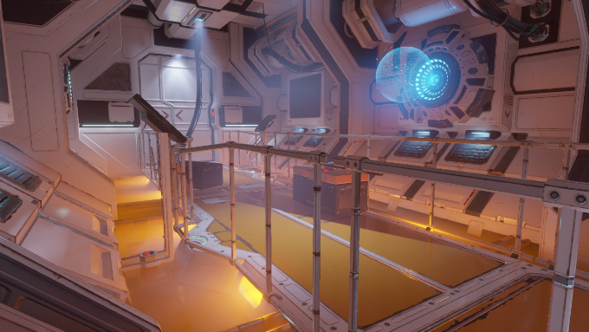
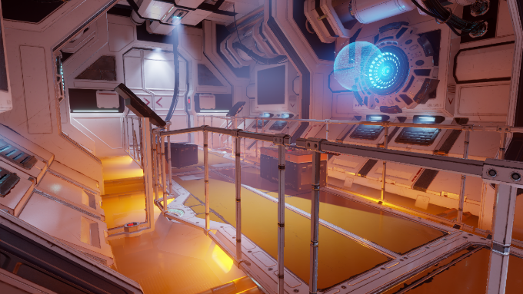
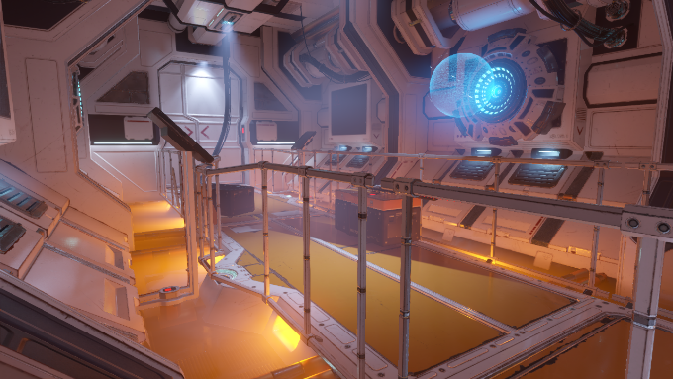
Tonemapping
Reinhard Exponential
Hejl/
Burgess- Hable
Dawson
1
Notes:
Example of four tonemappers:
Two simple (Reinhard & Exponential). Primarily a shoulder (affect brightest parts the most, darkest parts the least).
Two filmic (Hejl/Burgess-Dawson & Hable). Toe and shoulder as well as contrast changes.

Slide 7
Tonemapping (bonus slide)
Reinhard x=x/(1+x)
1
Notes:
X axis = brightness in stops (EVs).
Y axis = tonemapped value converted to sRGB.

Slide 8
Tonemapping (bonus slide)
Exponential x=1-exp(-x)
1
Notes:
X axis = brightness in stops (EVs).
Y axis = tonemapped value converted to sRGB.

Slide 9
Tonemapping (bonus slide)
Hejl/Burgess-Dawson
1
Notes:
This one is an analytical fit of a tweaked approximation of a Kodak characteristic curve.
Strong toe adds contrast to darks and mids.
X axis = brightness in stops (EVs).
Y axis = tonemapped value converted to sRGB.

Slide 10
Tonemapping (bonus slide)
Hable
1
Notes:
This is Hables operator with default settings.
Note that this operator is highly configurable and can be tweaked to suit many needs.
X axis = brightness in stops (EVs).
Y axis = tonemapped value converted to sRGB.

Slide 11
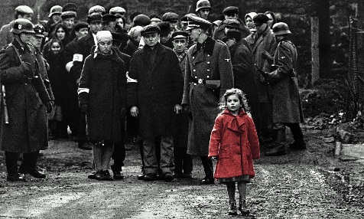
Color grading
The act of applying a “look”
Background in film developing. E.g.
Choose different film stock
Apply or skip different processing steps (e.g. bleach bypass)
Digitally we can do a lot more
White balancing
Color replacement
Orange & Teal …
1
Notes:
Color grading is the act of applying a characteristic look to the scene
Still has its background in film, for example one could choose different film stock to achieve a look
Or during film processing (developing the negative) one could perhaps change the processing
e.g. bleach bypass is skipping the bleaching process which produces a higher contrast ‘silvery’ look.
With CG, we can do a lot more than this
-Change white balance or exposure
-Arbitrary color replacement or highlighting (Schindler's List)
-Orange and Teal (Michael Bay)
-”Fix it in post”
Image credit: http://www.drodd.com/images14/schindlers-list3.jpg
Image credit: https://pix-media.priceonomics-media.com/blog/892/trans.jpg

Slide 12
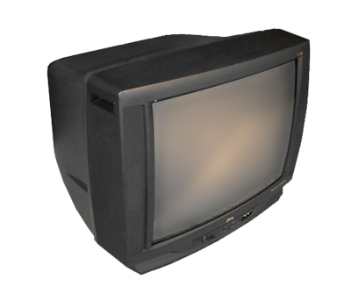
Brief history of TVs & standards
Older (CRT) TV/monitors had limited dynamic range
0.1 – 100 nits (cd/m2)
Non-linear response to electrical input
Electro Optical Transfer Function (EOTF)
Also known as ‘gamma curve’
sRGB/BT.1886 standard introduced
Standard and display capability are similar
We still use this standard today
1
Notes:
Image credit: http://zerowaste.co.in/img/products/tv-crt-curve.png

Slide 13
Brief history of TVs & standards
Modern TVs (0.01-300+ nits … HDR way more)
Hardware far more capable than the standard
LCD response different to CRT response
We still use sRGB/709
TVs modify our 0.1-100 nit signal to best “show off” the TV
We have no control over this, other than asking for calibration
Tends to end up with too much contrast
And that’s just luminance
Too much over-saturation as well (e.g. store demo mode)
1

Slide 14
Frostbite legacy pipeline
2
Notes:
Now to cover our legacy grading pipeline

Slide 15
Frostbite legacy pipeline
Post (FP16)
Tone
map
sRGB
Grading
UI
TV
Scene is linear floating point up to and including post FX
Bloom, motion blur, vignette, depth of field etc
Apply tonemap
Linear to sRGB conversion
Apply color grade
Draw UI on top
Scanout to TV
1
Notes:
High level summary of the legacy pipeline.

Slide 16
Frostbite legacy pipeline
Post (FP16)
Tone
map
sRGB
Grading
UI
TV
Tonemap chosen by artist from a fixed set of built-in algorithms
Usually a filmic tonemap
Tonemaps are 1D curves, applied independently to RGB values
Linear to sRGB conversion
Constrains results to 0-1
1

Slide 17
Frostbite legacy pipeline
Post (FP16)
Tone
map
sRGB
Grading LUT
UI
TV
Color grading is a 3D LUT generated offline
Load (tonemapped, sRGB) screenshot in Photoshop
Load 32x32x32 ‘identity’ color cube layer
Apply look transformations
Save (now non-identity) colour cube LUT
Index this LUT by [s]RGB at runtime
Use LUT RGB value as color
1

Slide 18
Frostbite legacy pipeline troubles
Post (FP16)
Tone
map
sRGB
Grading LUT
UI
TV
1D curve applied separately RGB causes hue shifts
Not completely linear in mid section (shots later)
Highlights shift as channels clip
Usually filmic so this applies a “look”
This “look” choice is a different workflow to grading
It’s not easy for content to author new tonemaps
Tonemaps are not data driven (only selectable)
1

Slide 19
Frostbite legacy pipeline troubles
Post (FP16)
Tone
map
sRGB
Grading LUT
UI
TV
Photoshop is not really a grading package
Non-optimal workflow
LUT is often 8bit
Irrecoverable quantisation
Mach banding & hue shifts
No access to values >1!
We clamped it earlier
1

Slide 20
Frostbite legacy pipeline troubles
Post (FP16)
Tone
map
sRGB
Grading LUT
UI
TV
Tonemap + sRGB = LUT distribution function
Distribution function is not optimal for grading
Different distribution depending on tonemap
Cannot share LUTs with other EA teams if they use a different tonemap
1
Notes:
Graphs:
X axis = brightness in stops (EVs).
Y axis = tonemapped value converted to sRGB.

Slide 21
Frostbite legacy pipeline troubles
Post (FP16)
Tone
map
sRGB
Grading LUT
UI
SDR
TV
Legacy pipeline is hardcoded to SDR
Want to support HDR TVs
Higher bit depth
Higher dynamic range
Higher color range (wider gamut)
Want to give content creators control over all of this
Take creative control of the TV, not rely on TV manufacturers
1

Slide 22
HDR TV support – simple approach
Post (FP16)
Tone
map
sRGB
Grading LUT
UI
Reverse
Tone
Map
HDR
TV
Reverse tonemap curve to extract original HDR data
Cheapest possible option
Recall that tonemaps have a shoulder
Reverse the shoulder
Recover the original HDR data
Profit?
1
Notes:
Image credit: http://www.naturephotographers.net/articles0303/tw0303-4.gif
From http://www.naturephotographers.net/articles0303/tw0303-1.html

Slide 23
HDR TV support – simple approach
Post (FP16)
Tone
map
sRGB
Grading LUT
UI
Reverse
Tone
Map
HDR
TV
Plenty of restrictions
8bit not enough precision to reverse
Multiple different tonemap curves, all need to be reversible
A limited range can be recovered
Order of operations not correct
Grading and UI are drawn after tonemapping
Reversing tonemap later incorrectly reverses these
1

Slide 24
HDR TV support – simple approach
Post (FP16)
Tone
map
sRGB
Grading LUT
UI
Reverse
Tone
Map
HDR
TV
Can we make it ‘good enough’?
Tweak tonemap curves (LUT distribution function)
Capture more range
Compute analytical reverse mappings
Promote render targets and grades to 10bit
Re-author legacy 8bit grades
Ask teams to use mild color grading
Scale UI to avoid shoulder region
1
Notes:
Question is – can this be made to work?
Yes, in many cases it can.
Tweak tonemap to capture ‘enough’ range to reverse, and compute reverse function.
Increase precision of render targets and grades to 10bit.
Use less extreme color grading, work within the limits.
Scale the UI during rendering to avoid the shoulder region that will be reversed.
Sucker Punch (team behind Infamous: Second Son) has done some nice blog posts which cover this approach. See
http://www.glowybits.com/blog/2016/12/21/ifl_iss_hdr_1/
http://www.glowybits.com/blog/2017/01/04/ifl_iss_hdr_2/

Slide 25
Frostbite approach – clean sheet
Post (FP16)
To LUT
space
Grading
LUT
Decode
HDR
Comp UI
Tonemap
and
Display Encode
SDR
Transform HDR to LUT space
LUT based grading
Draw UI offscreen
Premultiplied alpha essential
Composite UI
Tonemap & encode for target display
UI
HDR10
Dolby Vision
?
1
Notes:
Our approach was to go for a new, clean sheet implementation.
LUT space = a single distribution function optimized for grading once in a master HDR space, regardless of connected TV or output tonemap.

Slide 26
Frostbite approach – clean sheet
Post (FP16)
To LUT
space
Grading
LUT
Decode
HDR
Comp UI
Tonemap
and
Display Encode
SDR
Why do this?
Improve workflow
Single grade for all TV variants
If redoing grades, do them well
And don’t restrict grading
UI tech is complex and customized
Wanted a full HDR implementation
‘Future proof’ to look better on newer TVs
UI
HDR10
Dolby Vision
?
1
Notes:
Move all “look” workflow into a single place.
Grade once in a master space, regardless of connected TV/output dynamic range.
Remove UI from the equation, since lots of UI exists that would look different/incorrect if we changed the way that was drawn.
Regarding “future proof”, the current HDR specification is bigger (in terms of luminance range and color gamut) than any display can reproduce today.
By targeting the full specification, our games will look better when played on better TVs in future, which reproduce more of the range we use.

Slide 27
HDR grading
HDR friendly distribution function
Went through a few ideas (log, S-Log, LogC) etc
Ended up using ST.2084 or “PQ” (Perceptual Quantiser)
PQ ensures LUT entries are perceptually spaced, gives great control
33x33x33 LUT lookup (10bit UNORM runtime format)
Industry standard size allows use of ‘standard’ grading tools
Single distribution function gives other gains
Anyone can make a “look” LUT and share it across EA
Build a look library
1

Slide 28
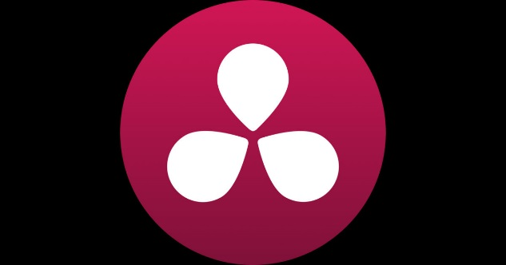
HDR grading
Create grades using DaVinci Resolve
Industry standard grading tool
Build view LUTs to match Frostbite tonemapping (WYSIWYG workflow)
Why not write our own in engine?
No need, time or desire to reinvent the wheel & maintain it
Reduces friction hiring experienced graders
Free version of Resolve does enough for many
“Resolve Live” is a great workflow improvement
Must buy a capture/monitor card though … so not free
1
Notes:
https://www.blackmagicdesign.com/uk/products/davinciresolve
Image credit: http://is3.mzstatic.com/image/thumb/Purple122/v4/04/cc/37/04cc3729-b79f-37f4-c5e3-1b70a942a728/source/1200x630bf.jpg

Slide 29
Tone Display mapping
The HDR version of the game is the reference version
We tonemap at the last stage of the pipeline
The tonemap is different depending on the attached display
Aggressive tonemap on SDR
Less aggressive in HDR but still varies depending on TV
No tonemap for Dolby Vision
Each TV gets a subtly different version tuned for each case
Not just curves, exposure too
Decided to use the term Display Mapping instead
2
Notes:
Will explain the HDR/Dolby Vision differences in later slides

Slide 30
Tone Display mapping
SDR
Main challenges of display mapping
Scale across wide range of devices
Achieve a similar look regardless of TV
Desirable properties
No toe
No contrast change
No hue shifts
No built in film look
Build as neutral a display map as we could
HDR10
Dolby Vision
?
2

Slide 31
Display mapping
Recall our example image
1
Notes:
Going to use this example image for our tests, screenshot from internal test level built by Joacim Lunde
-Good contrast
-Wide dynamic range
-Clearly suffering from lack of tonemapping in several parts (lights, hologram)
-This shot is the image naively converted to sRGB

Slide 32
Display mapping
Our solution
1
Notes:
Going to use this example image for our tests, screenshot from internal test level built by Joacim Lunde
-Good contrast
-Wide dynamic range
-Clearly suffering from lack of tonemapping in several parts (lights, hologram)
-This shot is the display mapped image

Slide 33
Display mapping
Side by side
2
Notes:
Note lack of hue shifts in the shoulder region.
No toe, no contrast or “look” just very neutral.
Rest of image is unchanged.

Slide 34
Display mapping
How?
Work in luma/chroma rather than RGB
Apply shoulder to luma only
Progressively desaturate chroma depending on shoulder
Use a ‘new’ working space (ICtCp)
Developed by Dolby for HDR
Chroma follows lines of perceptually constant hue
Tuned by eye on a lot of different images/games
Not very “PBR” but this is about perception not maths
2
Notes:
https://www.dolby.com/us/en/technologies/dolby-vision/ICtCp-white-paper.pdf

Slide 35
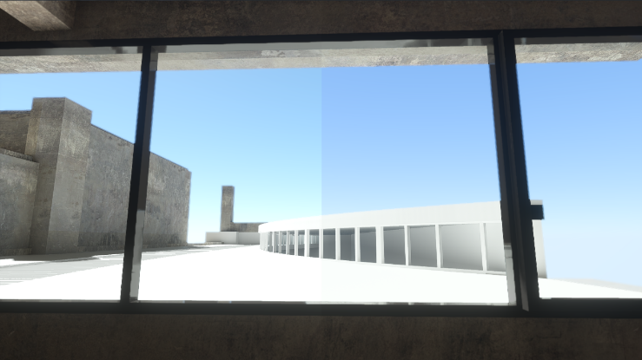
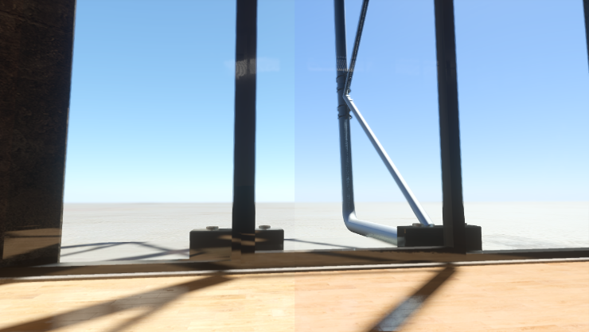
Filmic tonemap vs Display map
2
Notes:
Comparison with our Filmic (modified Hable) and our Display Mapper
Filmic is 1D and applied to each channel independently, has hue shifts.
This can all be tuned, but ultimately any non-linear 1D operator applied to color channels will hue shift.
Want to make a bright blue sky? It will become cyan.
Display mapper is highly neutral, hue-preserving, does a good job of reproducing artistic intent.

Slide 36
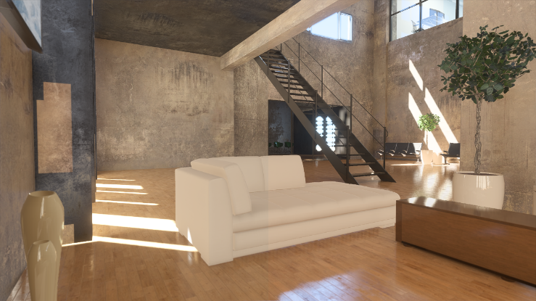
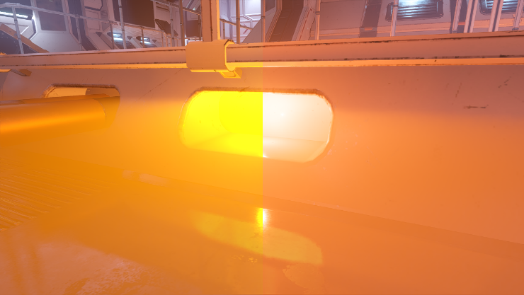
Filmic tonemap vs Display map
2
Notes:
Comparison with our Filmic (modified Hable) and our Display Mapper
Filmic is 1D and applied to each channel independently, has hue shifts.
This can all be tuned, but ultimately any non-linear 1D operator applied to color channels will hue shift.
Watch our for desaturated midtones (in our case, at least).
Want to make a bright orange sunset? It will become yellow.
Display mapper is highly neutral, hue-preserving, does a good job of reproducing artistic intent.

Slide 37
Plain sailing, then?
No – of course not 😐
4
Notes:
Even though this was planned & we worked with several game teams to figure this out and roll it out, there were a few gotchas along the way.

Slide 38
Plain sailing, then?
Recall that SDR spec is 0.1-100 nits
And TVs are more capable and over-brighten the image …
… so 100 nits will really be more like 200-400
HDR TVs (by and large) do what they are told
So 100 nits is 100 nits …
… and HDR looks darker and “worse” than SDR!
We treat HDR as reference and expose for that
SDR display mapper under-exposes the SDR version
So that when (incorrectly) over-brightened it looks correct
4
Notes:
As mentioned at the start the SDR version gets brightened up by the TV, sometimes massively.
We can play to this strength and under-expose the SDR version so, when brightened by the TV, it looks OK again.
No this is not correct, and it does require some guesswork as to how bright the TV will be.
Artists can configure this SDR Peak value so when working on calibrated monitors it is accurate.
Assume SDR TV is 200 nits as a default, considering letting people tune this value at home as well.

Slide 39
OK, plain sailing now, then?
No – of course not ☺
Display mapper is a hue preserving shoulder
This faithfully and neutrally reproduces content
Changes the look of existing/legacy assets
Some assets authored to leverage legacy hue shifts
These assets no longer look good
4
Notes:
Many assets were authored to leverage the hue shifts that come from clipping color channels.
Any color that contains multiple primaries will hue shift if it’s brightened and one channel clips but the other doesn’t.
The ratios between the color channels fundamentally change at this point, changing the color itself.
If you leverage this hue shift during asset authoring, then these effects long longer look correct when you remove the hue shift.

Slide 40
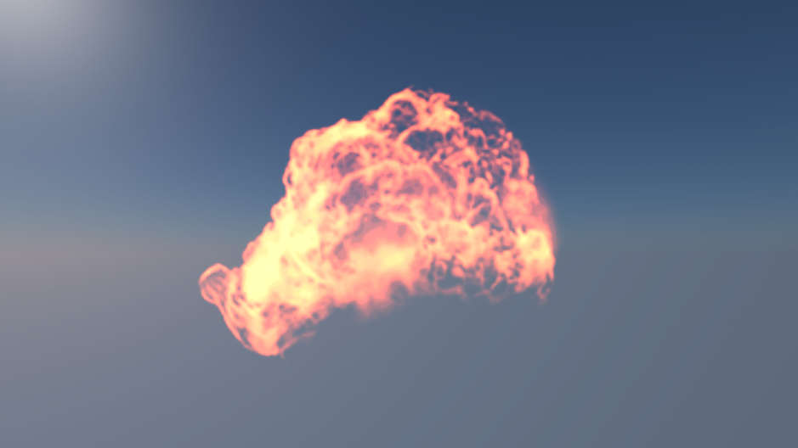
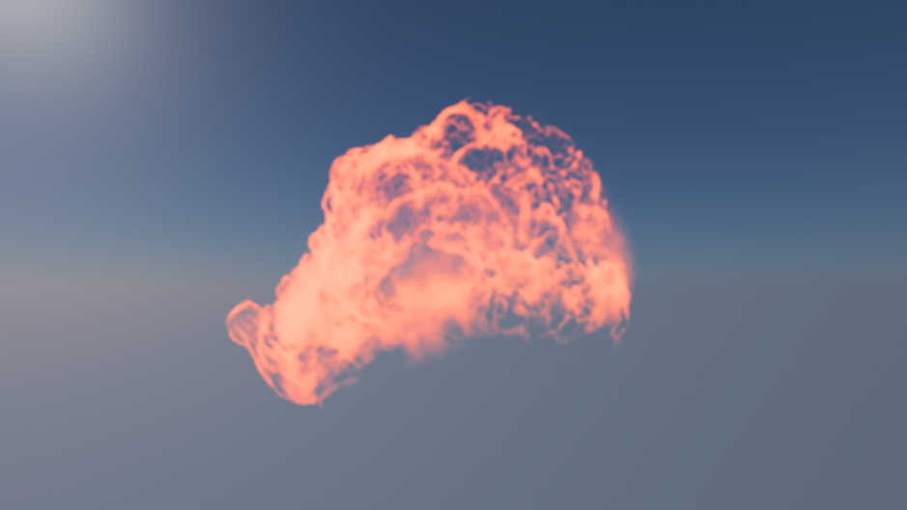
OK, plain sailing now, then?
Slightly contrived example
2
Notes:
This is a contrived example showing a fireball.
It’s an effect kindly shared by DICE but modified by me to highlight the issue in question.
This fireball is authored using a single hue … lets call it ‘burnt orange’.
Burnt orange has little to no blue component, but does have a lot of red and some green.
When over-exposed and fed into a tonemap that has a strong shoulder and/or simply hitting the color channel clipping point, the rate of change of red slows quickly and then clips but green does not.
As one keeps over-exposing, red moves slowly (or is stationary, if clipped) but green keeps increasing, fundamentally changing the color from orange to yellow creating a multi-hue effect.
When using a hue preserving shoulder, the authored hue is preserved and it looks ‘correct’ but that is now completely wrong.
This isn’t just the case for hue preserving shoulders though. If the original image were displayed via HDR broadcast standards which have much higher color channel clipping points, it would look wrong in HDR as well because the red channel simply wouldn’t clip as quickly. So the effect would appear bright orange.
So the hue preserving shoulder in SDR actually highlights trouble in the content that would be wrong in HDR.
This is quite a nice way to author HDR content (and find issues with existing content) without needing an HDR display.

Slide 41
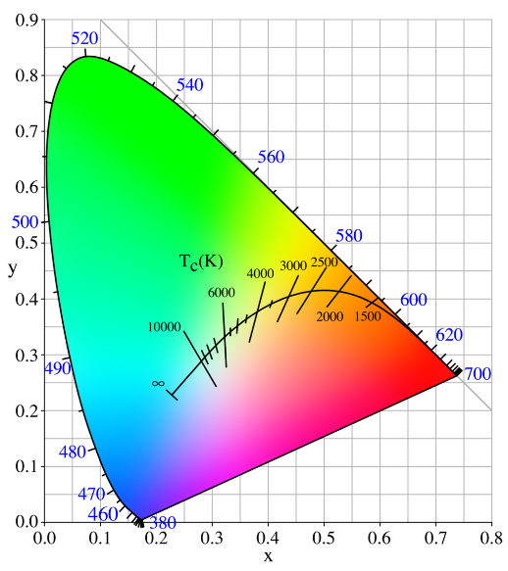
Re-author VFX
Fire effects changing was most common complaint
VFX authored to leverage hue shifts in legacy tonemapper
Looked OK in SDR but not in HDR
Use blackbody simulation
Author effect as temperature
Build colour ramp from blackbody radiation
Index ramp by temperature
Tweak ramp to suit
4
Notes:
Main point of this – any bright effects will suffer.
Many are authored to leverage the hue shifts that come from clipping color channels (red clips but green doesn’t -> effect increasingly becomes yellow as green increases).
These effects do not work well in HDR, as the clip point differs per TV (see notes on previous slide).
Intent must be to author to HDR as the reference, which means the hue shifts must be present in the artwork, not an artefact of the mapper.
Blackbody ‘simulation’ (temp based hue color lookup) to the rescue.
Iterate the display mapper to preserve saturation of medium/bright effects on SDR devices.
Image credit: https://en.wikipedia.org/wiki/Black-body_radiation

Slide 42
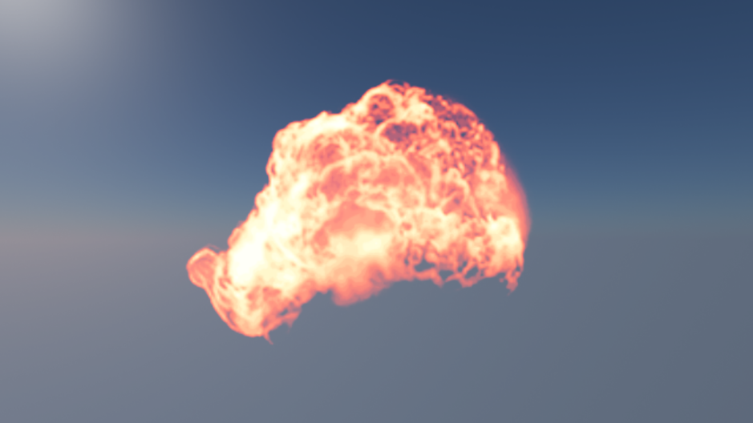
Re-author VFX
Single color vs Blackbody (display mapping enabled)
2
Notes:
Old asset with display mapping ON (no hue shifts) vs Display mapping ON and hue shifts are correctly present in source asset

Slide 43
Re-author VFX
Single color (no display mapping) vs Blackbody (display mapping)
2
Notes:
Old asset with display mapping OFF (hue shifts come from channels clipping) vs Display mapping ON and hue shifts are correctly present in source asset

Slide 44
So … plain sailing now ?
Er, no …
Hue preserving shoulder not always desirable
Prevents highly saturated very bright visuals … effects (again)
Prevents matching the look of certain films
Working with DICE effects team
Still iterating on display mapper
Re-introduce hue shifts
4
Notes:
Hue preserving operator is also troublesome if you are trying to match a “look” that is close to a certain film stock.
Must be able to do that.
Have started to work on re-adding hue shifts.
We’re not done yet, are still actively working on this.

Slide 45
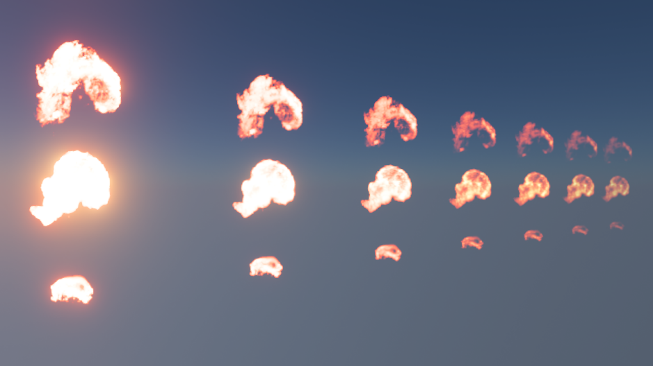
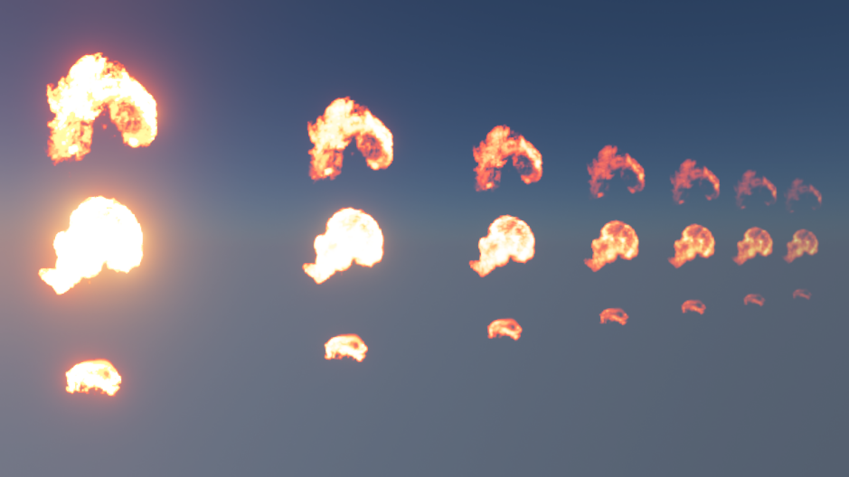
Re-introduce hue shifts
Hue preserving vs Hue shift
2
Notes:
Blackbody fire contained all the correct hues …
-See smaller circle
…were getting desaturated when very bright.
-See larger circle
Original display mapper on the left, small hue shifts (but massive improvement) on the right.

Slide 46
Re-introduce hue shifts
Hue preserving (left) vs Hue shift (right)
2
Notes:
Hue preserving on the left.
Re-introduction of some hue shifts on the right.

Slide 47
Re-introduce hue shifts
And against the original with no display mapping (left)
2
Notes:
No display mapping (tonemap disabled) on the left, hue-shifting display mapper on the right.
Even with some hue shifts, still dramatically better than no display map.

Slide 48
Re-introduce hue shifts
We’re not done
But getting there
Games shipping this year will have different implementations
Some prefer hue preserving
Some prefer hue shifts
Likely to offer content-driven mixing
Easy to do
Have graded an [HDR] reference implementation
Simply tweak to suit different displays
2
Notes:
As mentioned, still not done.
Likely to offer a configurable implementation, that each game can dial in the amount of hue shifting.
Really easy to do though (no re-grading etc) due to the wide HDR working space and display mapping right at the end of the frame.

Slide 49
What about ACES?
1
Notes:
But what about ACES?

Slide 50
What about ACES?
Academy Color Encoding System
Standardised color management for film CGI
Defines a processing pipeline
Includes “look” and display mapping
1
Notes:
http://www.oscars.org/science-technology/sci-tech-projects/aces
Image credit: http://www.oscars.org/sites/oscars/files/styles/hero_image_wide_default/public/aces_main3.png?itok=inY3Kf2j

Slide 51
What about ACES?
ODT
TV
IDT Input Device Transform
LMT Look Modification Transform
RRT Reference Rendering Transform
ODT Output Device Transform (varies per output)
Input
IDT
LMT
RRT
ODT
TV
1
Notes:
High level summary of the ACES pipeline.
IDT (Input Device Transform) transforms a known input space to the ACES working space.
LMT (Look Modification Transform) is where one applies the grade & “look”
RRT (Reference Rendering Transform) is essentially a filmic tonemap (an S curve applying a toe and shoulder)
ODT (Output Device Transform) is a per-display output transform to ensure consistent results on that display.

Slide 52
What about ACES?
Why didn’t we use it as-is?
We started work in 2014, ACES was only just getting going
Early versions required FP16, not suited to some texture formats
Was not convinced by the “filmic” RRT
But we agreed with the principles so we used it in concept
Order of operations
Used a wide ‘master’ working space
LMT = grading
ODT = display mapping
2

Slide 53
What about ACES?
Should I use it?
Yes absolutely look at it!
Suggest investigating ACEScc and ACEScg
Will Frostbite use it?
Quite possibly yes, in future
Will continue to investigate
Shared principles & defined spaces will ease transition
Very likely to adopt ACES color management for assets
2
Notes:
Due to the fundamentally aligned approaches, there is nothing stopping us from changing from our custom approach to ACES (ACEScc/cg in particular) in future, and all grades can be automatically upgraded/converted since both spaces are known and published. We can and will re-evaluate this in due course.

Slide 54
LUT Problems
2
Notes:
Now we look at some performance/quality tradeoffs.
For performance reasons we wanted to dynamically inject the display mapping into the same LUT as the grading.
This has some implications that we investigate here.

Slide 55
LUT Problems
2
Notes:
For performance reasons we wanted to dynamically inject the display mapping into the same LUT as the grading.
The order of operations of combining the display mapping at the end of the grading, is the same as doing it at the start of the composition shader. It’s just “free” (aside from the cost of injecting it into the grade, which is very cheap).
However, even with PQ distribution we have precision issues which masquerade as mach banding.
Top image is analytical display mapper, middle is baked into the RGB LUT, bottom has levels adjusted to highlight the differences.
Note: screenshot is from a level purchased from Evermotion, not authored by Frostbite.

Slide 56
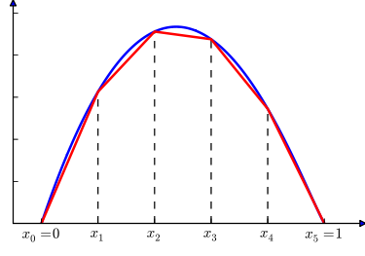
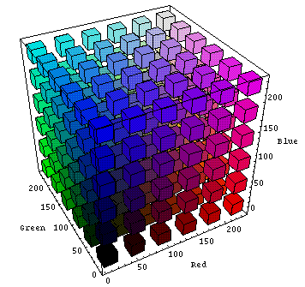
LUT problems
Piecewise Linear Approximation 3D LUT: 8 neighbors contribute
2
Notes:
Show linear filtering turns curves into piecewise linear approximations of curves.
Looks OK in 1D, where only pairs of values contribute.
But our LUTs are volumes (3D).
The luma axis (greyscale from black to white) is a diagonal, so exactly half way between texels 8 neighbors contribute equally.
Image credit: https://en.wikipedia.org/wiki/Piecewise_linear_function
Image credit: https://engineering.purdue.edu/~abe305/HTMLS/rgbspace.htm

Slide 57
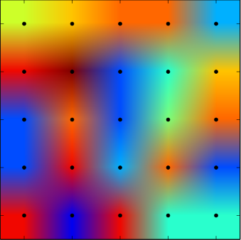
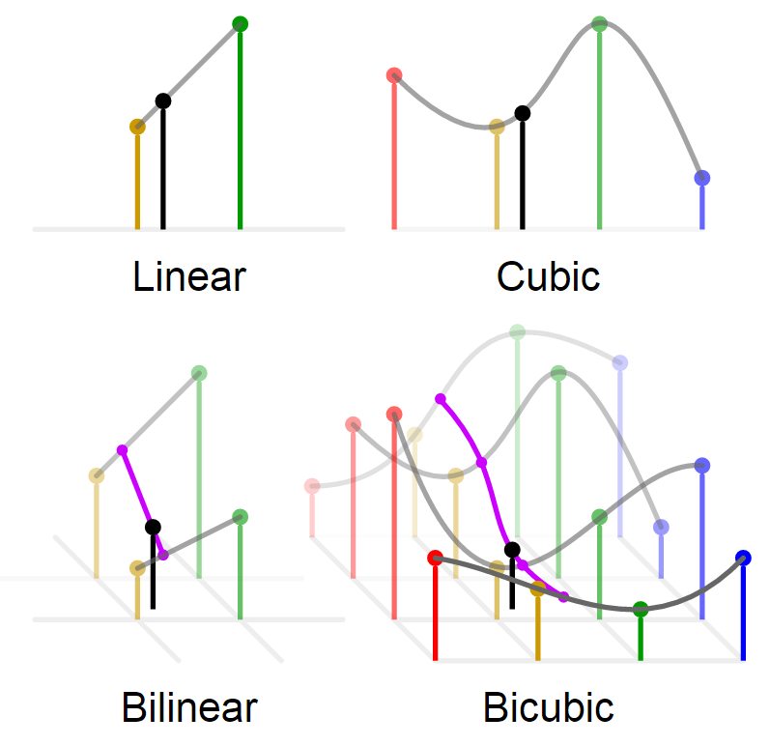
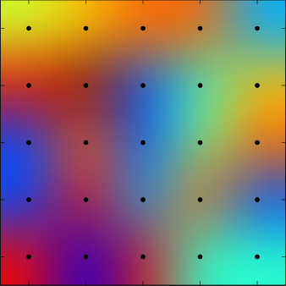
LUT filtering
Just use higher order filtering?
Costs too much ☹
2
Notes:
Using a higher order filter should improve things.
E.g. move from trilinear to tricubic.
But the cost is expensive (additional dimension over 2D).
Early tests of high order filtering doubled the costs of our main post process pass (which does a lot more than just grading) so it was immediately prohibitive.
Image credit: https://en.wikipedia.org/wiki/Bicubic_interpolation

Slide 58
LUT spaces – RGB
2
Notes:
But can use different spaces for the LUT. We don’t *have* to index by RGB …
In fact the display mapper is working in luma/chroma, so let’s try that.
Here’s RGB again as a reminder.

Slide 59
LUT spaces – YCgCo
2
Notes:
YCgCo – fastest decorrelated space (luma and chroma are separate).
Major improvement on RGB.

Slide 60
LUT spaces – YCbCr
2
Notes:
YCbCr – better than YCgCo

Slide 61
LUT spaces – ICtCp
2
Notes:
ICtCp – not as good as YCbCr but comparable to YCgCo.
It should be best since it natively matches our display mapping space, but reasons for this will be explained later. Relates to color gamut.

Slide 62
RGB/YCgCo/YCbCr/ICtCp
2
Notes:
Compare RGB to the three decorrelated spaces.
Decorrelated are all better in terms of luma than RGB.
Still using linear filtering but luma and chroma axis are aligned with cubemap axis now.
Luma-only ramps become 1D and touch fewer neighbours so the PLA artefacts are reduced.

Slide 63
Color grading LUT accuracy
Decorrelated LUTs improve precision issues for display mapping
Align luma with single axis rather than multiple axis
Piecewise Linear Approximation in 1D not 3D
Great!
But we’re baking display mapping on top of existing RGB LUTs
Concerned that different space would cause problems
Plotted LUT access patterns in different spaces
Measure percentage of LUT touched in each space
Determine if we would affect precision of color grading …
2
Notes:
So this is a major improvement and allows use of linear filtering without obvious artefacts.
But, will it impact the grades themselves, which are authored in RGB?

Slide 64
Color grading LUT accuracy
Reminder
1
Notes:
Again, we look at this test image.
By plotting each pixel into each LUT and tracking the coverage, we can easily compute the LUT volume used, as a percentage of the total number of texels that exist in the LUT.
Basically, more texels used = more precision for grading.

Slide 65
Color grading LUT accuracy
RGB: 7.9%
YCgCo: 3.3%
YCbCr: 3.3%
ICtCp: 4.1%
2
Notes:
Ah.
Decorrelated spaces fundamentally touch fewer texels, which is likely to have an impact on color grading accuracy ☹
ICtCp is better than either YCC format, but still not as accurate as RGB.
So today we have stuck with RGB (the visual artefacts are minimal, after all) but we are continuing to investigate decorrelated spaces for the future.
Perhaps we will transform RGB into a decorrelated space in the offline pipeline, using most appropriate high order filter.

Slide 66
Performance
2

Slide 67
Performance
Performance at a premium
Increased focus on 60hz
Increased focus on resolution
Cannot afford to give up visual quality to pay for HDR
New path entirely replaces legacy path
Requested to achieve performance parity with legacy path
2
Notes:
Performance parity was needed with the legacy path in order to achieve quick adoption. Performance timings from Xbox One as that was the slowest platform.
Legacy end-of-frame path:
Separable Resample from sRGB render target to 1080p backbuffer, via ESRAM transient on XBox: 0.43ms (Xbox is slowest platform, so is the one we use for timings).
UI draw on top of backbuffer: Arbitrary, typically 0.2-0.3ms.

Slide 68
Performance
Performance of legacy path
At the end of the frame we already do a high order resample
Dual pass (V/H)
Resample vertically to intermediate (ESRAM): 0.17ms (720 -> 1080)
Resample horizontally to backbuffer (DRAM): 0.26ms (1280 –> 1920)
Draw UI on top
Total: 0.43ms + UI
But UI costs a lot since it’s drawn to DRAM not ESRAM
NOTE: Numbers all from XBox One
2

Slide 69
Version 1: Naïve implementation
Render UI to offscreen RGBA8 target at backbuffer resolution
Must clear UI target first
+0.25ms
Modify second pass of dual-pass resample
Resample HDR & convert PQ to linear
Load UI target & convert sRGB to linear
Composite HDR & UI
Encode to sRGB
+0.45ms
Total: ~1.1ms ☹
2

Slide 70
Iterate: Low Hanging Fruit
Shader is dominated by ALU
UI render target is UNORM but contains sRGB values
Alias as sRGB for readback for free conversion
PQ to Linear expensive
Trade ALU for texture & use 1D LUT
Hitting bandwidth limits on Xbox
Put UI render target in ESRAM
Clear costs are halved, UI renders 2x faster
Total: ~0.8ms 😐
2
Notes:
ESRAM used for both planes (intermediate & UI). Manual ESRAM management *
Also roughly doubles speed of UI rendering, reaping benefits not shown here.
* See “FrameGraph: Extensible Rendering Architecture” talk for how we are moving to automatic ESRAM management

Slide 71
Iterate: Compute resample
Use single-pass CS for resample
Resample vertically to groupshared
Resample horizontally from groupshared
Optimisations (some GCN specific)
64x1 thread layout (linear tile mode backbuffers)
Precomputed kernel weights in StructuredBuffers
SMEM/SALU to load & extract vertical weights
Total ~0.7ms 😐
2
Notes:
Not super relevant to HDR, this was simply an enabling change.
Moving from two to one pass reduced work and enabled significantly better scheduling.
We use a thread layout optimized for the consoles and also for the linear tile modes used for swapchain/scanout targets.
Use of the 1D vertical thread layout allowed us to use the scalar pipeline present in GCN to obtain some of the filter weights for free.

Slide 72
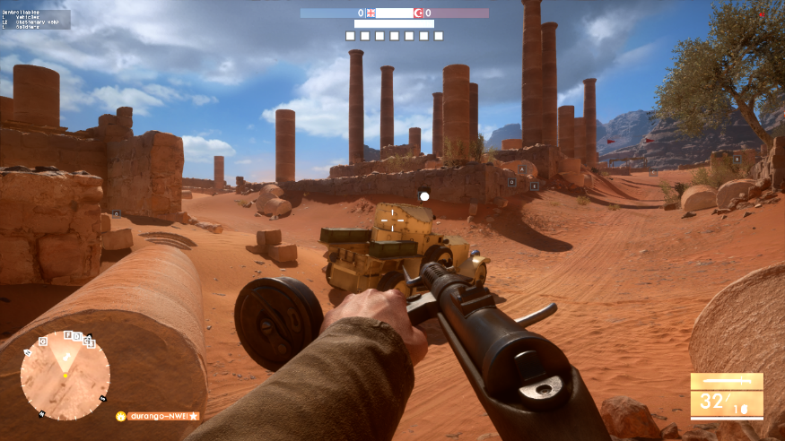
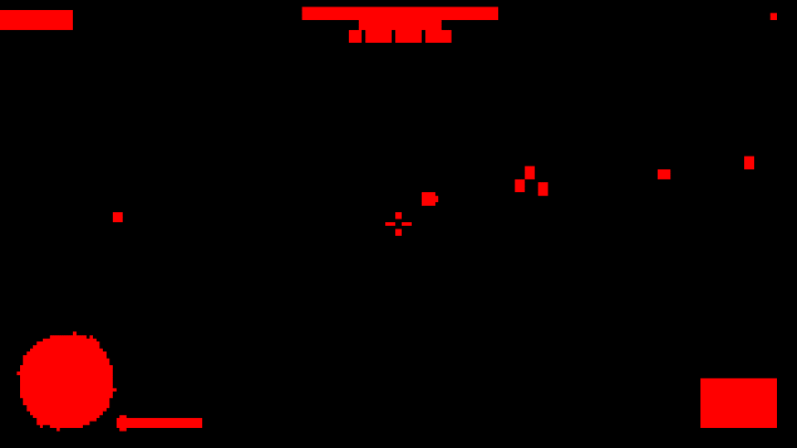
Iterate: CMASK-aware composite
GCN hardware maintains “CMASK” metadata for written pixels
Stores whether any block of 4x4 pixels was rendered to
Used in “Fast Clear Eliminate” to write clear color to unwritten pixels
2
Notes:
Actually GCN doesn’t always clear all pixels
Maintains metadata for which pixels were written.
Before readback, performs a “Fast Clear Eliminate” (FCE) pass to write back the clear color only to unwritten pixels.
Example CMASK screenshot shows typical in-game UI coverage. Red = pixels written. Black = unwritten pixels that will need clearing.

Slide 73
Iterate: CMASK-aware composite
We can read this metadata
Remove the Fast Clear Eliminate (FCE)
Read CMASK in composite pass
Skip reading and compositing of unwritten UI pixels
Not quite that simple
CMASK tiles are tiled & packed
Software de-tiling and unpacking needed
Not cheap ☹
2
Notes:
No FCE, instead use a custom CMASK transcode from sub-tiles to a 32x1 bitmask designed to be loaded via the scalar pipeline ‘for free’ on the final resample/merge/displaymap pass.

Slide 74
Iterate: CMASK-aware composite
Transcode CMASK via compute to composite-friendly format
1 bit per 4x4 pixels
32 bits per 128x4 pixels
Adds a cost of 0.02ms but much cheaper than FCE
Composite pass
Load 32bit bitmask via SMEM (free)
Unpack bit corresponding to current pixel (cheap)
If bit is zero, skip entire UI load & composite operation
Total: 0.5ms ☺
2
Notes:
No FCE, instead use a custom CMASK transcode from sub-tiles to a 32x1 bitmask designed to be loaded via the scalar pipeline ‘for free’ on the final resample/merge/displaymap pass.

Slide 75
HDR10 additional costs
Additional ALU work needed
Rotate primaries to 2020
Encode to PQ (slightly more ALU than sRGB encode)
Total: ~0.7ms (0.2ms more)
Only runs on Xbox One S (and PS4)
XBox One S GPU is ~7% faster than XB1 (1.1ms extra at 60hz)
0.2ms HDR overhead is tiny. Bulk of XB1S perf goes to the game
PS4 has more ALU than Xbox so we don’t worry about it
Same resolution (1080p) so PS4 is faster like-for-like in this case
2
Notes:
All timings so far have been from the SDR version on base Xbox One, since base Xbox One only supports SDR and SDR output will be the most common path for a while.
However, Xbox One S supports HDR10 and this incurs some additional costs to encode.
Xbox One S is faster though, so these overheads are well within the extra performance.

Slide 76
Further optimisations (bonus slide)
Skip reading/resampling HDR where all threads have opaque UI
Move UI load to start of shader
Skip resample if UI is opaque
Coherent branch if UI is all transparent or all opaque, slower if mixed
Some GCN specifics needed (again) due to optimized resample
Use cross-lane operations to determine UI opacity across all threads
Use approximations for PQ encode
Async compute
Run entire dispatch (& flip) asynchronously with next frame
2
Notes:
Future optimizations are still available to us.
UI load is cheap, move it to start of frame and look at alpha values.
If UI is opaque, skip expensive resample and merge operation.
On GCN can use wave-wide operations to check all threads are able to skip, which allows us to skip the first half of the resample which writes to groupshared then syncs threads.
Can also use async compute & overlap the merge with next frame, at the expense of a little latency.

Slide 77
HDR standards & platforms
2

Slide 78
HDR standards
Two primary standards
Dolby Vision
HDR10
Frostbite can support both * & supporting more is relatively easy
2
Notes:
Two primary (but very similar) HDR standards; likely more are coming
Frostbite can and will target any standard that makes sense
* It is down to each game to negotiate licensing though so I can’t say anything about specific games
Our display mapping “scanout shader” allows easy plugin of any format, it’s just another encoding/mapping.
Image credit: https://s.aolcdn.com/hss/storage/midas/e94dc10a6894b46ee659c6136fd7040c/203213453/dolbyvision.jpg
Image credit: http://edge.alluremedia.com.au/m/g/2016/01/ultra_hd_premium_2.jpg

Slide 79
Dolby Vision
Pros
12 bit signal, HDMI 1.4b compatible
No need to write a display mapper
Standardisation across displays (Dolby-tuned display mapper)
Good results from low-end panels
Cons
Metadata generation and framebuffer encoding adds a cost
Framebuffer encoding prevents overlays blending on top
Not supported by many 2016 TVs
2
Notes:
Essentially:
Dolby Vision uses a custom encoded framebuffer.
One must generate dynamic metadata (e.g. Min/max/avg luminance) & send it up to every frame to the TV.
Dolby build a custom display mapping for each panel to get the best from it, and achieve standardization of look across displays.
Can’t go into any more details here, suggest contacting Dolby if you are interested in supporting Dolby Vision.
https://www.dolby.com/us/en/technologies/dolby-vision/dolby-vision-white-paper.pdf

Slide 80
HDR10
Pros
More widespread at present
No custom framebuffer encoding; overlays ‘work’
Software display mapping can be cheap
Cons
No display mapping standardization across manufacturers
Game should do its own display mapping to help this
10bit
2
Notes:
Game can look quite different on each HDR10 TV, due to lack of standardization across manufacturers.

Slide 81
Commonalities
Share an EOTF (or ‘gamma curve’)
Share min, max & mastering luma
Share color gamut
Same ‘master’ content works on both
One display map target for each
2
Notes:
Lots of high level commonalities … try to support both.

Slide 82
Platform support
PS4 & PS4 Pro: HDR10
XBox One S: HDR10
PC: HDR10, Dolby Vision
Requires GPU vendor API to handle HDMI metadata
DX11: Exclusive fullscreen “just works”
DX12: Non-exclusive fullscreen
Desktop compositor can scale or add overlays
Can cause issues with Dolby Vision
Working with various parties to improve this
2

Slide 83
Don’t forget SDR TVs
Huge number of SDR TVs
Majority of market today
SDR version needs to look great
Content is mastered in HDR
HDR is reference version
We own the display mapping and it runs at the final stage
Tune display mapper to look great in SDR
Play to the fact a TV will over-brighten your image
2
Notes:
Huge number of SDR devices out there.
HDR must not be worse than SDR!
HDR is the reference in Frostbite; SDR is just an artefact of the display mapper.
Recall that SDR TVs scale the image up in terms of gamut and luminance.
No real control over this, though having HDR in the engine and being able to map to SDR helps get the best from each display.
This includes re-exposing the image as part of display mapping (under-expose it so that the SDR TV can re-brighten it again).

Slide 84
Next steps
2

Slide 85
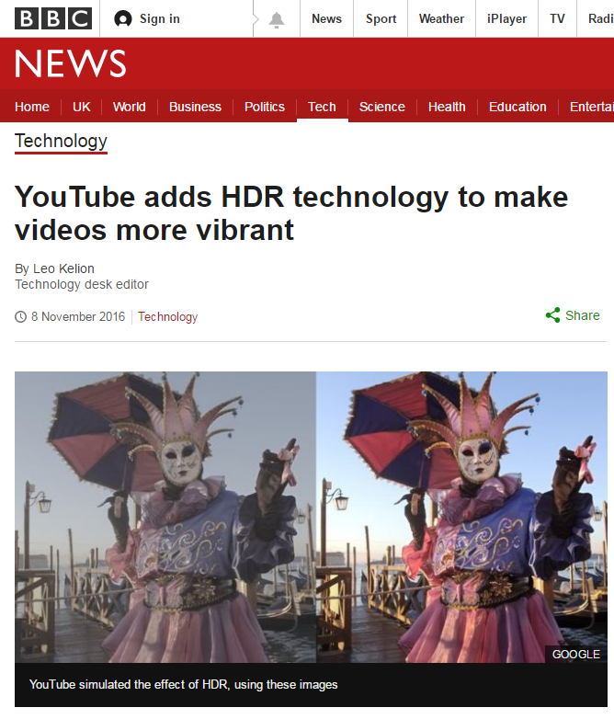
HDR video
High bit depth video
Decode performance overheads
File size and streaming overheads
Marketing materials
Multiple versions of same video
Wide Color Gamut support needed
2
Notes:
HDR movies need work.
Right now we use SDR movies but have a few tricks to extract pseudo-HDR data from them.
True HDR movies need increased storage, streaming, runtime playback costs of high bit depth video.
But the main issue is one of needing wide color gamut support.
Image credit: http://www.bbc.co.uk/news/technology-37908975

Slide 86
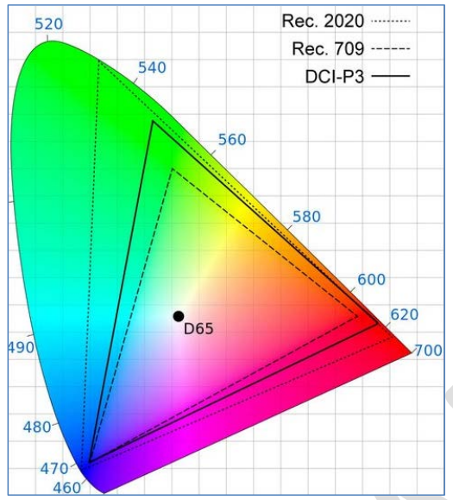
Wide gamut rendering
Lots to do
Expand runtime gamut
Add gamut metadata on every asset
Add color management to editors
Preserve metadata between DCCs
Where to start
Work from the TV backwards
Convert color grading to wide gamut
2
Notes:
Not “just” rendering – requires a collaboration with multiple parts of Frostbite (data pipelines, import/export, UI, movies, textures, shaders, timeline editors etc – anything with color data needs color management).
Specifically, challenge is related to maintaining and respecting the necessary gamut metadata.
First need to assign and manage gamut on every ‘colour’ asset (textures, colours in shader graphs or timelines, movies etc).
DCC packages may or may not support this; different approaches may be necessary to manage import/edit/export.
Likely to start by upgrading the engine from the “TV back” – first step will be to upgrade the color grading to wide gamut (likely 2020). ICtCp likely necessary for LUTs at this point (see next slides).
Runtime gamut reduction necessary; again we expect to use ICtCp for hue linear desaturation and fold it into the display mapper for free.
Image credit: http://www.acousticfrontiers.com/wp-content/uploads/2016/03/Color_Gamut.png

Slide 87
LUT accuracy in sRGB gamut
RGB: 7.9%
YCgCo: 3.3%
YCbCr: 3.3%
ICtCp: 4.1%
2
Notes:
And we’re back here again.
This is a reminder about the LUT accuracy of different spaces, but specifically calling out that we’re currently working in the sRGB gamut.

Slide 88
LUT accuracy in 2020 gamut
RGB: 4.7%
YCgCo: 1.7%
YCbCr: 1.8%
ICtCp: 4.1%
2
Notes:
In the future we want to support wider gamuts, so let’s test in 2020.
Aha. Not so good now.
RGB, YCgCo and YCbCr all nearly halve in accuracy/volume.
But ICtCp is natively wide gamut so stays the same, becoming more of a sensible choice now.

Slide 89
A note on gamut reduction
Gamut expansion is trivial
3x3 matrix multiply in linear space
Gamut reduction can produce out-of-gamut colors
Negative numbers when clipped to 0 cause hue shifts
Must map colors to target gamut before 3x3 matrix multiply
Suggest investigating ICtCp as a working space
Chroma scaling is perceptually hue linear
Adjust saturation to fit target gamut
2

Slide 90
Wrap up
Ensure your colors are in the assets
Don’t rely on tonemaps or clip points to change hue
Master your game in HDR
Move your tonemap as late in the pipeline as possible
Vary the tonemap for each display
Consider decorrelated spaces
RGB isn’t the only way to do things
Aim to support all standards
Please don’t forget about SDR ☺
1
Notes:
It has been an interesting journey, and we’re not done yet.
Hopefully our experiences learnt, and this talk, can be of use to someone.

Slide 91
Thanks to
Thanks to
Tomasz Stachowiak @h3r2tic
Ben Gannon, Bill Hofmann, Spencer Hooks & Thadeus Beyer at Dolby
Unnamed early adopter game teams ☺
The DICE VFX team
The EA rendering community
Mark Cerny
1
Notes:
Special thanks and credit especially to Tomasz who is the author of our display mapper.

Slide 92
Questions?
afry@europe.ea.com
@TheFryster
1
Notes:
Contact me if you need:
afry@europe.ea.com
@TheFryster

Slide 93
Code: display mapper
float3 applyHuePreservingShoulder(float3 col)
{
float3 ictcp = RGBToICtCp(col);
// Hue-preserving range compression requires desaturation in order to achieve a natural look. We adaptively desaturate the input based on its luminance.
float saturationAmount = pow(smoothstep(1.0, 0.3, ictcp.x), 1.3);
col = ICtCpToRGB(ictcp * float3(1, saturationAmount.xx));
// Only compress luminance starting at a certain point. Dimmer inputs are passed through without modification.
float linearSegmentEnd = 0.25;
// Hue-preserving mapping
float maxCol = max(col.x, max(col.y, col.z));
float mappedMax = rangeCompress(maxCol, linearSegmentEnd);
float3 compressedHuePreserving = col * mappedMax / maxCol;
// Non-hue preserving mapping
float3 perChannelCompressed = rangeCompress(col, linearSegmentEnd);
// Combine hue-preserving and non-hue-preserving colors. Absolute hue preservation looks unnatural, as bright colors *appear* to have been hue shifted.
// Actually doing some amount of hue shifting looks more pleasing
col = lerp(perChannelCompressed, compressedHuePreserving, 0.6);
float3 ictcpMapped = RGBToICtCp(col);
// Smoothly ramp off saturation as brightness increases, but keep some even for very bright input
float postCompressionSaturationBoost = 0.3 * smoothstep(1.0, 0.5, ictcp.x);
// Re-introduce some hue from the pre-compression color. Something similar could be accomplished by delaying the luma-dependent desaturation before range compression.
// Doing it here however does a better job of preserving perceptual luminance of highly saturated colors. Because in the hue-preserving path we only range-compress the max channel,
// saturated colors lose luminance. By desaturating them more aggressively first, compressing, and then re-adding some saturation, we can preserve their brightness to a greater extent.
ictcpMapped.yz = lerp(ictcpMapped.yz, ictcp.yz * ictcpMapped.x / max(1e-3, ictcp.x), postCompressionSaturationBoost);
col = ICtCpToRGB(ictcpMapped);
return col;
}
2
Notes:
Note: this function is expensive.
This is why we bake it down into a LUT (ideally the same LUT we use for grading, to make it free).
This is the hue-preserving version used for screenshots in this article, it’s very ad-hoc but hopefully interesting to play with.
float3 applyHuePreservingShoulder(float3 col)
{
float3 ictcp = RGBToICtCp(col);
// Hue-preserving range compression requires desaturation in order to achieve a natural look. We adaptively desaturate the input based on its luminance.
float saturationAmount = pow(smoothstep(1.0, 0.3, ictcp.x), 1.3);
col = ICtCpToRGB(ictcp * float3(1, saturationAmount.xx));
// Only compress luminance starting at a certain point. Dimmer inputs are passed through without modification.
float linearSegmentEnd = 0.25;
// Hue-preserving mapping
float maxCol = max(col.x, max(col.y, col.z));
float mappedMax = rangeCompress(maxCol, linearSegmentEnd);
float3 compressedHuePreserving = col * mappedMax / maxCol;
// Non-hue preserving mapping
float3 perChannelCompressed = rangeCompress(col, linearSegmentEnd);
// Combine hue-preserving and non-hue-preserving colors. Absolute hue preservation looks unnatural, as bright colors *appear* to have been hue shifted.
// Actually doing some amount of hue shifting looks more pleasing
col = lerp(perChannelCompressed, compressedHuePreserving, 0.6);
float3 ictcpMapped = RGBToICtCp(col);
// Smoothly ramp off saturation as brightness increases, but keep some even for very bright input
float postCompressionSaturationBoost = 0.3 * smoothstep(1.0, 0.5, ictcp.x);
// Re-introduce some hue from the pre-compression color. Something similar could be accomplished by delaying the luma-dependent desaturation before range compression.
// Doing it here however does a better job of preserving perceptual luminance of highly saturated colors. Because in the hue-preserving path we only range-compress the max channel,
// saturated colors lose luminance. By desaturating them more aggressively first, compressing, and then re-adding some saturation, we can preserve their brightness to a greater extent.
ictcpMapped.yz = lerp(ictcpMapped.yz, ictcp.yz * ictcpMapped.x / max(1e-3, ictcp.x), postCompressionSaturationBoost);
col = ICtCpToRGB(ictcpMapped);
return col;
}

Slide 94
Code: supporting functions
// RGB with sRGB/Rec.709 primaries to ICtCp
float3 RGBToICtCp(float3 col)
{
col = RGBToXYZ(col);
col = XYZToLMS(col);
// 1.0f = 100 nits, 100.0f = 10k nits
col = linearToPQ(max(0.0.xxx, col), 100.0);
// Convert PQ-LMS into ICtCp. Note that the "S" channel is not used,
// but overlap between the cone responses for long, medium, and short wavelengths
// ensures that the corresponding part of the spectrum contributes to luminance.
float3x3 mat = float3x3(
0.5000, 0.5000, 0.0000,
1.6137, -3.3234, 1.7097,
4.3780, -4.2455, -0.1325
);
return mul(mat, col);
}
float3 ICtCpToRGB(float3 col)
{
float3x3 mat = float3x3(
1.0, 0.00860514569398152, 0.11103560447547328,
1.0, -0.00860514569398152, -0.11103560447547328,
1.0, 0.56004885956263900, -0.32063747023212210
);
col = mul(mat, col);
// 1.0f = 100 nits, 100.0f = 10k nits
col = PQtoLinear(col, 100.0);
col = LMSToXYZ(col);
return XYZToRGB(col);
}
2
Notes:
// RGB with sRGB/Rec.709 primaries to ICtCp
float3 RGBToICtCp(float3 col)
{
col = RGBToXYZ(col);
col = XYZToLMS(col);
// 1.0f = 100 nits, 100.0f = 10k nits
col = linearToPQ(max(0.0.xxx, col), 100.0);
// Convert PQ-LMS into ICtCp. Note that the "S" channel is not used,
// but overlap between the cone responses for long, medium, and short wavelengths
// ensures that the corresponding part of the spectrum contributes to luminance.
float3x3 mat = float3x3(
0.5000, 0.5000, 0.0000,
1.6137, -3.3234, 1.7097,
4.3780, -4.2455, -0.1325
);
return mul(mat, col);
}
float3 ICtCpToRGB(float3 col)
{
float3x3 mat = float3x3(
1.0, 0.00860514569398152, 0.11103560447547328,
1.0, -0.00860514569398152, -0.11103560447547328,
1.0, 0.56004885956263900, -0.32063747023212210
);
col = mul(mat, col);
// 1.0f = 100 nits, 100.0f = 10k nits
col = PQtoLinear(col, 100.0);
col = LMSToXYZ(col);
return XYZToRGB(col);
}

Slide 95
Code: supporting functions
// RGB with sRGB/Rec.709 primaries to CIE XYZ
float3 RGBToXYZ(float3 c)
{
float3x3 mat = float3x3(
0.4124564, 0.3575761, 0.1804375,
0.2126729, 0.7151522, 0.0721750,
0.0193339, 0.1191920, 0.9503041
);
return mul(mat, c);
}
float3 XYZToRGB(float3 c)
{
float3x3 mat = float3x3(
3.24045483602140870, -1.53713885010257510, -0.49853154686848090,
-0.96926638987565370, 1.87601092884249100, 0.04155608234667354,
0.05564341960421366, -0.20402585426769815, 1.05722516245792870
);
return mul(mat, c);
}
// Converts XYZ tristimulus values into cone responses for the three types of cones in the human visual system, matching long, medium, and short wavelengths.
// Note that there are many LMS color spaces; this one follows the ICtCp color space specification.
float3 XYZToLMS(float3 c)
{
float3x3 mat = float3x3(
0.3592, 0.6976, -0.0358,
-0.1922, 1.1004, 0.0755,
0.0070, 0.0749, 0.8434
);
return mul(mat, c);
}
float3 LMSToXYZ(float3 c)
{
float3x3 mat = float3x3(
2.07018005669561320, -1.32645687610302100, 0.206616006847855170,
0.36498825003265756, 0.68046736285223520, -0.045421753075853236,
-0.04959554223893212, -0.04942116118675749, 1.187995941732803400
);
return mul(mat, c);
}
2
Notes:
// RGB with sRGB/Rec.709 primaries to CIE XYZ
float3 RGBToXYZ(float3 c)
{
float3x3 mat = float3x3(
0.4124564, 0.3575761, 0.1804375,
0.2126729, 0.7151522, 0.0721750,
0.0193339, 0.1191920, 0.9503041
);
return mul(mat, c);
}
float3 XYZToRGB(float3 c)
{
float3x3 mat = float3x3(
3.24045483602140870, -1.53713885010257510, -0.49853154686848090,
-0.96926638987565370, 1.87601092884249100, 0.04155608234667354,
0.05564341960421366, -0.20402585426769815, 1.05722516245792870
);
return mul(mat, c);
}
// Converts XYZ tristimulus values into cone responses for the three types of cones in the human visual system, matching long, medium, and short wavelengths.
// Note that there are many LMS color spaces; this one follows the ICtCp color space specification.
float3 XYZToLMS(float3 c)
{
float3x3 mat = float3x3(
0.3592, 0.6976, -0.0358,
-0.1922, 1.1004, 0.0755,
0.0070, 0.0749, 0.8434
);
return mul(mat, c);
}
float3 LMSToXYZ(float3 c)
{
float3x3 mat = float3x3(
2.07018005669561320, -1.32645687610302100, 0.206616006847855170,
0.36498825003265756, 0.68046736285223520, -0.045421753075853236,
-0.04959554223893212, -0.04942116118675749, 1.187995941732803400
);
return mul(mat, c);
}

Slide 96
Code: supporting functions
static const float PQ_constant_N = (2610.0 / 4096.0 / 4.0);
static const float PQ_constant_M = (2523.0 / 4096.0 * 128.0);
static const float PQ_constant_C1 = (3424.0 / 4096.0);
static const float PQ_constant_C2 = (2413.0 / 4096.0 * 32.0);
static const float PQ_constant_C3 = (2392.0 / 4096.0 * 32.0);
// PQ (Perceptual Quantiser; ST.2084) encode/decode used for HDR TV and grading
float3 linearToPQ(float3 linearCol, const float maxPqValue)
{
linearCol /= maxPqValue;
float3 colToPow = pow(linearCol, PQ_constant_N);
float3 numerator = PQ_constant_C1 + PQ_constant_C2*colToPow;
float3 denominator = 1.0 + PQ_constant_C3*colToPow;
float3 pq = pow(numerator / denominator, PQ_constant_M);
return pq;
}
float3 PQtoLinear(float3 linearCol, const float maxPqValue)
{
float3 colToPow = pow(linearCol, 1.0 / PQ_constant_M);
float3 numerator = max(colToPow - PQ_constant_C1, 0.0);
float3 denominator = PQ_constant_C2 - (PQ_constant_C3 * colToPow);
float3 linearColor = pow(numerator / denominator, 1.0 / PQ_constant_N);
linearColor *= maxPqValue;
return linearColor;
}
2
Notes:
static const float PQ_constant_N = (2610.0 / 4096.0 / 4.0);
static const float PQ_constant_M = (2523.0 / 4096.0 * 128.0);
static const float PQ_constant_C1 = (3424.0 / 4096.0);
static const float PQ_constant_C2 = (2413.0 / 4096.0 * 32.0);
static const float PQ_constant_C3 = (2392.0 / 4096.0 * 32.0);
// PQ (Perceptual Quantiser; ST.2084) encode/decode used for HDR TV and grading
float3 linearToPQ(float3 linearCol, const float maxPqValue)
{
linearCol /= maxPqValue;
float3 colToPow = pow(linearCol, PQ_constant_N);
float3 numerator = PQ_constant_C1 + PQ_constant_C2*colToPow;
float3 denominator = 1.0 + PQ_constant_C3*colToPow;
float3 pq = pow(numerator / denominator, PQ_constant_M);
return pq;
}
float3 PQtoLinear(float3 linearCol, const float maxPqValue)
{
float3 colToPow = pow(linearCol, 1.0 / PQ_constant_M);
float3 numerator = max(colToPow - PQ_constant_C1, 0.0);
float3 denominator = PQ_constant_C2 - (PQ_constant_C3 * colToPow);
float3 linearColor = pow(numerator / denominator, 1.0 / PQ_constant_N);
linearColor *= maxPqValue;
return linearColor;
}

Slide 97
Code: supporting functions
// Aplies exponential ("Photographic") luma compression
float rangeCompress(float x)
{
return 1.0 - exp(-x);
}
float rangeCompress(float val, float threshold)
{
float v1 = val;
float v2 = threshold + (1 - threshold) * rangeCompress((val - threshold) / (1 - threshold));
return val < threshold ? v1 : v2;
}
float3 rangeCompress(float3 val, float threshold)
{
return float3(
rangeCompress(val.x, threshold),
rangeCompress(val.y, threshold),
rangeCompress(val.z, threshold));
}
2
Notes:
// Aplies exponential ("Photographic") luma compression
float rangeCompress(float x)
{
return 1.0 - exp(-x);
}
float rangeCompress(float val, float threshold)
{
float v1 = val;
float v2 = threshold + (1 - threshold) * rangeCompress((val - threshold) / (1 - threshold));
return val < threshold ? v1 : v2;
}
float3 rangeCompress(float3 val, float threshold)
{
return float3(
rangeCompress(val.x, threshold),
rangeCompress(val.y, threshold),
rangeCompress(val.z, threshold));
}

