Slide 1
Lighting you up in Battlefield 3
Kenny Magnusson (DICE)
GDC 2011
Notes:
Hi, my name is Kenny Magnusson. I am a senior artist at dice, right now working on Battlefield 3. before I worked on the frostbite team as technical lighting atist
I have worded at dice for almost 15 years now and been involved with most of the games created at dice.
Lighting both in film and computer games has always been a passion of mine.
Lighting in computer games are especially interesting because we let the player take control of the camera and basically look at whatever he ore she wants.
I am going to talk to you to day about the new lighting system in the Frostbite 2 engine and how it enables us to stretch the boundaries of lighting in Battlefield 3 with its highly dynamic, varied and destructible environments.

Slide 2
Agenda:
Past:
Battlefield and Mirror's edge
Want:
The best from both worlds
Improvements
Real-time radiosity lighting system
Frostbite 2
How:
Real time radiosity architecture
Small environments
Large environments
Lights
Best practice
Conclusion:
Summary:
Notes:
I will talk about our past, what we wanted for battlefield 3, how we got it and The conclusion n last I’ll summarize.

Slide 3
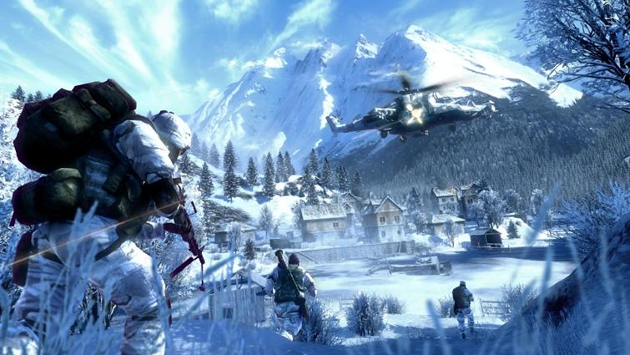
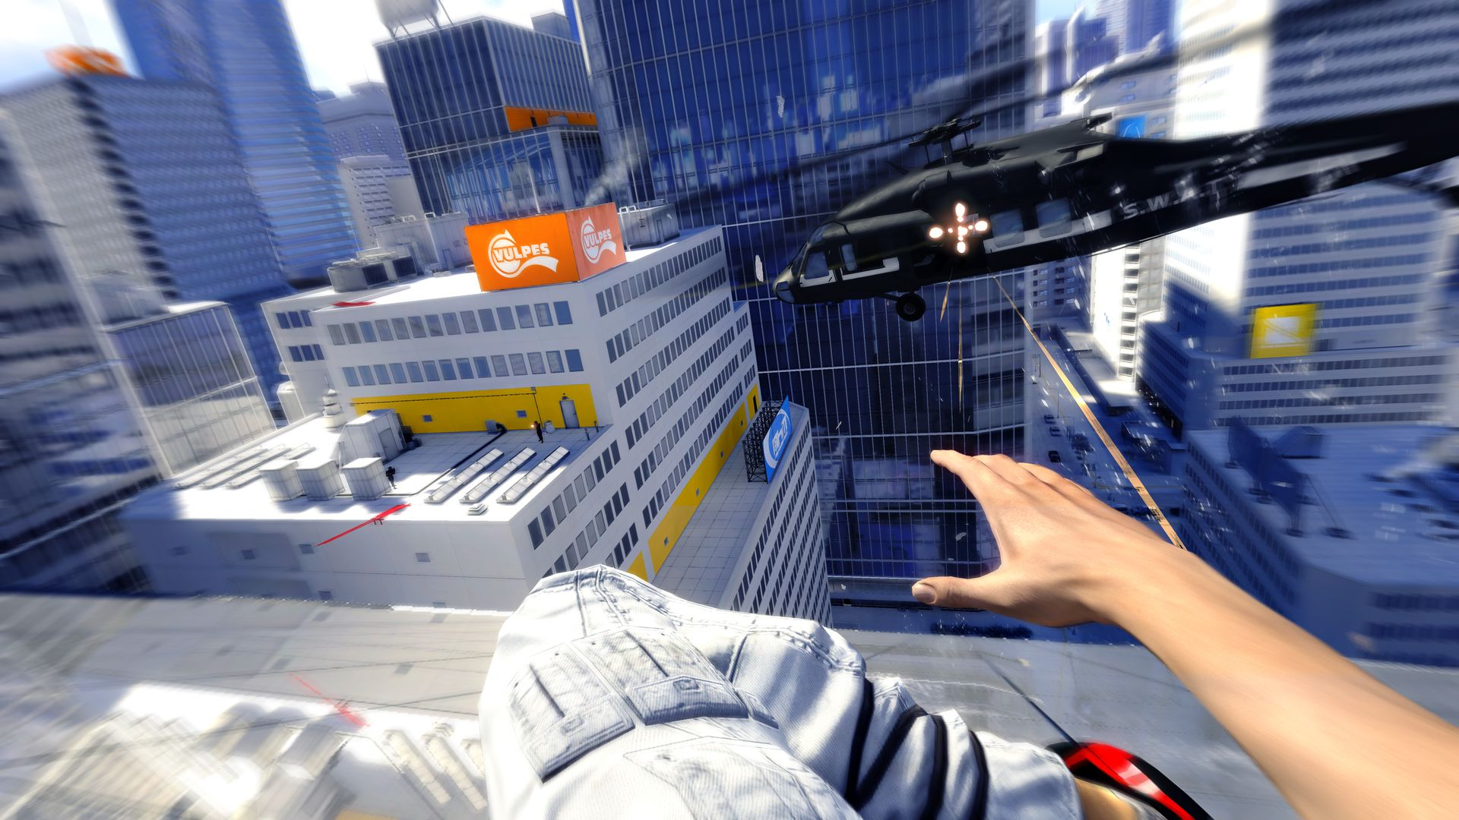
PAST:
Battlefield Bad Company
Frostbite 1
Mirror’s Edge
Unreal Engine 3
Notes:
So our past : our past is Battlefield bad comapny using Frostbite 1 engine and Mirrors edge with Unreal engine 3

Slide 4
PAST:
Battlefield Bad Company
Frostbite 1
Mirror’s Edge
Unreal Engine 3
Forward-rendering
No streaming
Hemispherical sky/ground light + directional sun light
3 point lighting
100% Dynamic shadows, cascaded shadowmaps
3 slices, 1024x1024
Single (!) point light per object
No Global Illumination
No Screen Space Ambient Occlusion
Static sky occlusion maps for buildings & bigger objects
Static sky occlusion volumes for indoor environments that dynamic objects sampled a single value from
Forward-rendering
Streaming
Static world / static lighting
Illuminate Labs Beast Offline Generation
Global Illumination (bounce, emissive, translucent)
Stored as directional lightmaps (Radiosity Normal Maps)
Dynamic objects (i.e. Faith)
Pre-calculated light probes form basis for relighting dynamic objects
Combine most relevant probes to form SH basis for lighting
Extract major light axis as “directional light source”
Use conventional shadow mapping from extracted directional
Notes:
This two engines are very different
Frostbite 1 was made to have vast outdoor landscapes and a fully destructible world.
It had 100 dynamic shadows and 3 point lighting system.
No global illumination.
We baked Static occlusion maps for bigger objects.
Mirrors edge Didn't need any destruction in the same scale as Battlefield and there main focus was a city landscape.
So static baked lightmaps worked fine.
We used Unreal Engine 3 with Illuminate Labs Beast Offline Lightmap baking for this project.

Slide 5
WANT:
How could we get the best from both worlds?
+ some more..

Slide 6
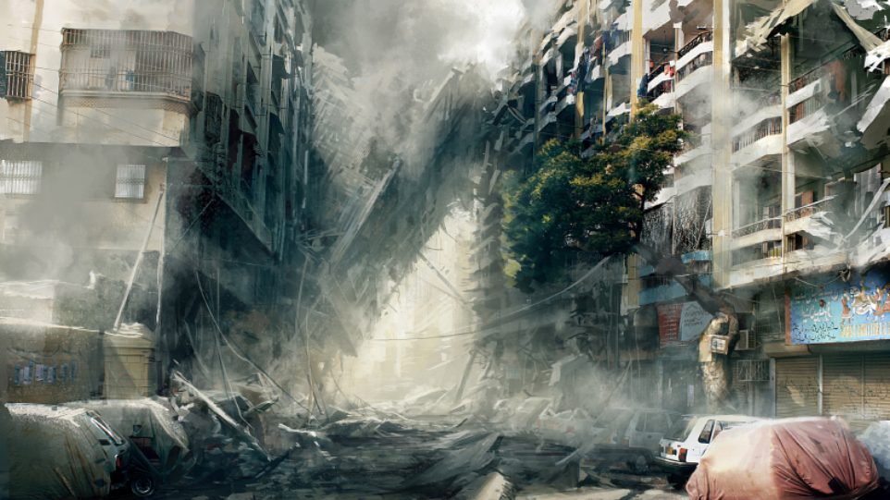
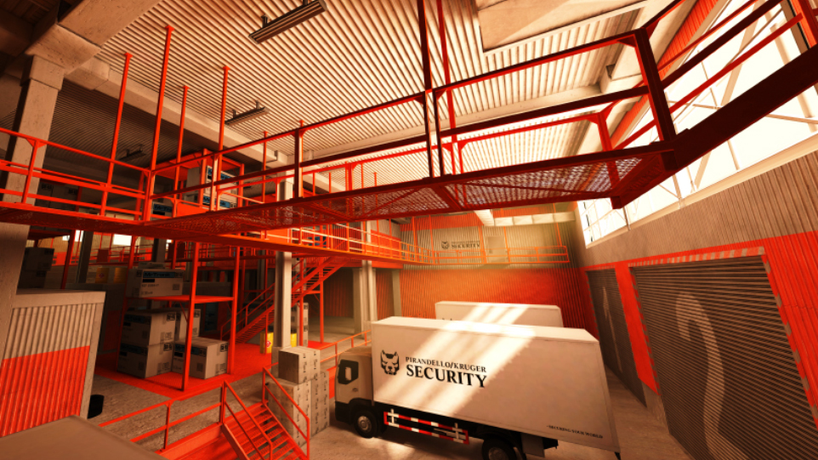
WANT:
GI In a highly dynamic and destructible environment
Notes:
This is the big one right. How to get it looking like ME and a destructible world.

Slide 7
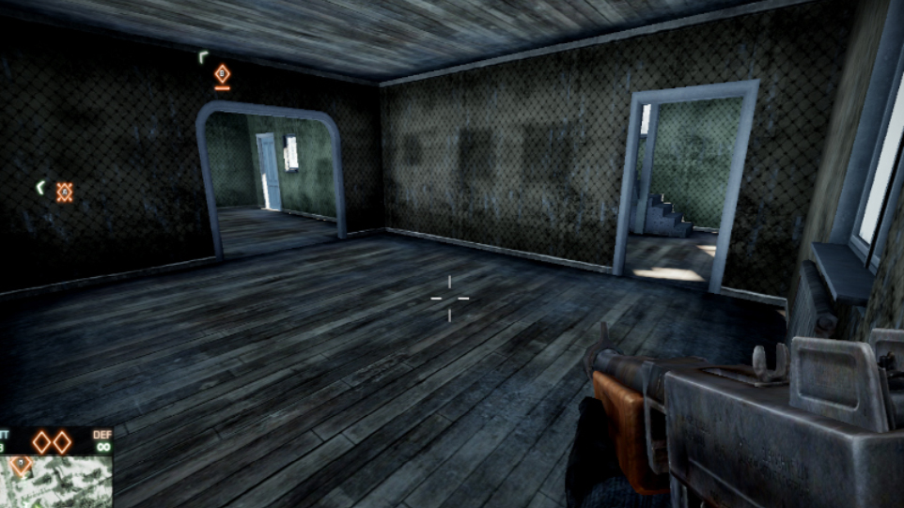
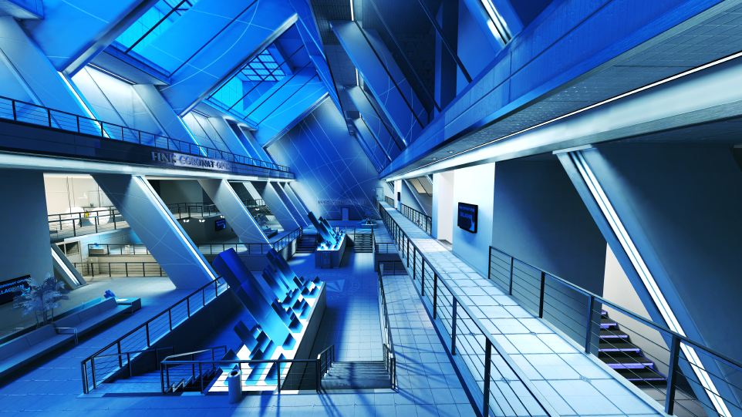
WANT:
Indoor
Notes:
We wanted the indoor lighting to look as good as ME wile having a fully destructible indoor environment. Battlefield BC 2 indoor lighting did not look that good.

Slide 8
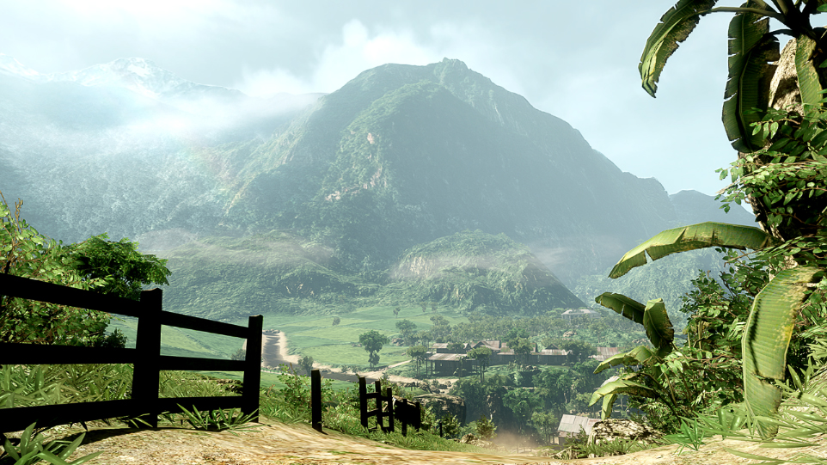
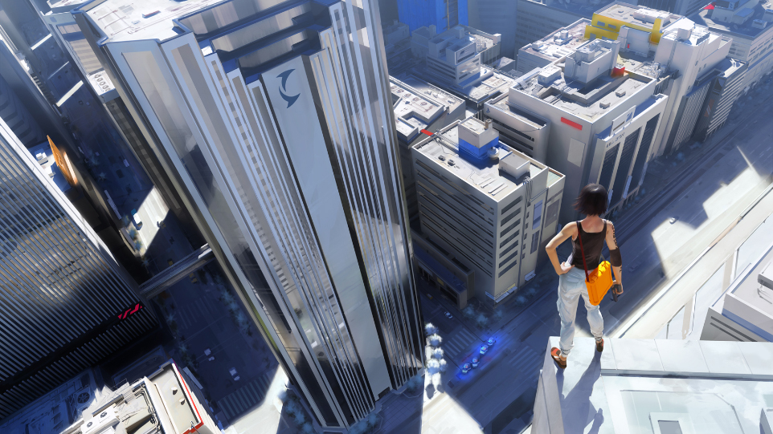
WANT:
Outdoor
Notes:
We wanted both beautiful landscape and a stunning city vista in one level.

Slide 9
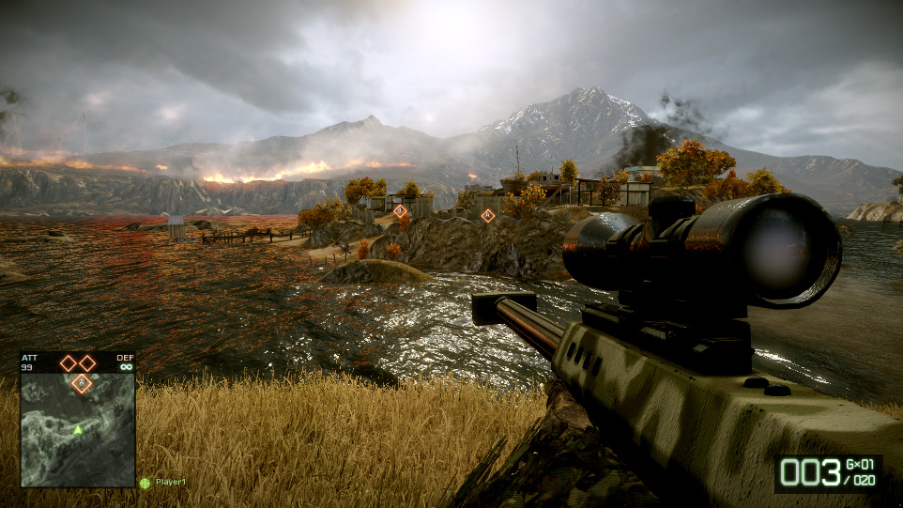
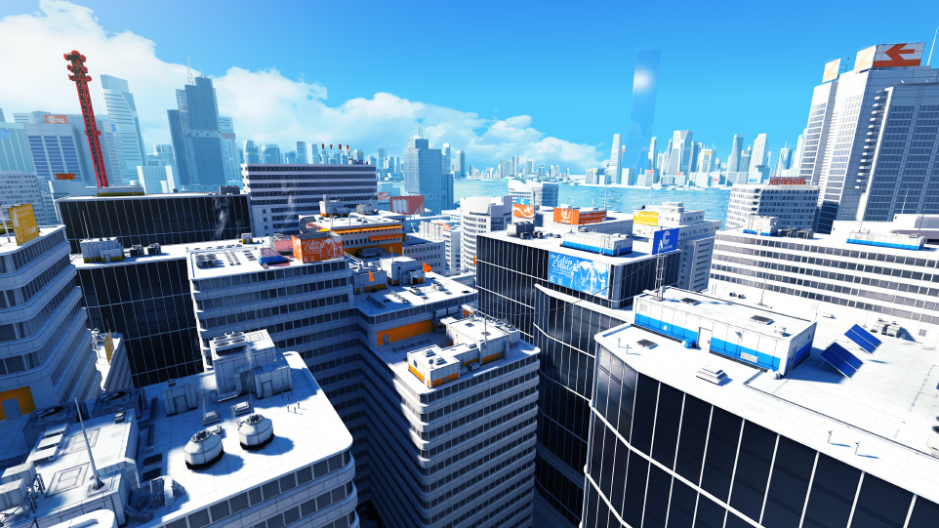
WANT:
Large environments with reflective surfaces
Notes:
Reflective surfaces is very important to give life to all materials, ME did this very good but Frostbite 1 has always struggled with this. One big problem is when your moving from a outdoor environment in to a indoor environment.

Slide 10
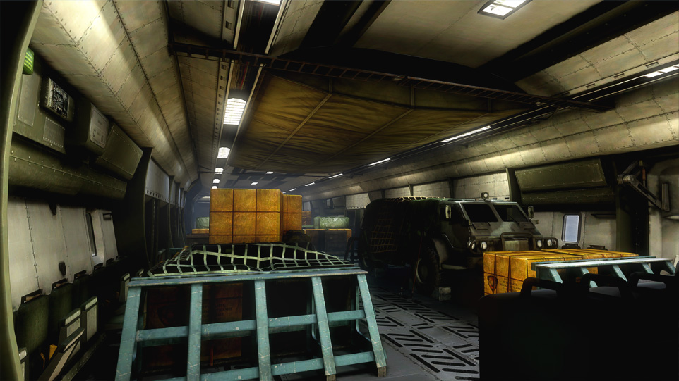
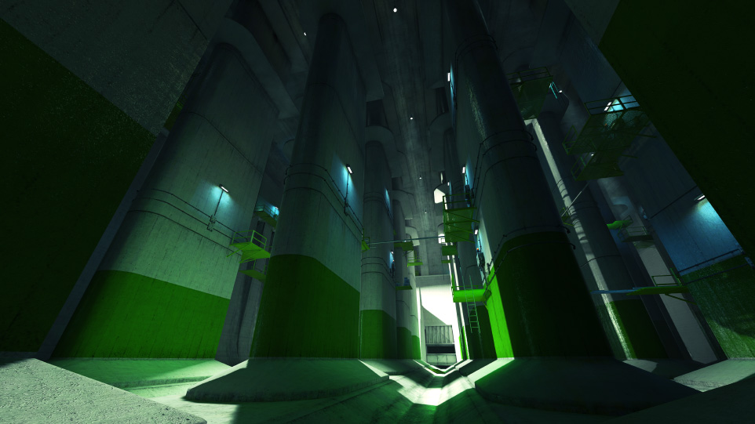
WANT:
Lights
Notes:
With lights and destruction comes one big problem.
We want to be able to destroy lights.
ME hade static baked lightmaps, so did the last BC2 lv.
And therefore we can not destroy light because the light is baked in to the texture.

Slide 11
WANT:
Improvements
Notes:
To be able to have a very Dynamic and Destructibal world, we needed some more imorovements. You cant have static baked light maps in a destrutiable world, we needed a nother sulution.

Slide 12
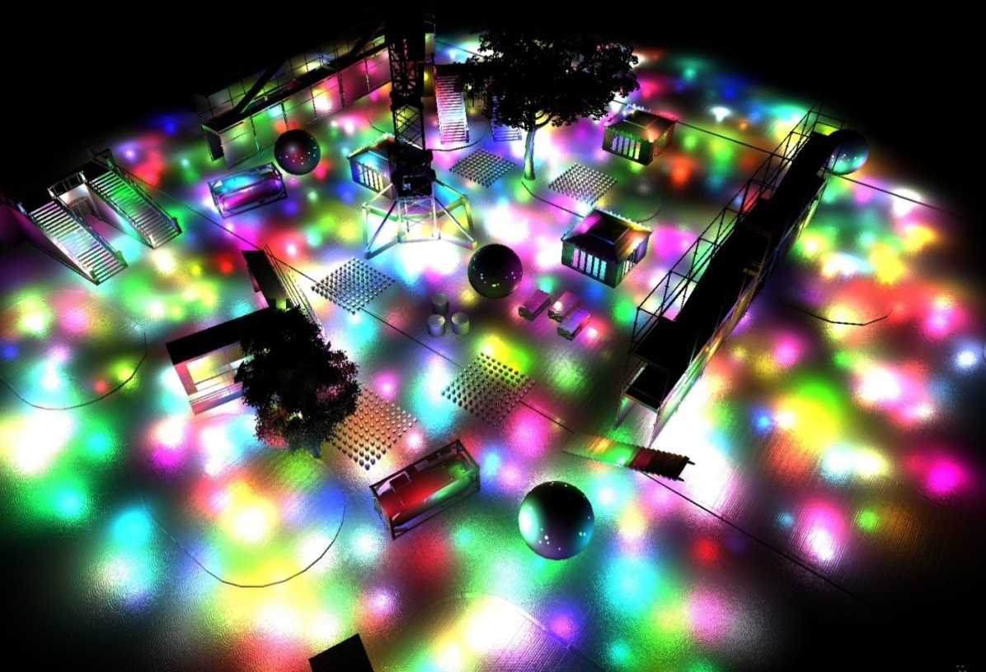
WANT:
Improvements
Deferred rendering
Notes:
If we want lights in the world, we need to be able to destroy them to. Right…

Slide 13
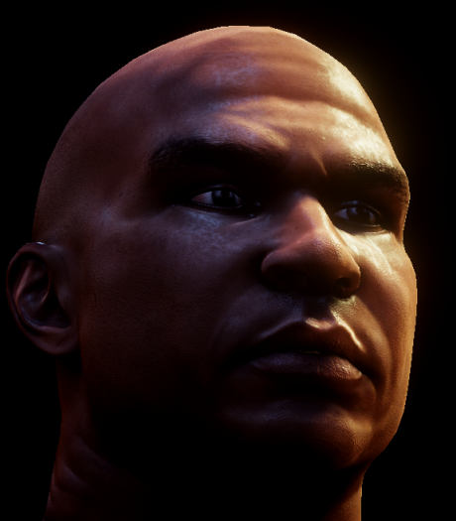
WANT:
Improvements
Deferred rendering
More lighting models

Slide 14
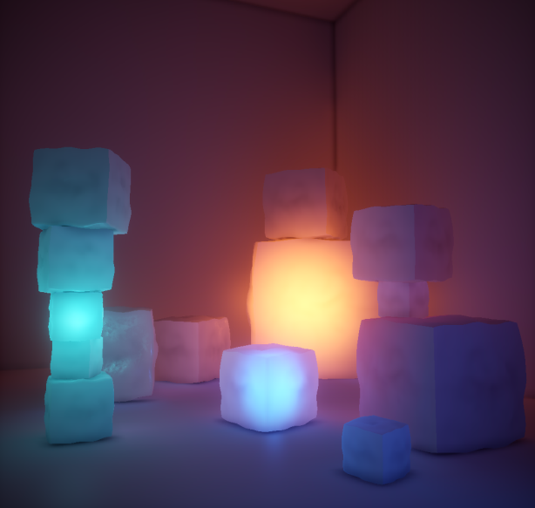
WANT:
Improvements
Deferred rendering
More lighting models
Translucency

Slide 15
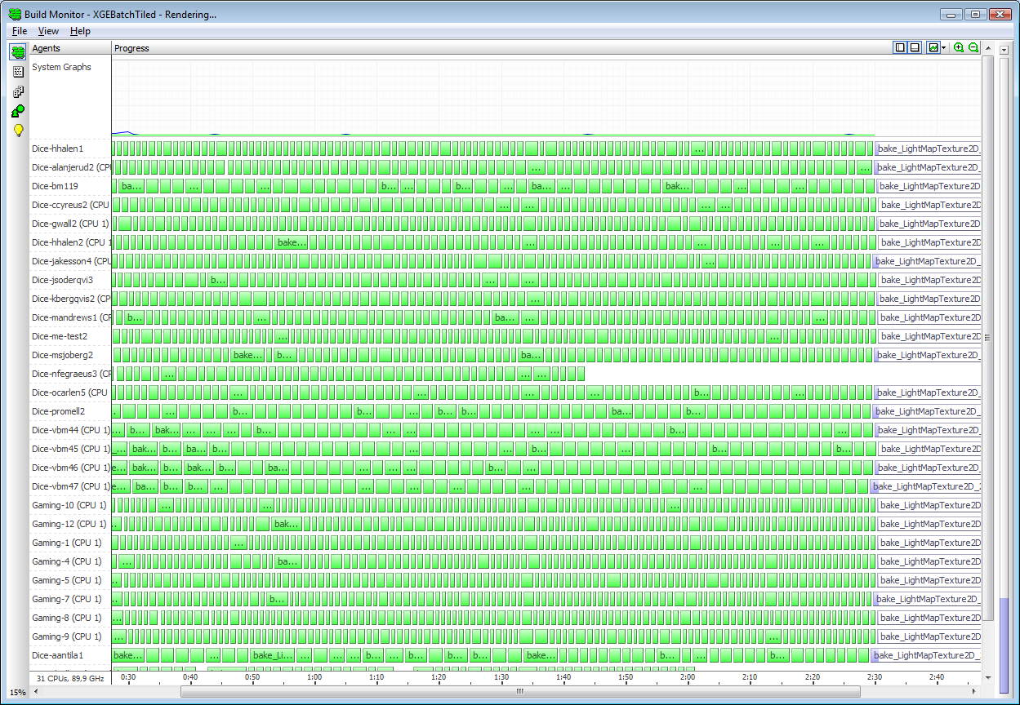
WANT:
Improvements
Deferred rendering
More lighting models
Translucency
Faster workflows
Notes:
recognize this?

Slide 16
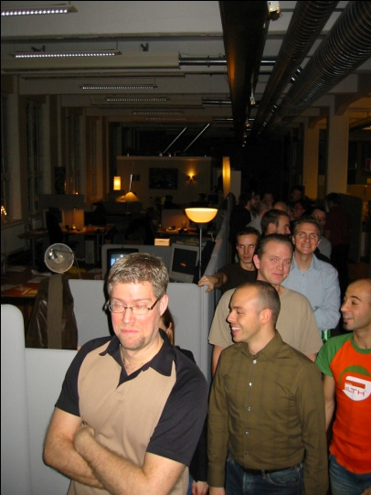
WANT:
Improvements
Deferred rendering
More lighting models
Translucency
Faster workflows
Simultaneous
Notes:
Here everybody is standing in line to work on the game. To be able to work simultaneous with art, design and sound on one level would be grate. Usually we have a lot off different gates when we produce games, first design, then art and so on.

Slide 17
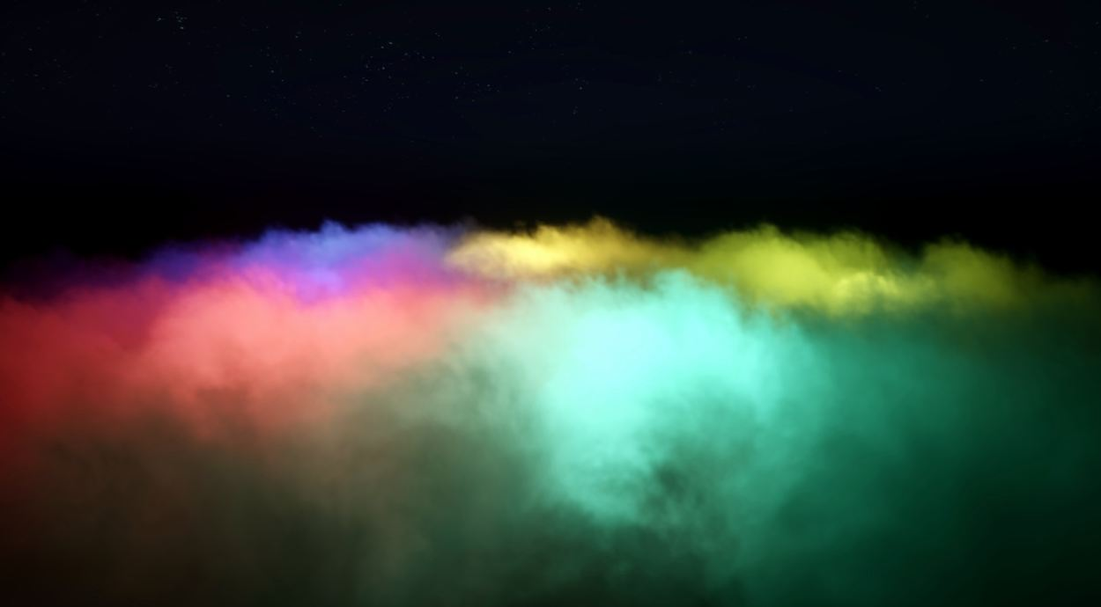
WANT:
Improvements
Deferred rendering
More lighting models
Translucency
Faster workflows
Simultaneous
Particle lighting
Notes:
We have always had problems making particles look like they fit in to the world. They are sometimes to dark ore to bright ore wrong color.

Slide 18
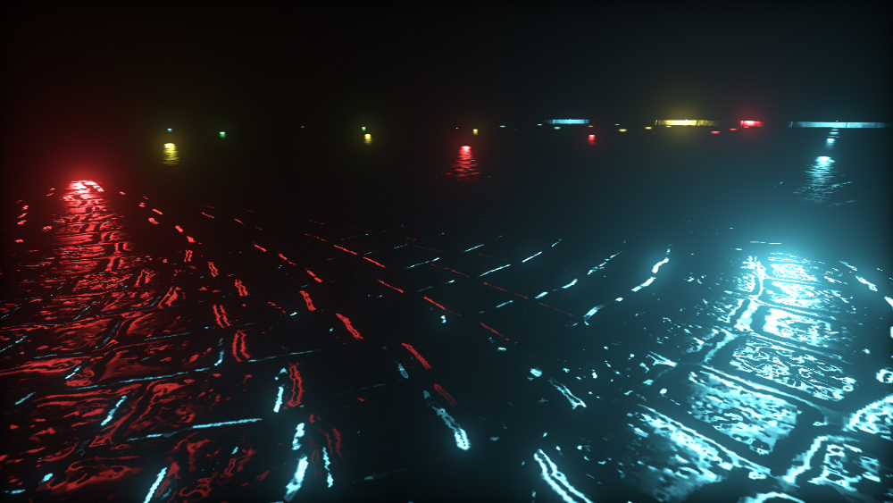
WANT:
Improvements
Deferred rendering
More lighting models
Translucency
Faster workflows
Simultaneous
Particle lighting
Bloom

Slide 19
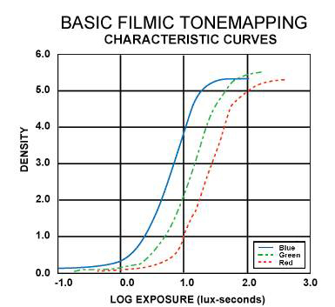
WANT:
Improvements
Deferred rendering
More lighting models
Translucency
Faster workflows
Simultaneous
Particle lighting
Bloom
Filmic Tonemapping

Slide 20
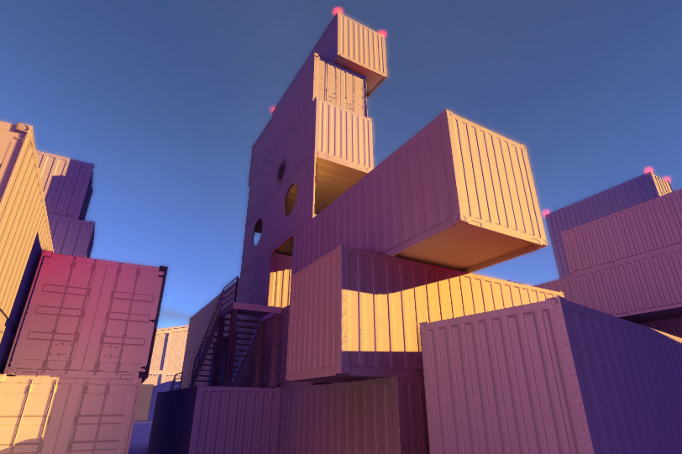
WANT:
Real-time radiosity lighting system
Enlighten
Geomerics
Cambridge, UK based. Spun out of Cambridge University
Collaborated over many years
Works for all platforms
PLAYSTATION®3,XBox 360™, PC for Windows.
Notes:
Implamenting enlighten in frostbite

Slide 21
WANT:
Frostbite 2
Notes:
Last but not least editor workflows have always been a problem for us, especially when it comes to the consoles.

Slide 22
HOW:
”Realtime radiosity architecture for a game”
How does the full lighting pipeline work in Battlefield 3
Notes:
either reflected, or absorbed and partially re‐emitted.
Surfaces that mostly reflect light appear shiny and we say they are highly specular.
Surfaces that absorb and then re‐emit tend to do so in all directions, so they appear matte and look the same regardless of what angle you look at them from. Mostly matte surfaces, such as dry concrete or paper, are said to be highly diffuse.
Both specular reflections and diffuse re‐emission bounce light back into the world.
The reflected light could then strike another surface, where another portion of it may be bounced, and this continues until all light has been fully absorbed or reflected out of the environment.
This light bouncing effect is typically ignored in most game lighting models because it massively increases the complexity of the computations.

Slide 23
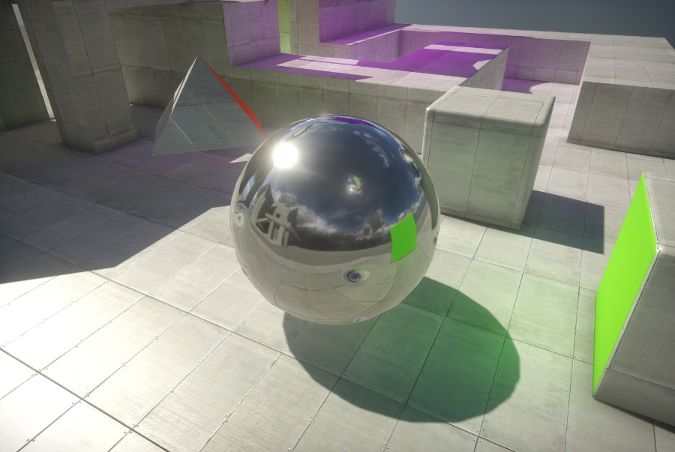
HOW:
Specular
Notes:
either reflected, or absorbed and partially re‐emitted.
Surfaces that mostly reflect light appear shiny and we say they are highly specular.

Slide 24
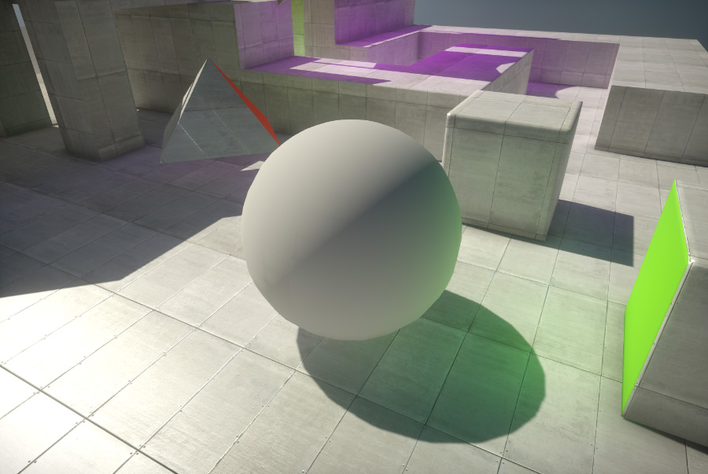
HOW:
Diffuse
Notes:
Surfaces that absorb and then re‐emit tend to do so in all directions, so they appear matte and look the same regardless of what angle you look at them from. Mostly matte surfaces, such as dry concrete or paper, are said to be highly diffuse.

Slide 25
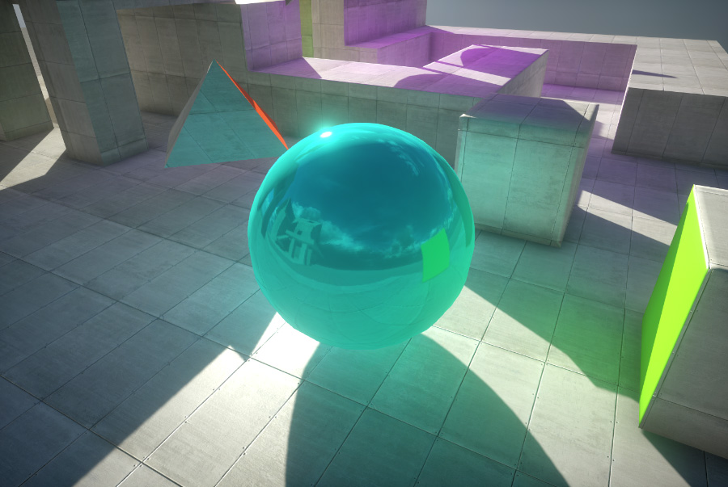
HOW:
Specular bounce
Notes:
Both specular reflections and diffuse re‐emission bounce light back into the world.

Slide 26
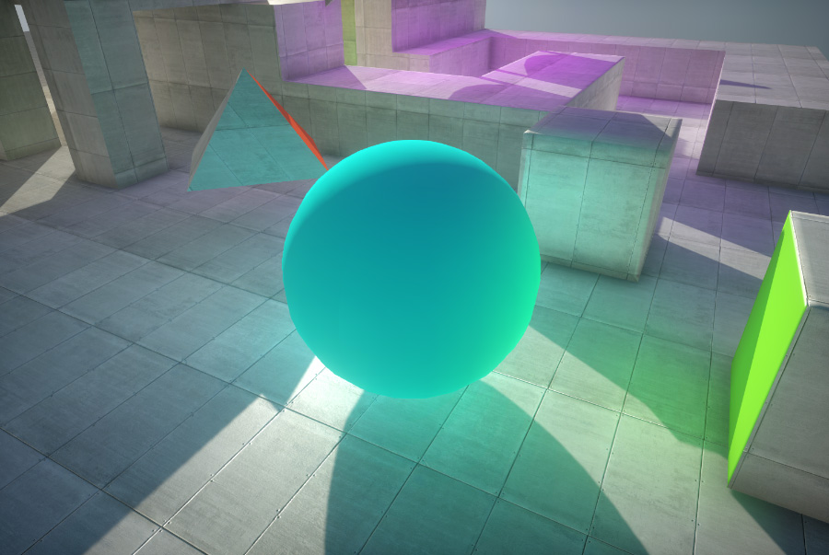
HOW:
Diffuse bounce
Notes:
The reflected light could then strike another surface, where another portion of it may be bounced, and this continues until all light has been fully absorbed or reflected out of the environment.
This light bouncing effect is typically ignored in most game lighting models because it massively increases the complexity of the computations.
There are two main approaches to simulating global illumination effects in games right now. Artists can either resort to pre‐baked lightmaps or can manually place lights in the scene to model light reflection. Both approaches to lighting have a number of failings:

Slide 27
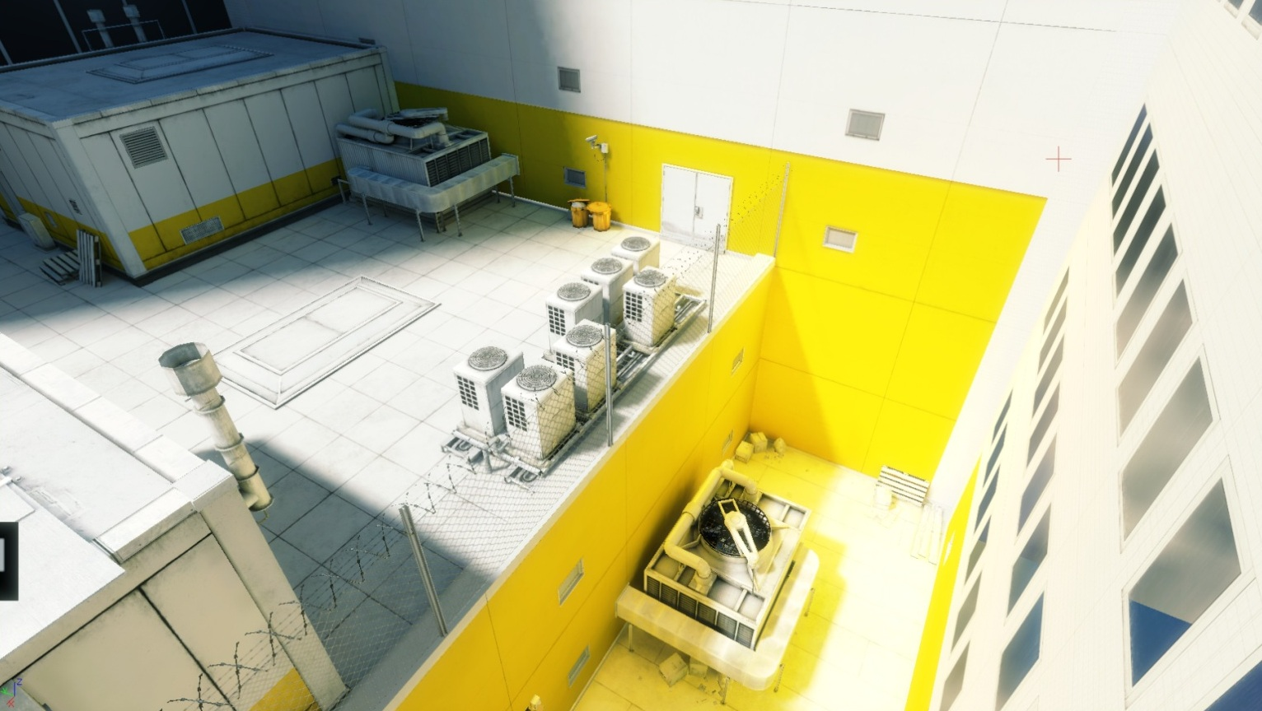
HOW:
Pre‐baked lightmaps
Notes:
· Pre‐baking lightmaps can produce high quality results, but severely limits the dynamic aspects of game lighting. time consuming, limiting artists’ ability to iterate on a scene.

Slide 28
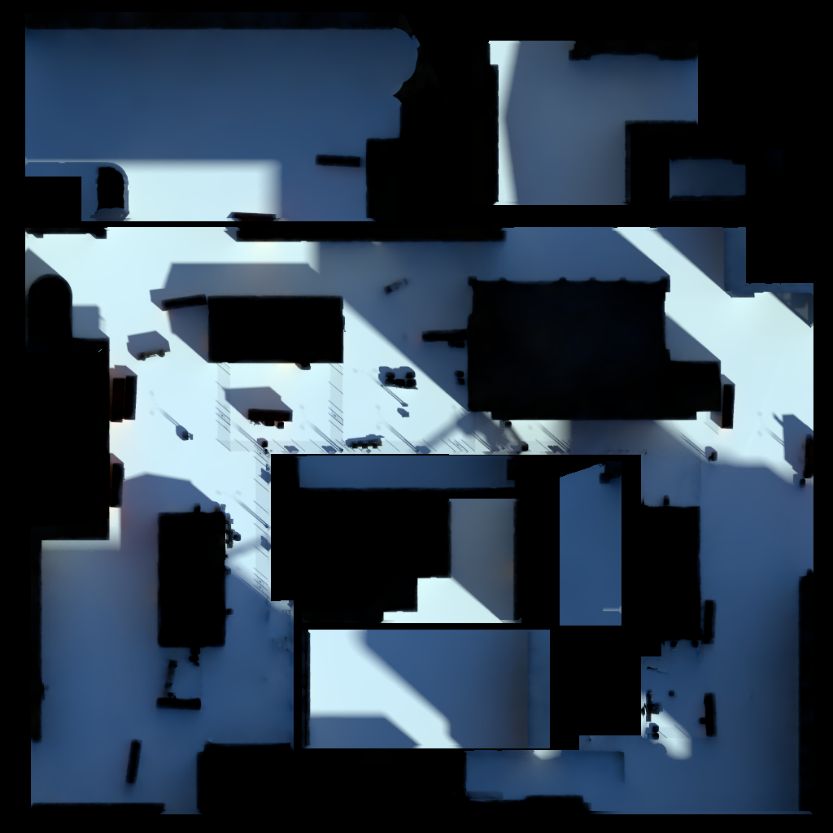
HOW:
Typical lightmap
Notes:
· Pre‐baking lightmaps can produce high quality results, but severely limits the dynamic aspects of game lighting. time consuming, limiting artists’ ability to iterate on a scene.

Slide 29
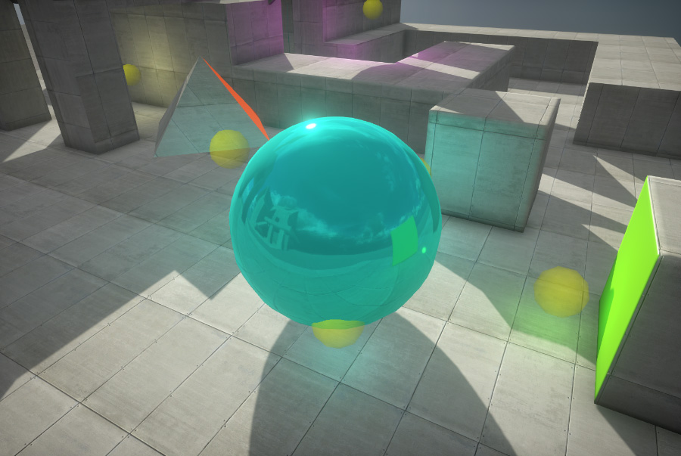
HOW:
Placing direct lights
Notes:
· Simulating global illumination by placing direct lights does give an artist control, but can be very difficult to use in practice. affect performance.

Slide 30
HOW:
Radiosity
Notes:
· Simulating global illumination by placing direct lights does give an artist control, but can be very difficult to use in practice. affect performance.

Slide 31
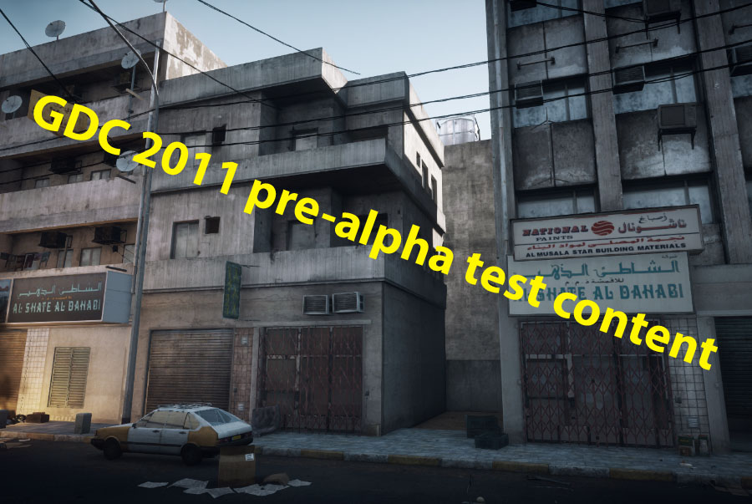
HOW:

Slide 32
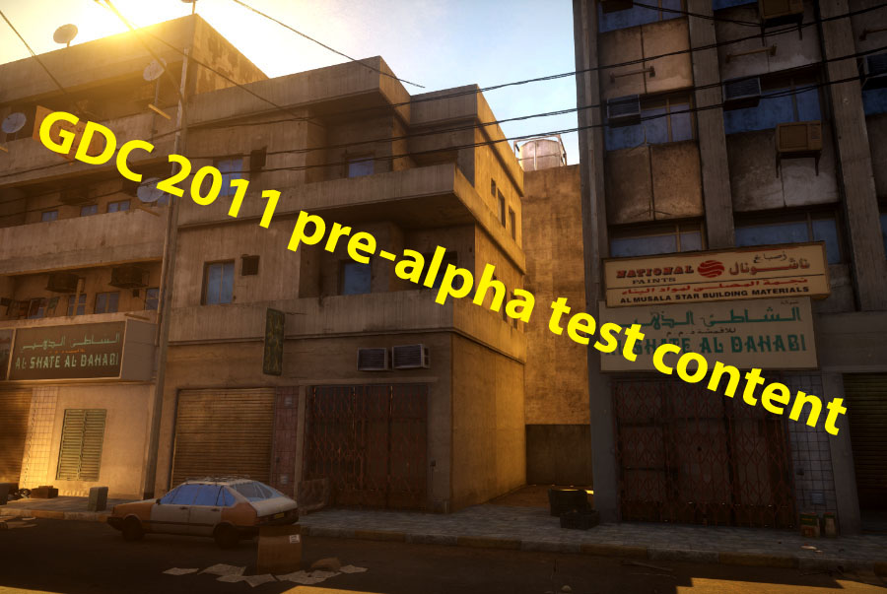
HOW:
Notes:
Enlighten dynamically computes indirect lighting within your scene.
Real-time radiosity realy provides full artistic control over the bounced light to allow a fully dynamic workflow.
This greatly reduces the time required to light a scene by artists, and opens up the possibility of completely changing the feel and mood of your scenes dynamically.
The Real-time radiosity output textures store the color and intensity of the indirect lighting as well as the major directions of light.
This information can be used in your shaders to compute indirect specular reflections and lnormal‐mapped surfaces.
We need to split the lighting system in to two part and this is mainly because of memory consumption but also performance wile lighting. Simplifying the geometry is necessary for Enlighten to be able to Handle all the radiosity data.

Slide 33
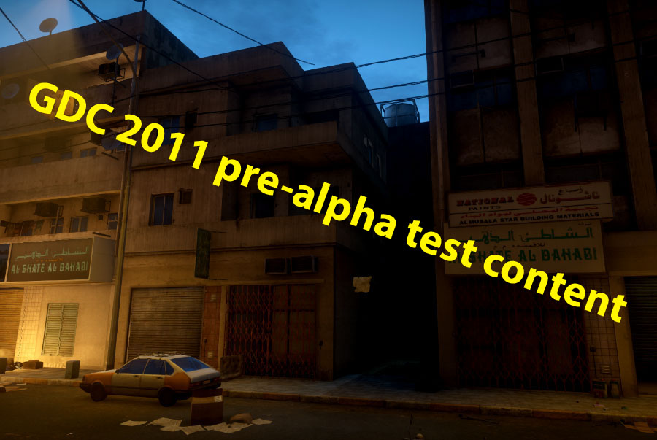
HOW:
Notes:
Enlighten dynamically computes indirect lighting within your scene.
Real-time radiosity realy provides full artistic control over the bounced light to allow a fully dynamic workflow.
This greatly reduces the time required to light a scene by artists, and opens up the possibility of completely changing the feel and mood of your scenes dynamically.
The Real-time radiosity output textures store the color and intensity of the indirect lighting as well as the major directions of light.
This information can be used in your shaders to compute indirect specular reflections and lnormal‐mapped surfaces.
We need to split the lighting system in to two part and this is mainly because of memory consumption but also performance wile lighting. Simplifying the geometry is necessary for Enlighten to be able to Handle all the radiosity data.

Slide 34
HOW:
Lightmap lit geometry
Large and inanimate
Receive and bounce light
Static geometry
Lightprobe lit geometry
Small and organic
Only receive light
Cant bounce light
Dynamic and static geometry
Notes:
The fist one is The Lightmap lit geometry and the second one is the Lightprobe lit geometry.
Lightmap lit geometry is parameterized and lit with dynamic lightmaps. This geometry can bounce light, and typically represents large and inanimate objects that don’t move.
Lightprobe lit geometry can only receive bounce light by sampling light probes. I will get back to what lightprobes are in a minit. They are typically the character ore a dynamic object but can also be a static geometry that don’t affect the lighting too much.

Slide 35
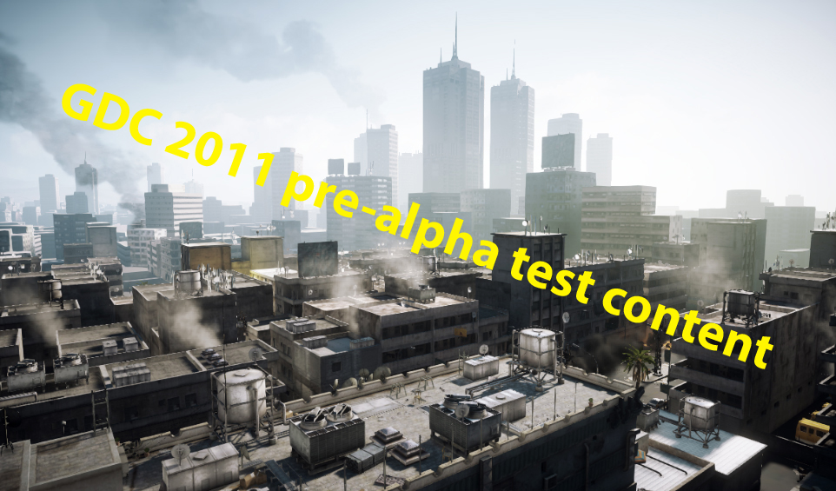
HOW:
Notes:
In the mesh classification picture you will soon se, you can see how we clearly define Lightmap lit geometry and Lightprobe lit geometry

Slide 36
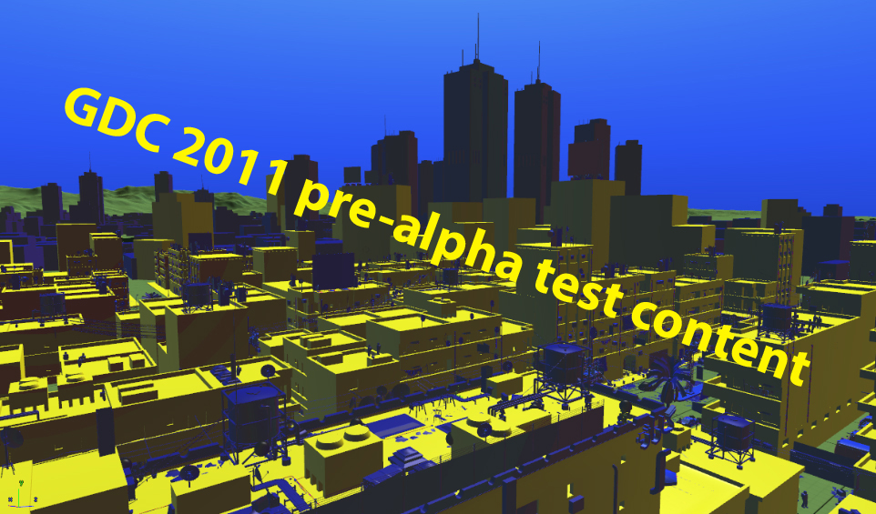
HOW:
Notes:
: static in yellow and dynamic in blue. The underlying geometry ( Lightmap lit geometry ) is used to bounce light, which then is transferred to all objects ( Lightprobe lit geometryin ) the scene.

Slide 37
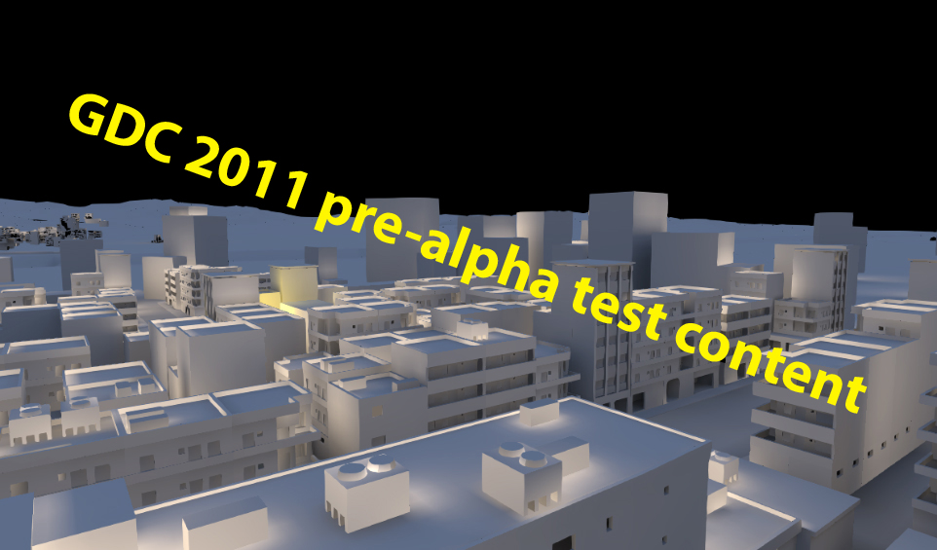
HOW:

Slide 38
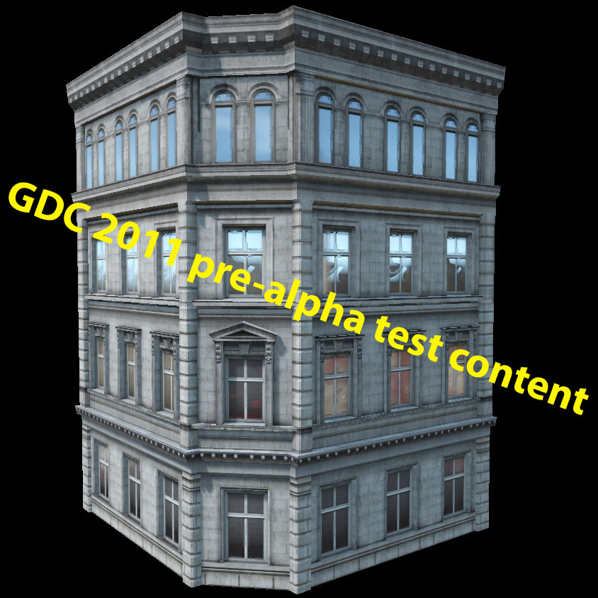
HOW:
Lightmap lit geometry

Slide 39
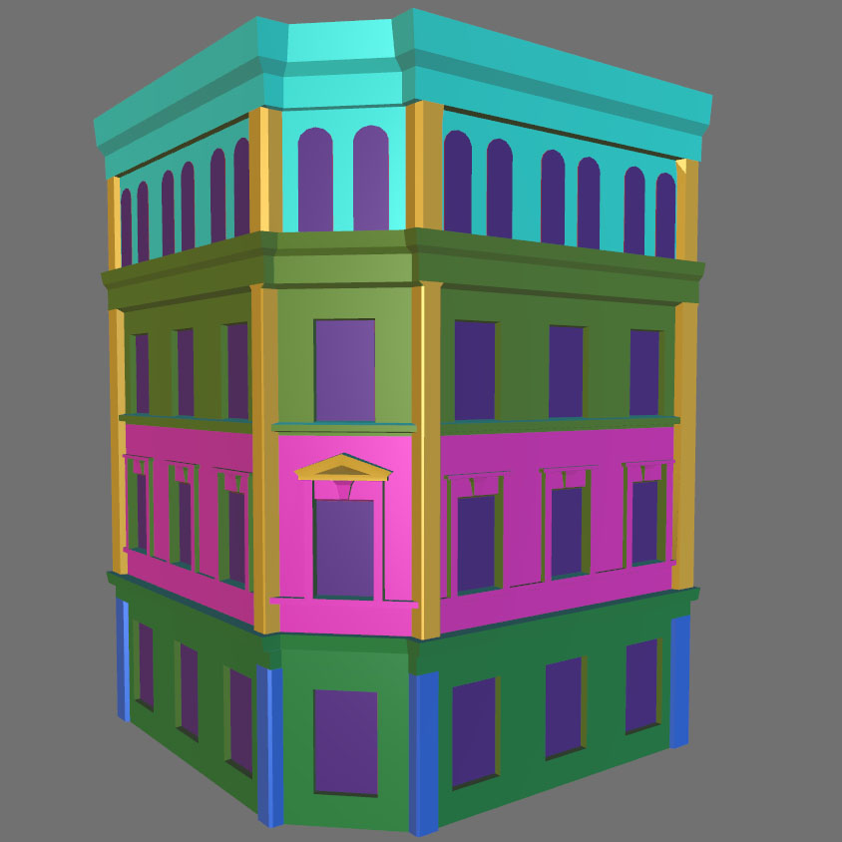
HOW:
Lightmap lit geometry
Detail geometry

Slide 40
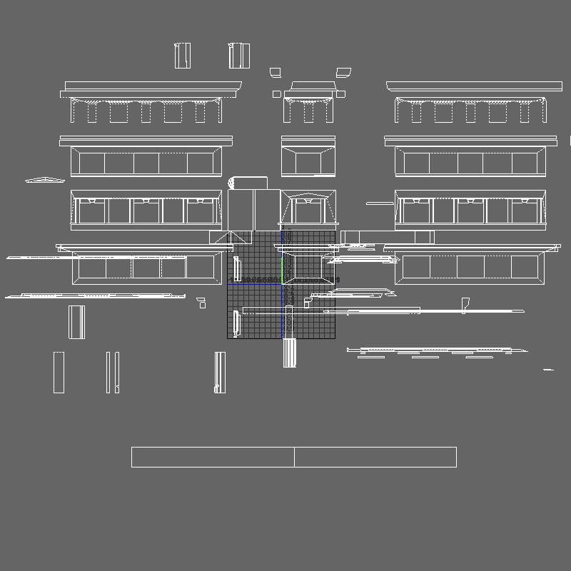
HOW:
Lightmap lit geometry
Detail geometry
UVs generated by projection
Notes:
This means that a new UV set is created automatically

Slide 41
HOW:
Lightmap lit geometry
Detail geometry
UVs generated by projection
No additional lighting data

Slide 42
HOW:
Lightmap lit geometry
Detail geometry
UVs generated by projection
No additional lighting data
“Off-axis” lighting comes from directional data in lightmap

Slide 43
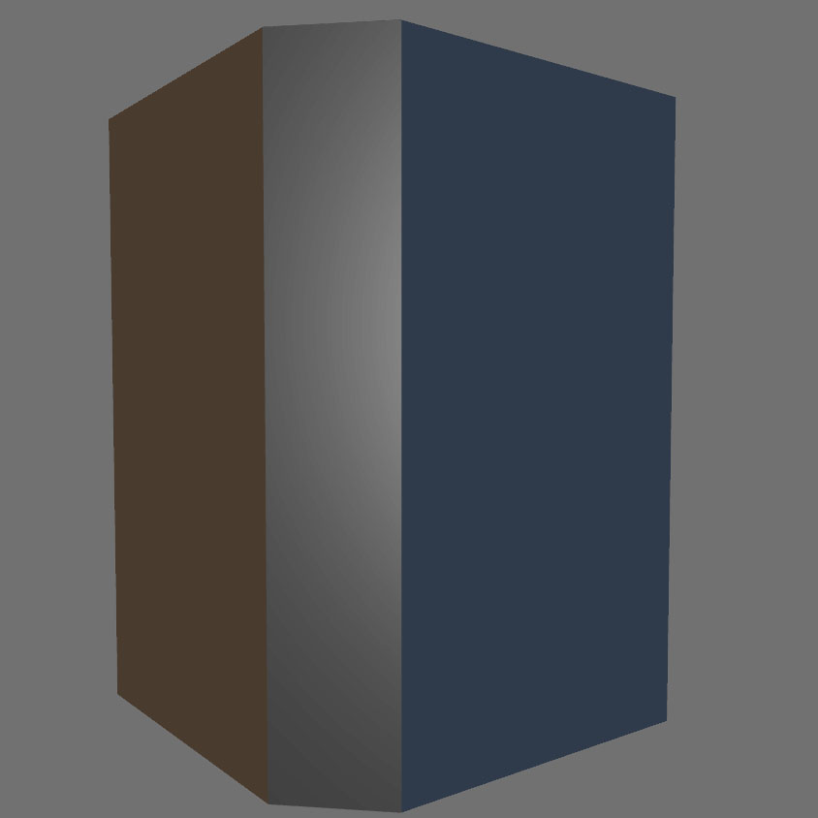
HOW:
Lightmap lit geometry
Detail geometry
UVs generated by projection
No additional lighting data
“Off-axis” lighting comes from directional data in lightmap
Target geometry
Notes:
We need to make simpler geometry for the Lighting system to be able to handle all the radiosity data

Slide 44
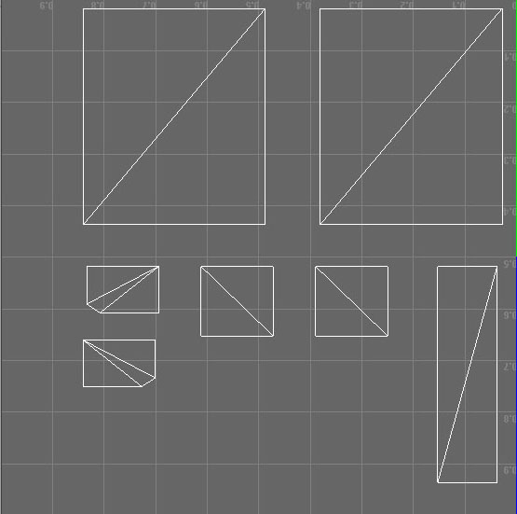
HOW:
Lightmap lit geometry
Detail geometry
UVs generated by projection
No additional lighting data
“Off-axis” lighting comes from directional data in lightmap
Target geometry
Has simple UV surface area

Slide 45
HOW:
Lightmap lit geometry
Detail geometry
UVs generated by projection
No additional lighting data
“Off-axis” lighting comes from directional data in lightmap
Target geometry
Has simple UV surface area
Poly count is not important
Various authoring options

Slide 46
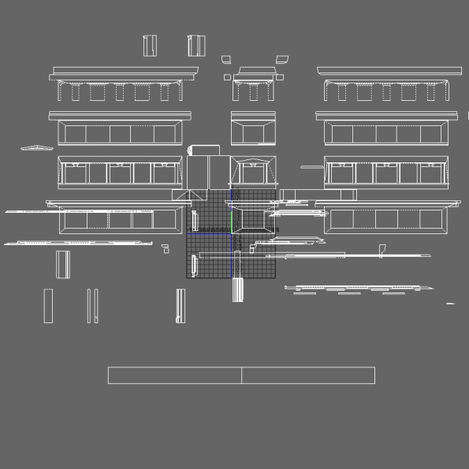
HOW:
Lightmap lit geometry
Authoring of geometry
UVs
Detail geometry UV
Target geometry UV

Slide 47
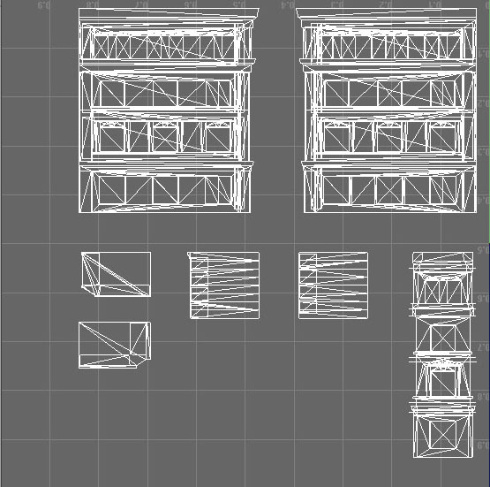
HOW:
Detail geometry UV
Transferred to the
Target geometry UV
Lightmap lit geometry
Authoring of geometry
UVs
Surface transfer

Slide 48
HOW:
Detail geometry UV
Transferred to the
Target geometry UV
Lightmap lit geometry
Authoring of geometry
UVs
Surface transfer

Slide 49
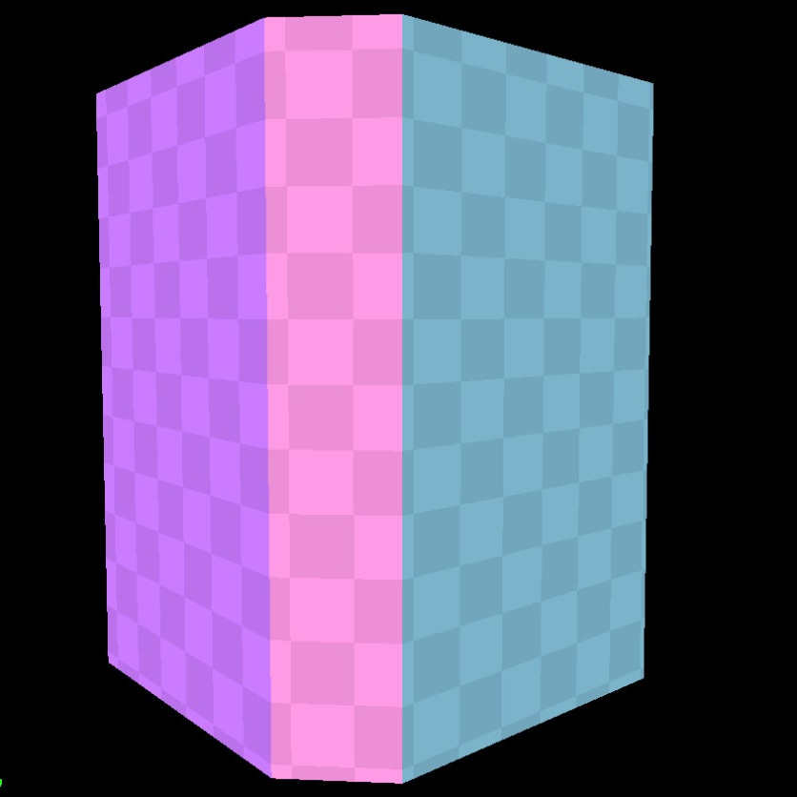
HOW:
Target geometry lightmap
Lightmap lit geometry
Authoring of geometry
UVs
Surface transfer

Slide 50
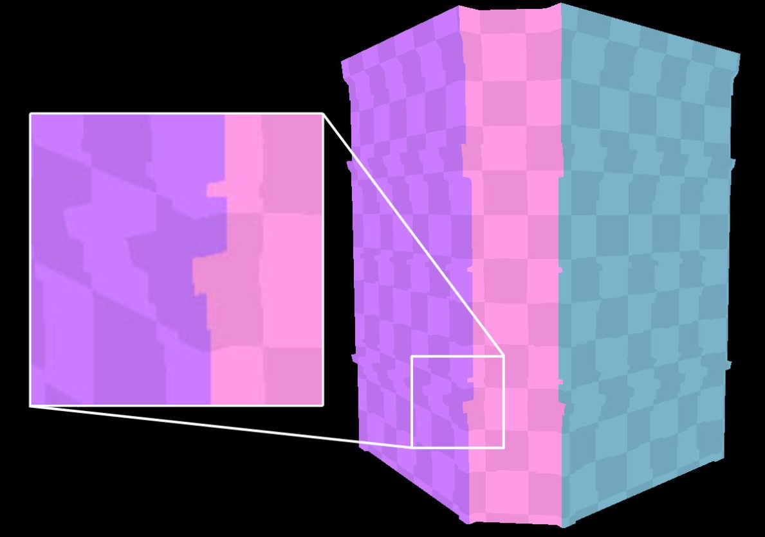
HOW:
Target geometry lightmap
Transferred to the
Detail geometry
Lightmap lit geometry
Authoring of geometry
UVs
Surface transfer
Notes:
This uv projection is done when we import an object into the Editor.

Slide 51
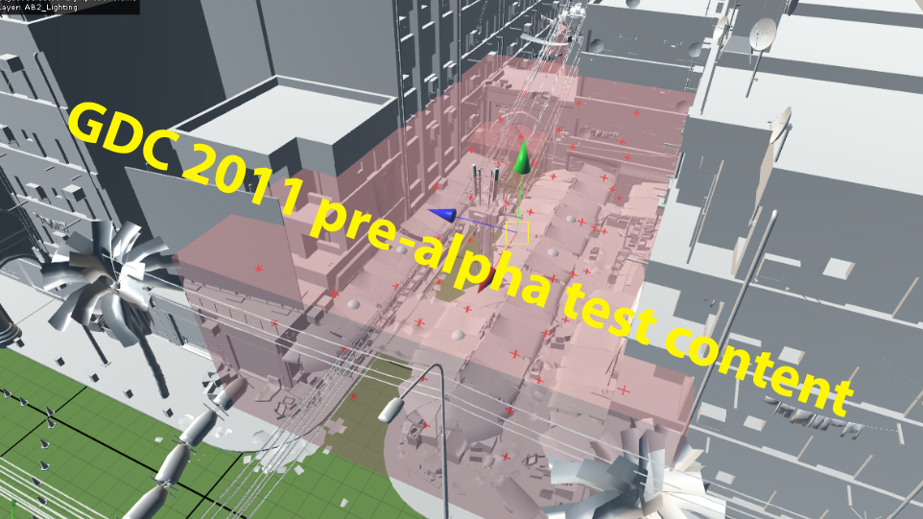
HOW:
Lightprobe lit geometry
Lightprobe volumes
Notes:
We need to store lighting information for the dynamic, small and the very complex (organic ) objects in different way.
Therefore, we place light probes in the world that store the global illumination lighting.
The objects that read these light probes can only receive light, not bounce or generate additional light.
The probes are stored in a grid:

Slide 52
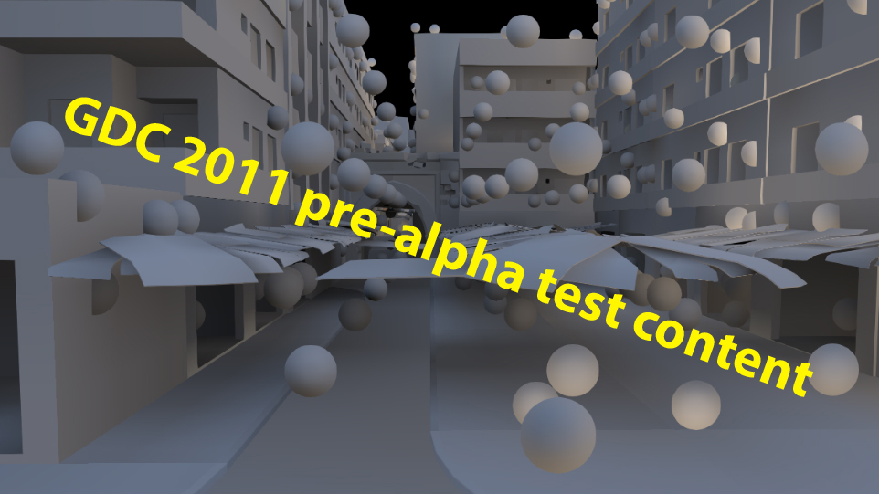
HOW:
Lightprobe lit geometry
Lightprobe volumes
Notes:
in this picture their positions are represented as spheres. In each of these positions we store the lighting using a spherical harmonic representation, which means we basically have the incoming lighting in all directions. As dynamic objects move through this grid, they will pick up the correct lighting.

Slide 53
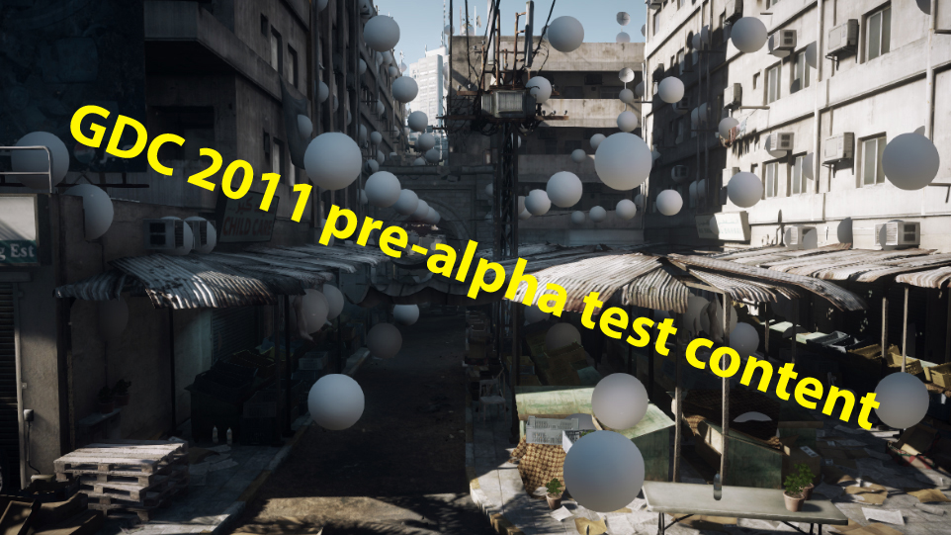
HOW:
Lightprobe lit geometry
Lightprobe volumes
Notes:
in this picture their positions are represented as spheres. In each of these positions we store the lighting using a spherical harmonic representation, which means we basically have the incoming lighting in all directions. As dynamic objects move through this grid, they will pick up the correct lighting.

Slide 54
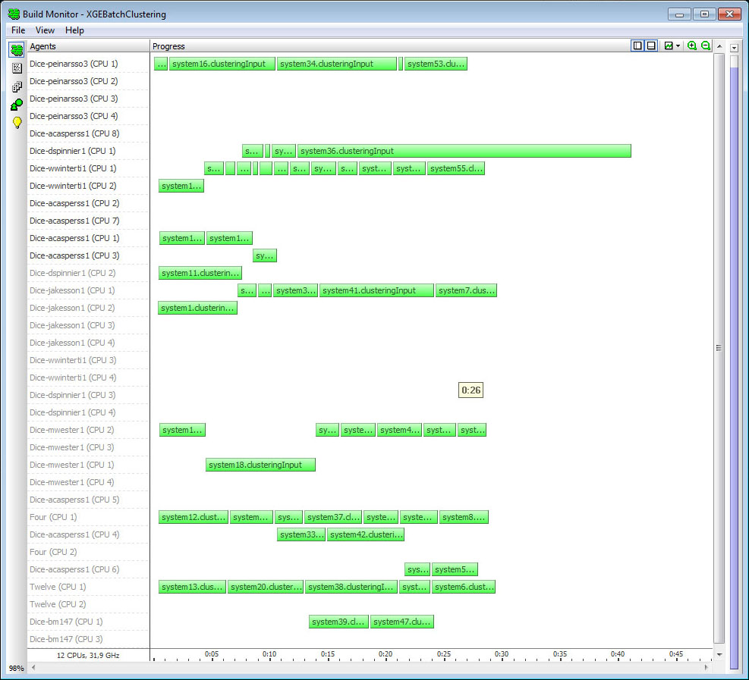
HOW:
Precompute
Analyze the geometry
Notes:
Before we can run the game with dynamic radiosity we have to do a precompute pass in the pipeline.
In this step we analyze the geometry in the scene and generate data which we need in the game to generate the dynamic lighting.
This step can be time consuming. For the scene you’ve seen here it takes about 20 minutes.
But we only have to redo this step when we modify the static geometry in the scene, not when we change the lighting or the surface colors.

Slide 55
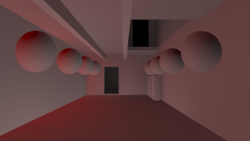
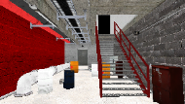
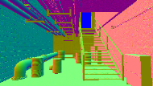
HOW:
Runtime lighting pipeline
Radiosity pass (CPU)
Update indirect lightmaps and lightprobes
Geometry pass (GPU)
Store indirect lighting in separate G-buffer
Light pass (GPU)
Render deferred light sources
Add indirect lighting from G-buffer
Notes:
The complete render pipeline looks like this. First, we update lightmaps & light probes on the CPU.
Next, we run the geometry pass, where we add bounce light from the lightmaps and lightprobes to a separate g-buffer.
Finally, in the light pass, we first render all deferred lights. Then We add the indirect lighting from the g-buffer.

Slide 56
HOW:
Small environments
Sky visibility
Notes:
Sky visibility is a term we use to say how much of the sky each pixel can see.
We use it to blend between a dynamic outdoor environment map and a static indoor environment map to avoid the problem of a strong blue sky reflection on objects inside buildings as well as to smoothly transition between indoor and outdoor environments.

Slide 57
HOW:
Small environments
Sky visibility
Environment maps
Notes:
The indoor environment map gets its color and intensity from the dynamic radiosity that we calculate and this is combined with a black & white albedo envmap that modulates it and creates view-dependent motion in the surface.

Slide 58
HOW:
Large environments
Skylight
Notes:
We need to make a spherical harmonic representation of the sky. This is used for lighting big outdoor environments. The small Envmap cross you see to the left of every picture is the spherical harmonic debug view.

Slide 59
HOW:
Large environments
Skylight
Notes:
We need to make a spherical harmonic representation of the sky. This is used for lighting big outdoor environments. The small Envmap cross you see in the middle of every picture is the spherical harmonic debug view.

Slide 60
HOW:
Large environments
Skylight
Notes:
We need to make a spherical harmonic representation of the sky. This is used for lighting big outdoor environments. The small Envmap cross you see in the middle of every picture is the spherical harmonic debug view.

Slide 61
HOW:
Large environments
Skylight
Terrain

Slide 62
HOW:
Large environments
Skylight
Terrain
Notes:
Every red point you see in the picture is a light probe, it’s getting snapped to the height field of the terrain. The resolution of the light probe grid depends on the terrain patch size.

Slide 63
HOW:
Large environments
Skylight
Terrain
Notes:
It’s the same for the lightmpas for the terrain, it also deepens on the terrain patch size..

Slide 64
HOW:
Light

Slide 65
HOW:
Light

Slide 66
HOW:
Light

Slide 67
HOW:
Why is it important to separate some elements in the lighting system?
Notes:
Freedom : As a lighting artist I want to be able to have a red sky and green ground, and not to be forced to change the color of the sky just to get the ground brighter. You need to be careful what systems interact with each other in a lighting system.

Slide 68
HOW:
Best practice
Complex geometry
Notes:
Complex geometry : Working with light probes: for complex objects (i.e. house), some parts can be taken out of the geometry and imported as lightprobe lit geometry to optimize authoring time. Gray is lightmap lit geometry, red are lightprobe lit geometry and the blue are transparent surface and don’t need to be lit by enlighten
Static radiosity maps : You can use this system as a fast way of baking out light maps / radiosity maps in this case (no shados).
Real-time : The real-time part on Enlighten can be used in smaller contained areas.
Streaming : Streaming in and out baked radiosity maps works fine depending on the sizes of the streaming zones
Time laps : Time-lapse works only with dynamic enlighten enabled.
Range : Be careful if you have too much range in the lighting because of the data stored in the light probes are packed.
Color Grading : Looking how film is post processed, color grading should be applied last in the chain.
Filmic tone mapping : . There are a couple of filmic tonemapping formulas out there, use the one that suit the art direction of your game.

Slide 69
HOW:
Best practice
Complex geometry
Static radiosity maps
Notes:
Complex geometry : Working with light probes: for complex objects (i.e. house), some parts can be taken out of the geometry and imported as lightprobe lit geometry to optimize authoring time. Gray is lightmap lit geometry, red are lightprobe lit geometry and the blue are transparent surface and don’t need to be lit by enlighten
Static radiosity maps : You can use this system as a fast way of baking out light maps / radiosity maps in this case (no shados).
Real-time : The real-time part on Enlighten can be used in smaller contained areas.
Streaming : Streaming in and out baked radiosity maps works fine depending on the sizes of the streaming zones
Time laps : Time-lapse works only with dynamic enlighten enabled.
Range : Be careful if you have too much range in the lighting because of the data stored in the light probes are packed.
Color Grading : Looking how film is post processed, color grading should be applied last in the chain.
Filmic tone mapping : . There are a couple of filmic tonemapping formulas out there, use the one that suit the art direction of your game.

Slide 70
HOW:
Best practice
Complex geometry
Static radiosity maps
Real-time
Notes:
Complex geometry : Working with light probes: for complex objects (i.e. house), some parts can be taken out of the geometry and imported as lightprobe lit geometry to optimize authoring time. Gray is lightmap lit geometry, red are lightprobe lit geometry and the blue are transparent surface and don’t need to be lit by enlighten
Static radiosity maps : You can use this system as a fast way of baking out light maps / radiosity maps in this case (no shados).
Real-time : The real-time part on Enlighten can be used in smaller contained areas.
Streaming : Streaming in and out baked radiosity maps works fine depending on the sizes of the streaming zones
Time laps : Time-lapse works only with dynamic enlighten enabled.
Range : Be careful if you have too much range in the lighting because of the data stored in the light probes are packed.
Color Grading : Looking how film is post processed, color grading should be applied last in the chain.
Filmic tone mapping : . There are a couple of filmic tonemapping formulas out there, use the one that suit the art direction of your game.

Slide 71
HOW:
Best practice
Complex geometry
Static radiosity maps
Real-time
Streaming
Notes:
Complex geometry : Working with light probes: for complex objects (i.e. house), some parts can be taken out of the geometry and imported as lightprobe lit geometry to optimize authoring time. Gray is lightmap lit geometry, red are lightprobe lit geometry and the blue are transparent surface and don’t need to be lit by enlighten
Static radiosity maps : You can use this system as a fast way of baking out light maps / radiosity maps in this case (no shados).
Real-time : The real-time part on Enlighten can be used in smaller contained areas.
Streaming : Streaming in and out baked radiosity maps works fine depending on the sizes of the streaming zones
Time laps : Time-lapse works only with dynamic enlighten enabled.
Range : Be careful if you have too much range in the lighting because of the data stored in the light probes are packed.
Color Grading : Looking how film is post processed, color grading should be applied last in the chain.
Filmic tone mapping : . There are a couple of filmic tonemapping formulas out there, use the one that suit the art direction of your game.

Slide 72
HOW:
Best practice
Complex geometry
Static radiosity maps
Real-time
Streaming
Time laps
Notes:
Complex geometry : Working with light probes: for complex objects (i.e. house), some parts can be taken out of the geometry and imported as lightprobe lit geometry to optimize authoring time. Gray is lightmap lit geometry, red are lightprobe lit geometry and the blue are transparent surface and don’t need to be lit by enlighten
Static radiosity maps : You can use this system as a fast way of baking out light maps / radiosity maps in this case (no shados).
Real-time : The real-time part on Enlighten can be used in smaller contained areas.
Streaming : Streaming in and out baked radiosity maps works fine depending on the sizes of the streaming zones
Time laps : Time-lapse works only with dynamic enlighten enabled.
Range : Be careful if you have too much range in the lighting because of the data stored in the light probes are packed.
Color Grading : Looking how film is post processed, color grading should be applied last in the chain.
Filmic tone mapping : . There are a couple of filmic tonemapping formulas out there, use the one that suit the art direction of your game.

Slide 73
HOW:
Best practice
Complex geometry
Static radiosity maps
Real-time
Streaming
Time laps
Range
Notes:
Complex geometry : Working with light probes: for complex objects (i.e. house), some parts can be taken out of the geometry and imported as lightprobe lit geometry to optimize authoring time. Gray is lightmap lit geometry, red are lightprobe lit geometry and the blue are transparent surface and don’t need to be lit by enlighten
Static radiosity maps : You can use this system as a fast way of baking out light maps / radiosity maps in this case (no shados).
Real-time : The real-time part on Enlighten can be used in smaller contained areas.
Streaming : Streaming in and out baked radiosity maps works fine depending on the sizes of the streaming zones
Time laps : Time-lapse works only with dynamic enlighten enabled.
Range : Be careful if you have too much range in the lighting because of the data stored in the light probes are packed.
Color Grading : Looking how film is post processed, color grading should be applied last in the chain.
Filmic tone mapping : . There are a couple of filmic tonemapping formulas out there, use the one that suit the art direction of your game.

Slide 74
HOW:
Best practice
Complex geometry
Static radiosity maps
Real-time
Streaming
Time laps
Range
Color Grading
ON
Notes:
Complex geometry : Working with light probes: for complex objects (i.e. house), some parts can be taken out of the geometry and imported as lightprobe lit geometry to optimize authoring time. Gray is lightmap lit geometry, red are lightprobe lit geometry and the blue are transparent surface and don’t need to be lit by enlighten
Static radiosity maps : You can use this system as a fast way of baking out light maps / radiosity maps in this case (no shados).
Real-time : The real-time part on Enlighten can be used in smaller contained areas.
Streaming : Streaming in and out baked radiosity maps works fine depending on the sizes of the streaming zones
Time laps : Time-lapse works only with dynamic enlighten enabled.
Range : Be careful if you have too much range in the lighting because of the data stored in the light probes are packed.
Color Grading : Looking how film is post processed, color grading should be applied last in the chain.
Filmic tone mapping : . There are a couple of filmic tonemapping formulas out there, use the one that suit the art direction of your game.

Slide 75
HOW:
Best practice
Complex geometry
Static radiosity maps
Real-time
Streaming
Time laps
Range
Color Grading
OFF
Notes:
Complex geometry : Working with light probes: for complex objects (i.e. house), some parts can be taken out of the geometry and imported as lightprobe lit geometry to optimize authoring time. Gray is lightmap lit geometry, red are lightprobe lit geometry and the blue are transparent surface and don’t need to be lit by enlighten
Static radiosity maps : You can use this system as a fast way of baking out light maps / radiosity maps in this case (no shados).
Real-time : The real-time part on Enlighten can be used in smaller contained areas.
Streaming : Streaming in and out baked radiosity maps works fine depending on the sizes of the streaming zones
Time laps : Time-lapse works only with dynamic enlighten enabled.
Range : Be careful if you have too much range in the lighting because of the data stored in the light probes are packed.
Color Grading : Looking how film is post processed, color grading should be applied last in the chain.
Filmic tone mapping : . There are a couple of filmic tonemapping formulas out there, use the one that suit the art direction of your game.

Slide 76
HOW:
Best practice
Complex geometry
Static radiosity maps
Real-time
Streaming
Time laps
Range
Color Grading
Filmic tone mapping
ON
Notes:
Complex geometry : Working with light probes: for complex objects (i.e. house), some parts can be taken out of the geometry and imported as lightprobe lit geometry to optimize authoring time. Gray is lightmap lit geometry, red are lightprobe lit geometry and the blue are transparent surface and don’t need to be lit by enlighten
Static radiosity maps : You can use this system as a fast way of baking out light maps / radiosity maps in this case (no shados).
Real-time : The real-time part on Enlighten can be used in smaller contained areas.
Streaming : Streaming in and out baked radiosity maps works fine depending on the sizes of the streaming zones
Time laps : Time-lapse works only with dynamic enlighten enabled.
Range : Be careful if you have too much range in the lighting because of the data stored in the light probes are packed.
Color Grading : Looking how film is post processed, color grading should be applied last in the chain.
Filmic tone mapping : . There are a couple of filmic tonemapping formulas out there, use the one that suit the art direction of your game.

Slide 77
HOW:
Best practice
Complex geometry
Static radiosity maps
Real-time
Streaming
Time laps
Range
Color Grading
Filmic tone mapping
OFF
Notes:
Complex geometry : Working with light probes: for complex objects (i.e. house), some parts can be taken out of the geometry and imported as lightprobe lit geometry to optimize authoring time. Gray is lightmap lit geometry, red are lightprobe lit geometry and the blue are transparent surface and don’t need to be lit by enlighten
Static radiosity maps : You can use this system as a fast way of baking out light maps / radiosity maps in this case (no shados).
Real-time : The real-time part on Enlighten can be used in smaller contained areas.
Streaming : Streaming in and out baked radiosity maps works fine depending on the sizes of the streaming zones
Time laps : Time-lapse works only with dynamic enlighten enabled.
Range : Be careful if you have too much range in the lighting because of the data stored in the light probes are packed.
Color Grading : Looking how film is post processed, color grading should be applied last in the chain.
Filmic tone mapping : . There are a couple of filmic tonemapping formulas out there, use the one that suit the art direction of your game.

Slide 78
CONCLUSION:
The advantages
Time
Fast workflow allowing for more iterations
Time
Design changes are not as painful
Unified lighting system
One system to light everything

Slide 79
CONCLUSION:
The disadvantages
Memory
The radiosity maps uses ‘some’ memory
Performance
Dependent on light probe density
Size and amount of pointlights
Authoring of geometry
It takes time
Grasp the concept
Precompute
Can take time depending on size of level

Slide 80
SUMMARY:
Workflow
It’s dynamic and fast
Different
Analyze the geometry
PC
Memory
Fully dynamic in game lighting
Consoles
Memory issue
Not fully dynamic
Shadows realtime
Lightprobes
Only intensity not directional

Slide 81
I want to thank the following:
Per Einarsson,
Torbjörn Malmer
Johan Andersson
Robert Kihl
Joakim Svärling
Christina Ann Coffin
Oscar Carlen
Andrew Hamilton

Slide 82
Questions?
Email: Kenny@dice.se
WWW.dice.se
MSN: Louie50028@hotmail.com
Battlefield 3 & Frostbite 2 talks at GDC’11:
Mon 1:45 | DX11 Rendering in Battlefield 3 | Johan Andersson
Wed 10:30 | SPU-based Deferred Shading in Battlefield 3 for PlayStation 3 | Christina Coffin
Wed 3:00 | Culling the Battlefield: Data Oriented Design in Practice | Daniel Collin
Thu 1:30 | Lighting You Up in Battlefield 3 | Kenny Magnusson
Fri 4:05 | Approximating Translucency for a Fast, Cheap & Convincing Subsurface Scattering Look | Colin Barré-Brisebois
For more DICE talks: http://publications.dice.se

