Slide 1
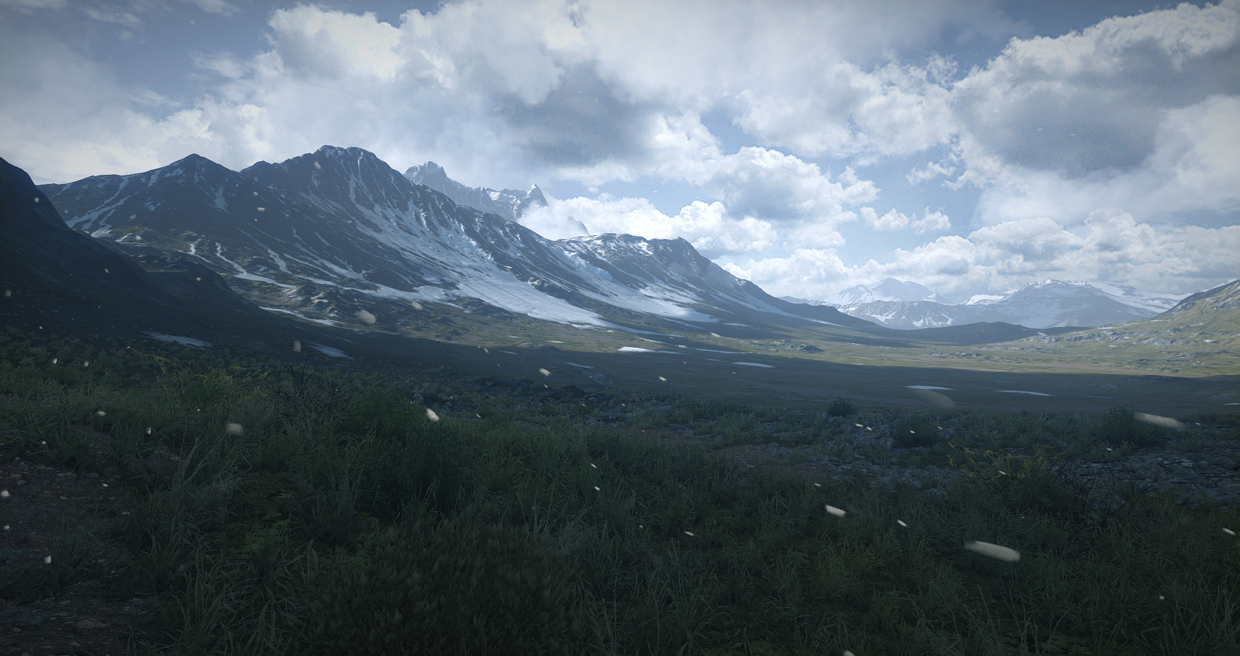
Terrain in Battlefield 3:
A modern, complete and scalable system
Mattias Widmark
Software Engineer, EA Digital Illusions (DICE), Stockholm

Slide 2
Overview
Scalability – hierarchies, payloads and limitations
Workflows – realtime in-game editing
CPU and GPU performance
Procedural virtual texturing – powerful GPU optimization
Data streaming – minimizing memory footprint
Robustness – global prioritization
Procedural mesh generation
Conclusions

Slide 3
But first...
... what are we talking about?
Frostbite terrain has many aspects other than the terrain mesh itself
  Let’s look at them!

Slide 4
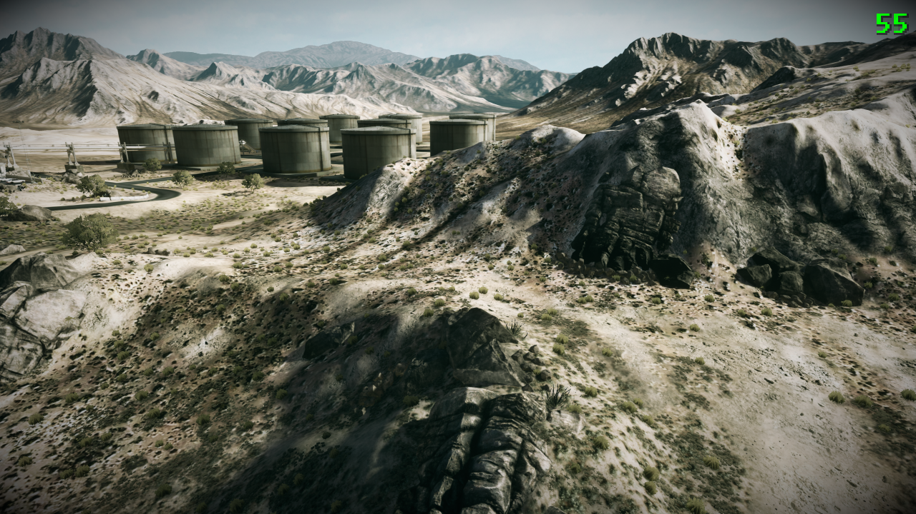
Heightfield-based
Mesh procedurally generated at runtime

Slide 5
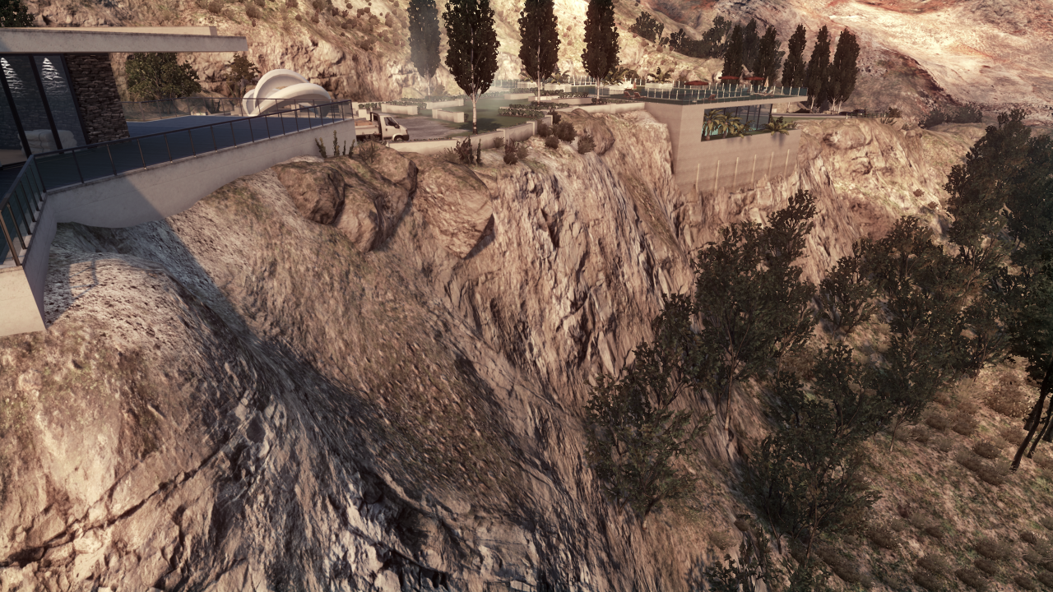
Surface rendering with procedual shader splatting
  Arbitrary shaders splatted according to painted masks

Slide 6
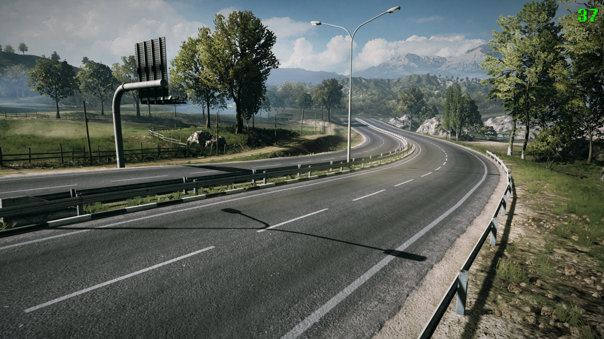
Spline and quad decals

Slide 7
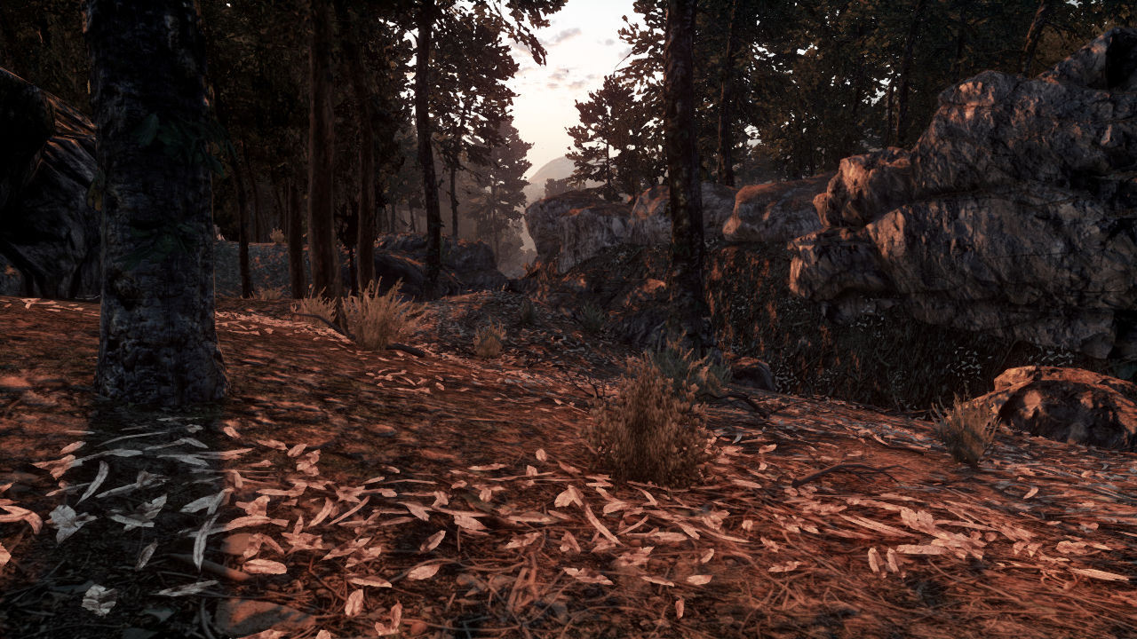
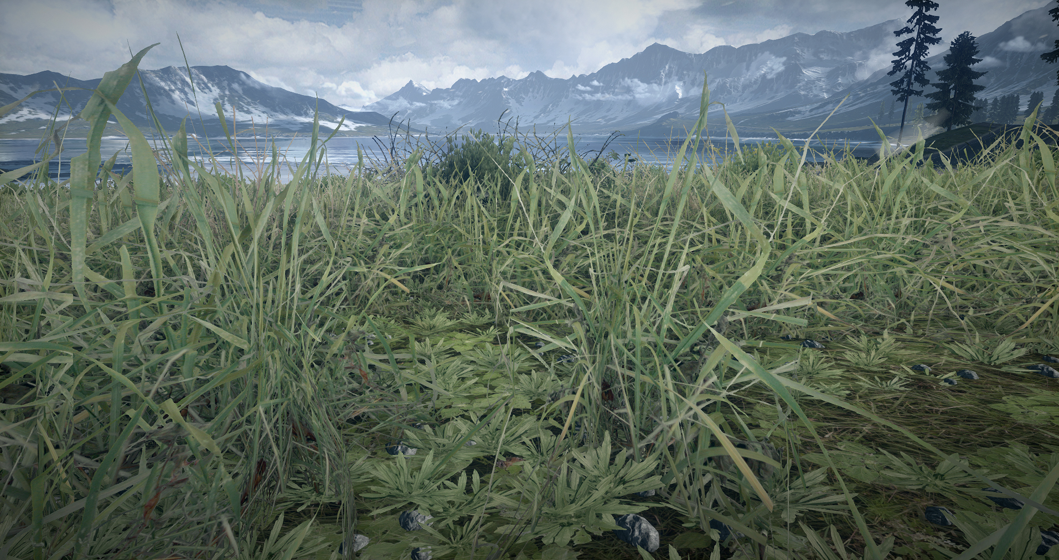
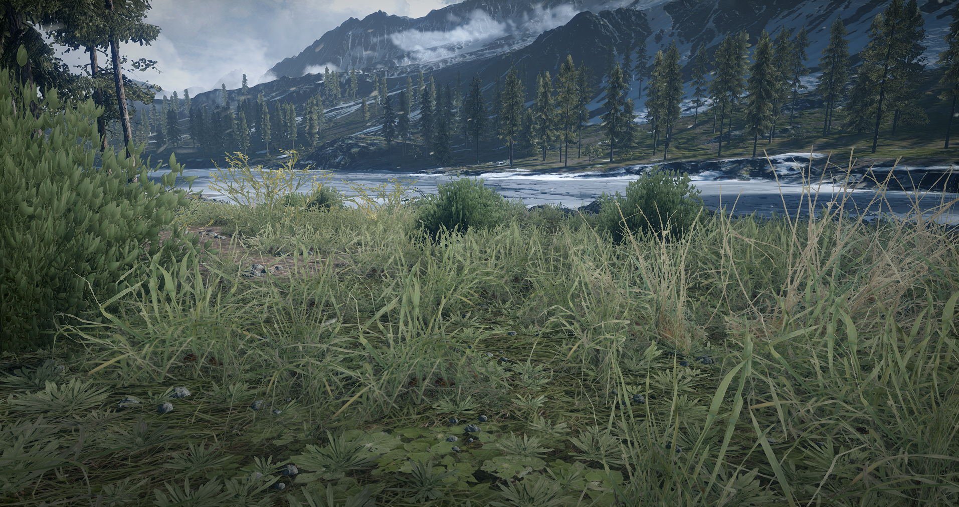
Terrain decoration
  Automatic distribution of meshes (trees, rocks, grass) according to mask
  Billboards supported

Slide 8
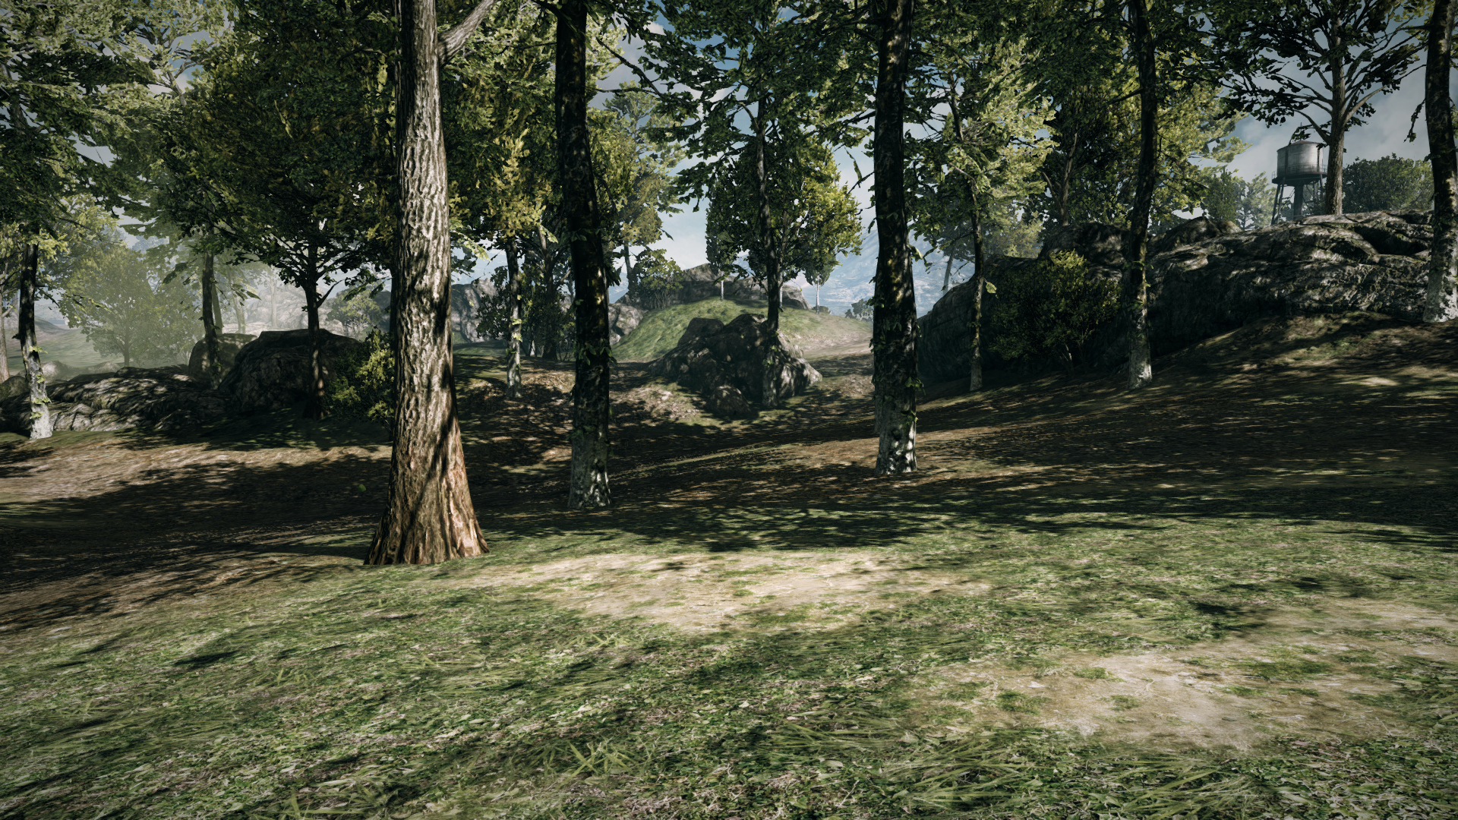
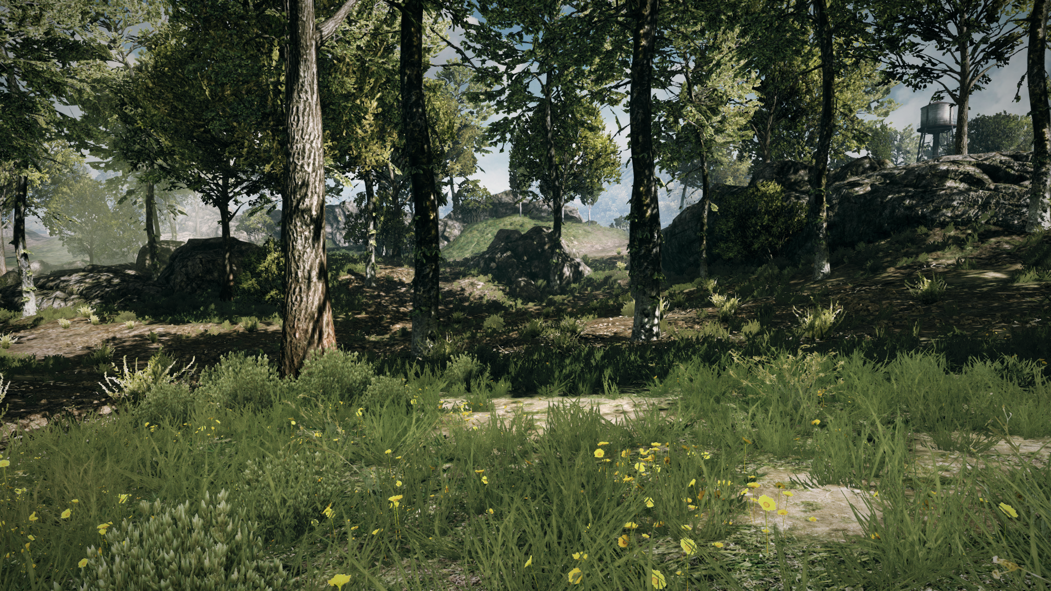
§
Terrain decoration
  Important as the terrain surface itself

Slide 9
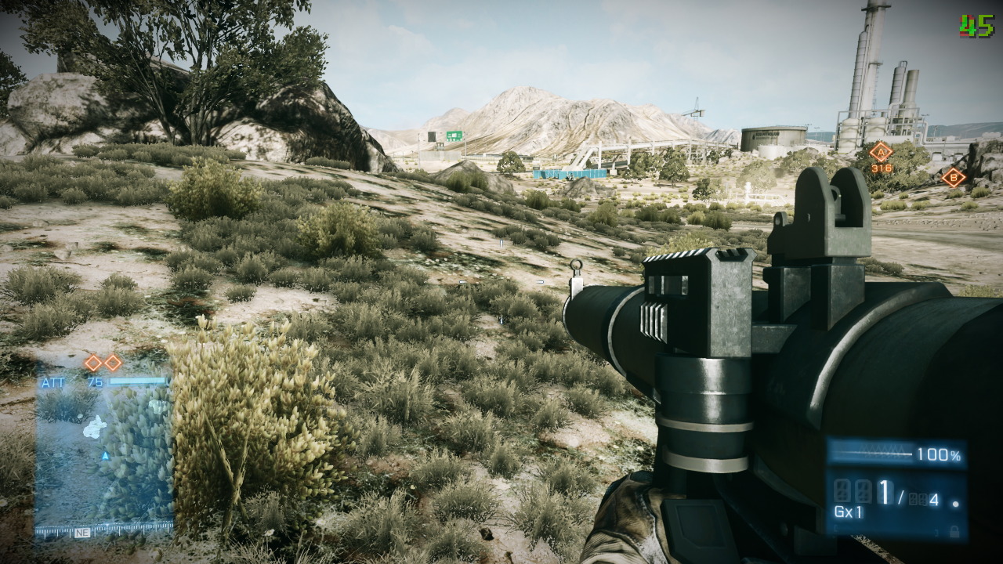
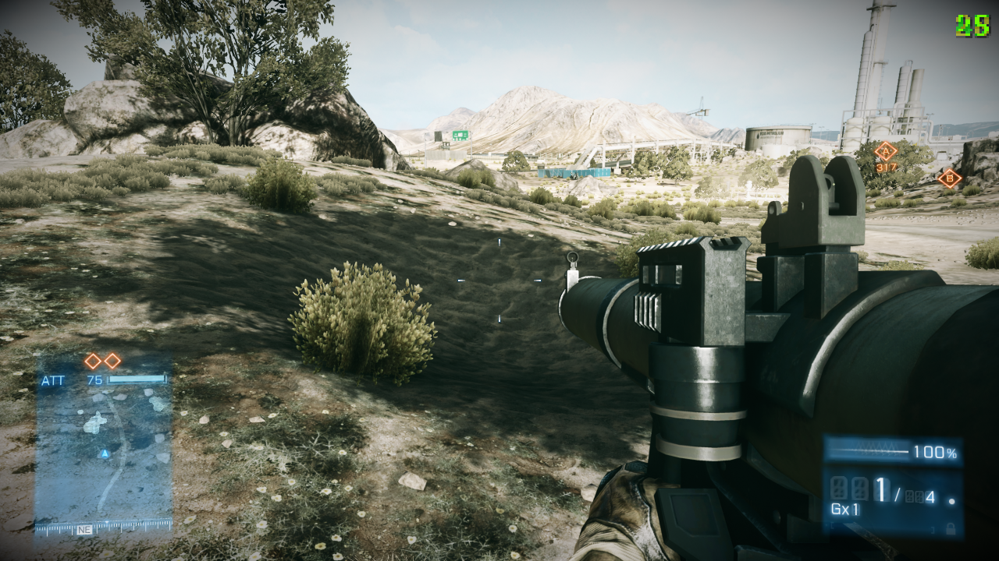
Destruction/dynamic terrain
  Destruction depth map
    Controls crater depth around ie static models
  Physics material map
    Controls surface effects, audio, crater depth and width

Slide 10
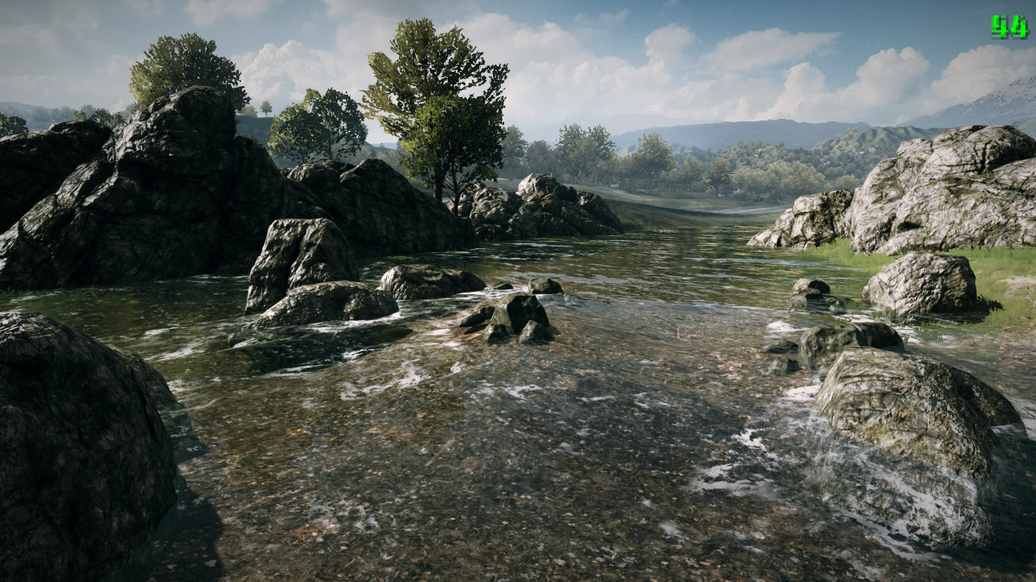
Rivers/lakes
  Implemented as free-floating decals
  Water depth in pixel shader

Slide 11
Terrain raster resources
Multiple raster resources used
  Heightfield
  Shader splatting masks
  Colormap, used as an overlay on top of shader splatting
  Physics materials
  Destruction depth mask
  Albedo map for bounce light
  Additional mask channels

Slide 12
Overview
Scalability – hierarchies, payloads and limitations
Workflows – realtime in-game editing
CPU and GPU performance
Procedural virtual texturing – powerful GPU optimization
Data streaming – minimizing memory footprint
Robustness – global prioritization
Procedural mesh generation
Conclusions

Slide 13
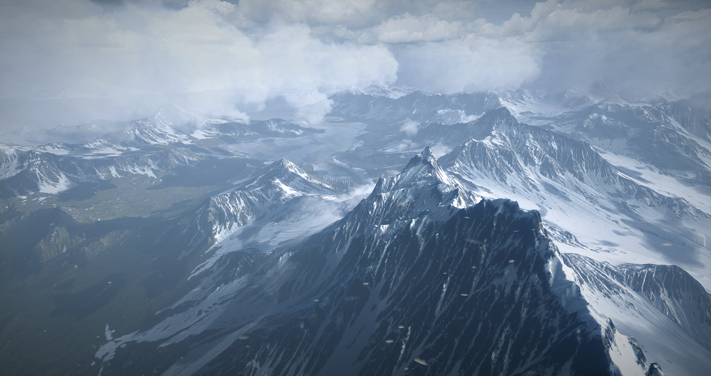
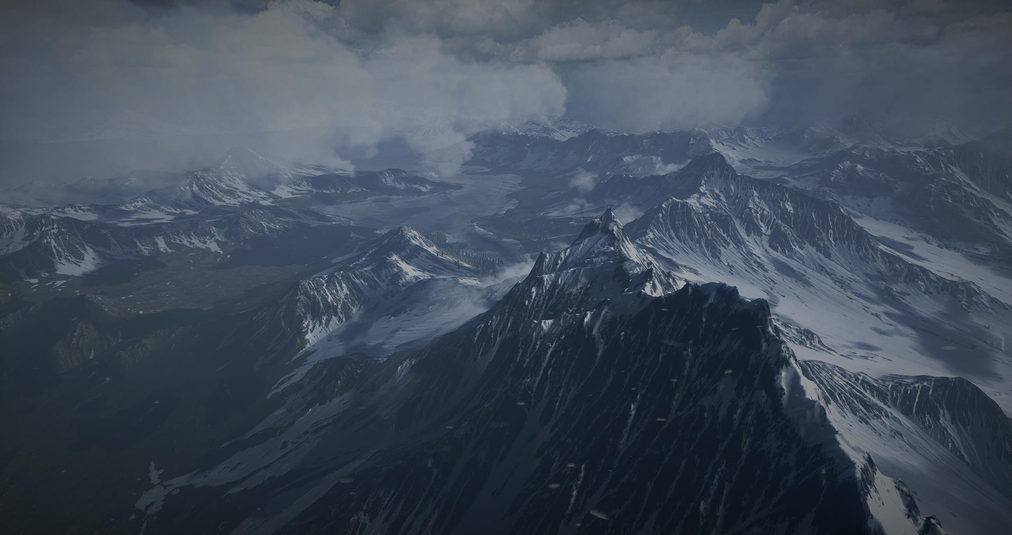
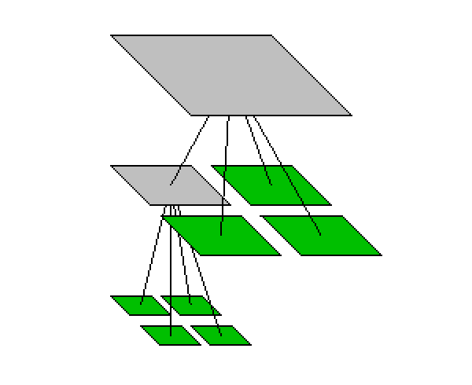
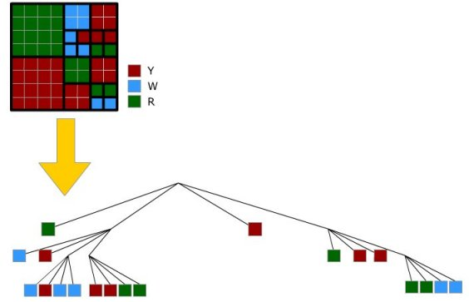
Scalability
Our definition of scalability
  Arbitrary view distance (0.06m to 30 000m)
  Arbitrary level of detail (0.0001m and lower)
  Arbitrary velocity (supercars and jets)
Main observation
  It is all about hierarchies!
  Consistent use of hierarchies gives scalability ”for free”
Hierarchies not new to terrain rendering
  Frostbite approach similar to flight simulators
Quadtree hierarchies used for all spatial representations
Assuming knowledge of quadtrees, we jump right into Frostbite specifics!

Slide 14
Quadtree node payload
The node payload is a central concept
A quadtree node can be attributed with a ”data blob”; the payload
Payload is
  a tile of raster data
  a cell of terrain decoration
    A list of instances (rock, grass, trees)
  a piece of decal mesh
All nodes have payload...
  ... but only a few have it loaded
Nodes (white circle)
Payload (red dot)

Slide 15
Nodes with and without payload
Payloads are constantly in motion
  They are loaded (streamed), generated or freed evey frame
  Only a fraction of the nodes have payload resident
Payload movement is governed by prioritization mechanisms...
  ... but more of that later

Slide 16
LOD payload
Non-leaf nodes have payload too
These payloads are used as LODs
Detail level depends on payload depth
  Nodes closer to root represent lower detail
Payload (red dot)
LOD payload (orange dot)
Increasing LOD

Slide 17
View-dependent payload usage
Set of payloads (green dots) used for a certain observer position
  Note area to the left is distant and use lower LOD
Observer moves and another set is used
  Area to the left now use higher LOD
Observer
Observer

Slide 18
Motivation for LOD payloads
With LOD
  cost (payload count) is mostly independent of terrain size
  Scalable!
Without LOD
  cost depend on terrain size
  Not scalable!

Slide 19
Generation of raster LOD payload
Source data and workflows on leaf level
LODs generated automatically by pipeline
Requirements
  Tile overlap (borders) for rendering algorithms
  Continuity
Recursive (reverse) depth first algorithm
  Green LOD tile is generated
  Four children (red) and up to 12 neighbor tiles
  (blue) are used

Slide 20
Terrain decoration payloads
Terrain decoration payload
  Is a list of instance transforms (for grass, trees, rocks)
  Is generated at runtime according to
    scattering rules
    shader splatted masks (position/density)
      Note that we allow shaders to modify masks!
    heightfield (ground-clamping and orientation)

Slide 21
Terrain decoration LOD payloads
Quite unique (and slightly confusing) concept
LOD payloads used for scalability
  Near-root payloads provide high view distance
  Near-leaf payloads provide high density
Payloads can overlap
  Providing high view distance and density

Slide 22
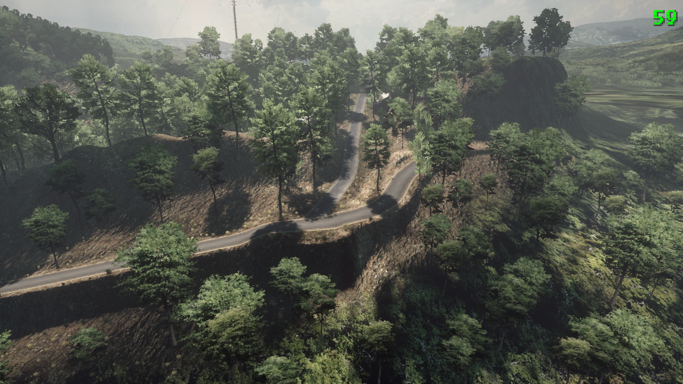
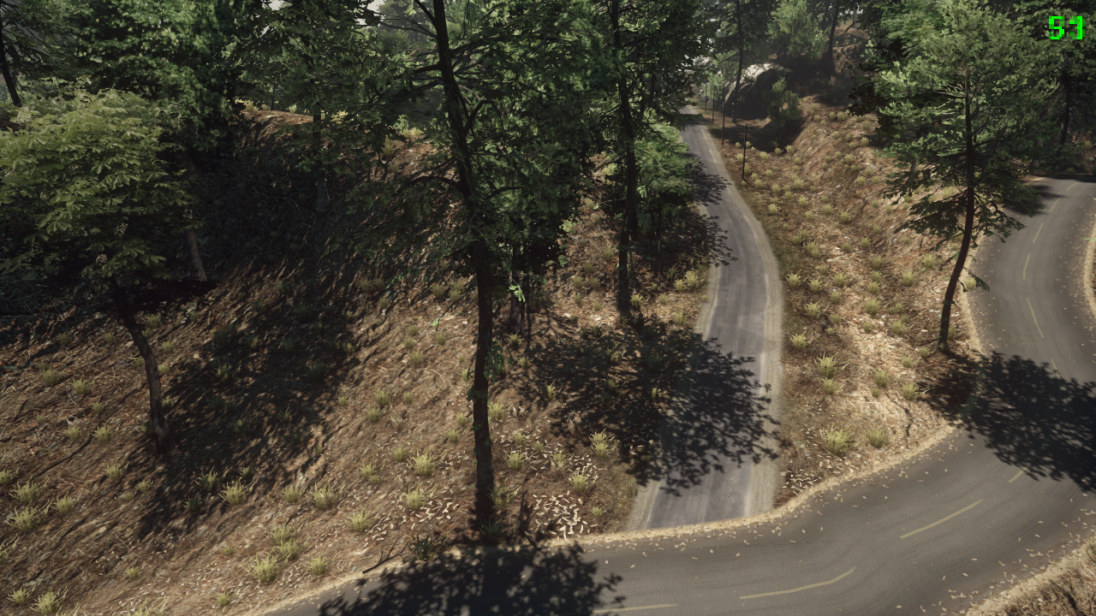
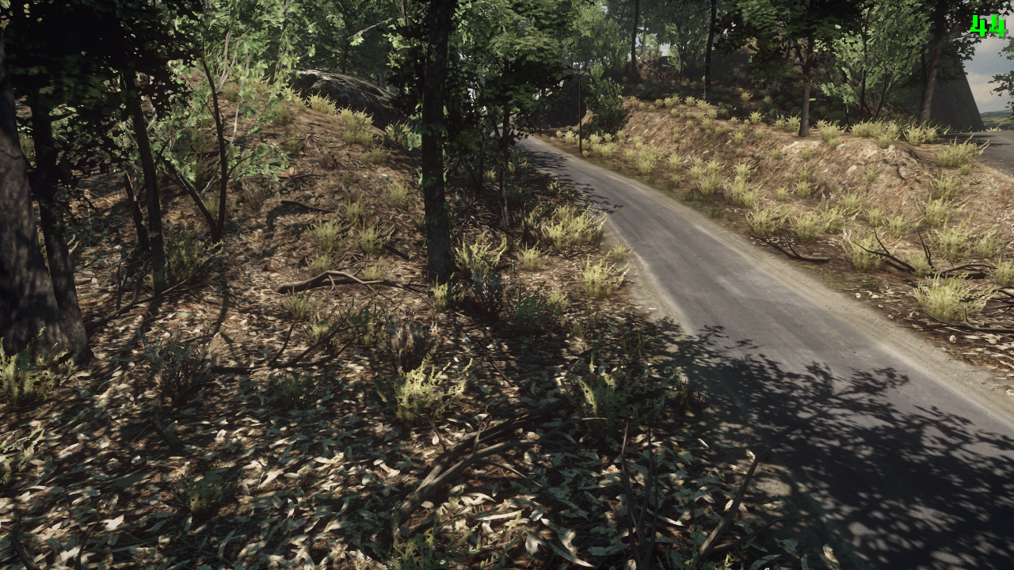
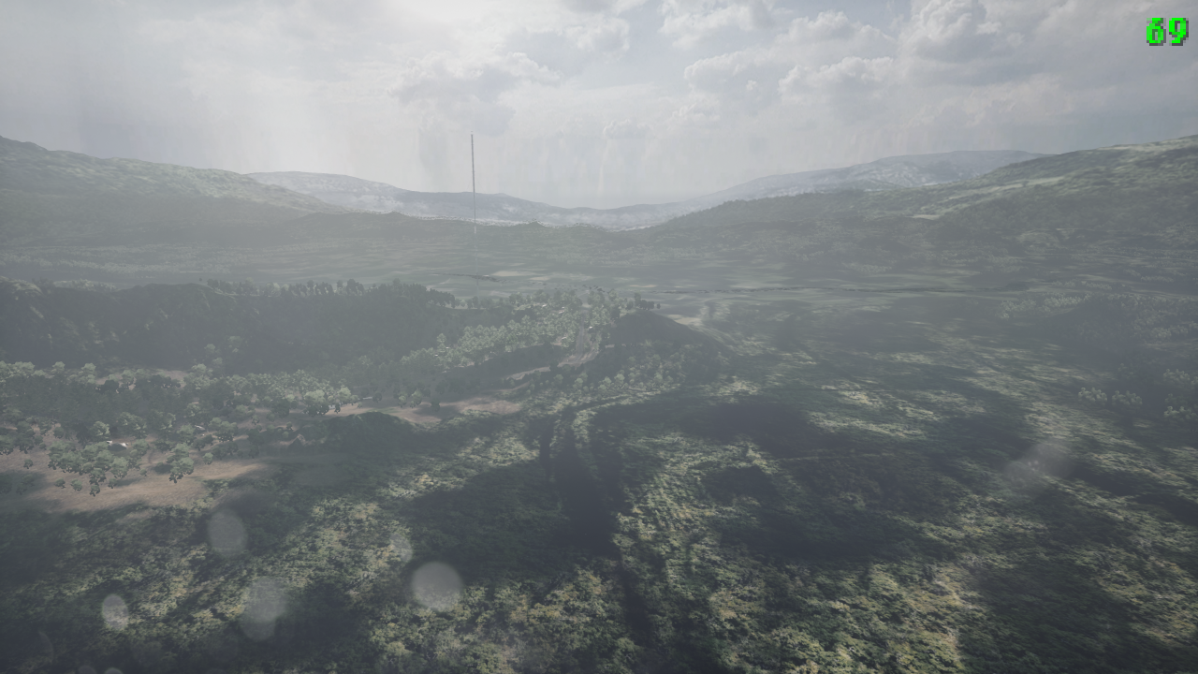
<screenshot from Frosted w/ game view>
High distance low density trees
Payload at level N
Medium distance medium density trees
Payload at level N+1
Adds to payload at level N for increased density
Lower distance bushes
Payload at level N+2
More leaves added (level N+4)
and branches
Trees
Bushes
Leaves
Level N+3

Slide 23
Overview
Scalability – hierarchies, payloads and limitations
Workflows – realtime in-game editing
CPU and GPU performance
Procedural virtual texturing – powerful GPU optimization
Data streaming – minimizing memory footprint
Robustness – global prioritization
Procedural mesh generation
Conclusions

Slide 24
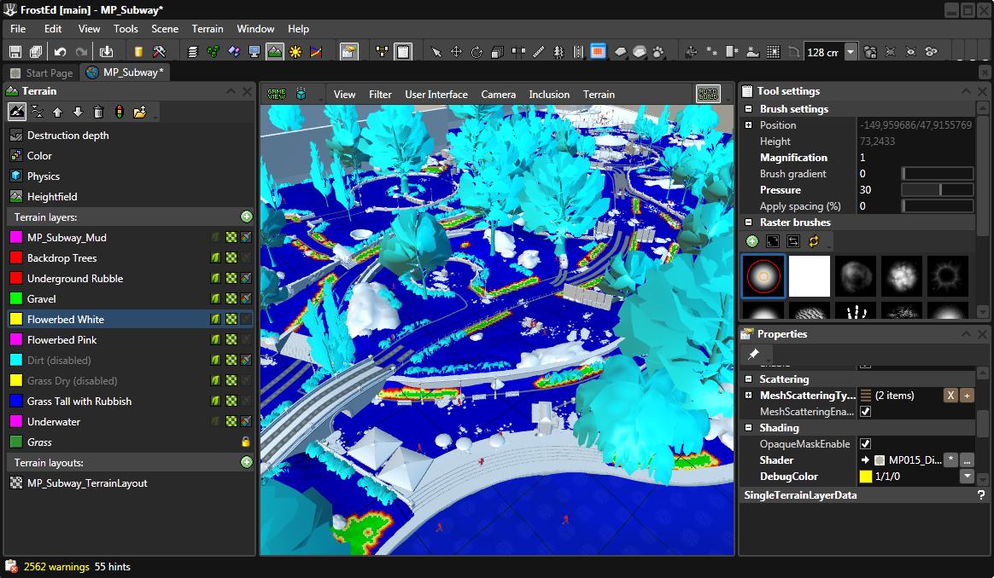
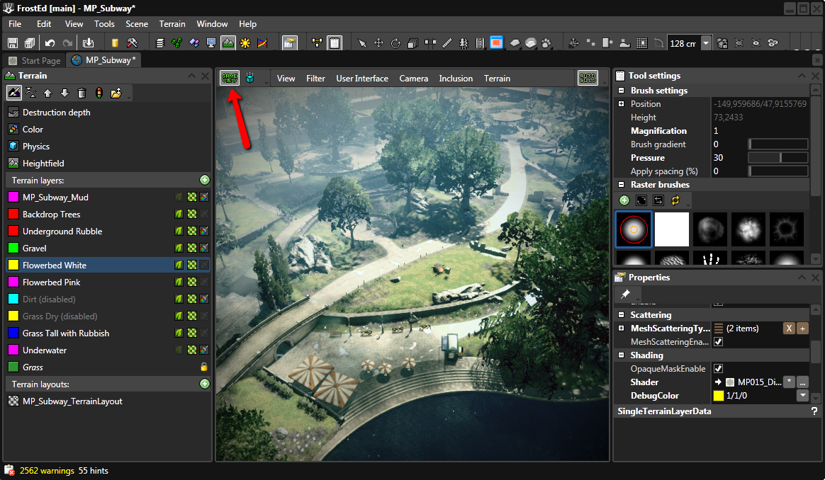
Real time editing in FrostEd
FrostEd is Frostbite editor
Game View is game rendering inside editor
Terrain editing with realtime feedback in game view
  Heightfield sculpting
  Mask and color painting
  Decal editing
  Terrain decoration

Slide 25
External tools
When tools are not enough terrain can be exported and imported
  Select all or part of terrain
  Metadata + raw file
  Edit raw file and reimport
    Metadata will import to right area
  Puts WorldMachine, GeoControl in the loop
    A common workflow

Slide 26

Workflow issues
Conflict between data compression and realtime editing
Realtime editing bypass pipeline
Clever update scheme for procedural content needed
  We already had one (destruction)
Frostbite terrains too large for some popular tools
  GeoControl and WorldMachine do not like 8k+ rasters

Slide 27
Overview
Scalability – hierarchies, payloads and limitations
Workflows – realtime in-game editing
CPU and GPU performance
Procedural virtual texturing – powerful GPU optimization
Data streaming – minimizing memory footprint
Robustness – global prioritization
Procedural mesh generation
Conclusions

Slide 28
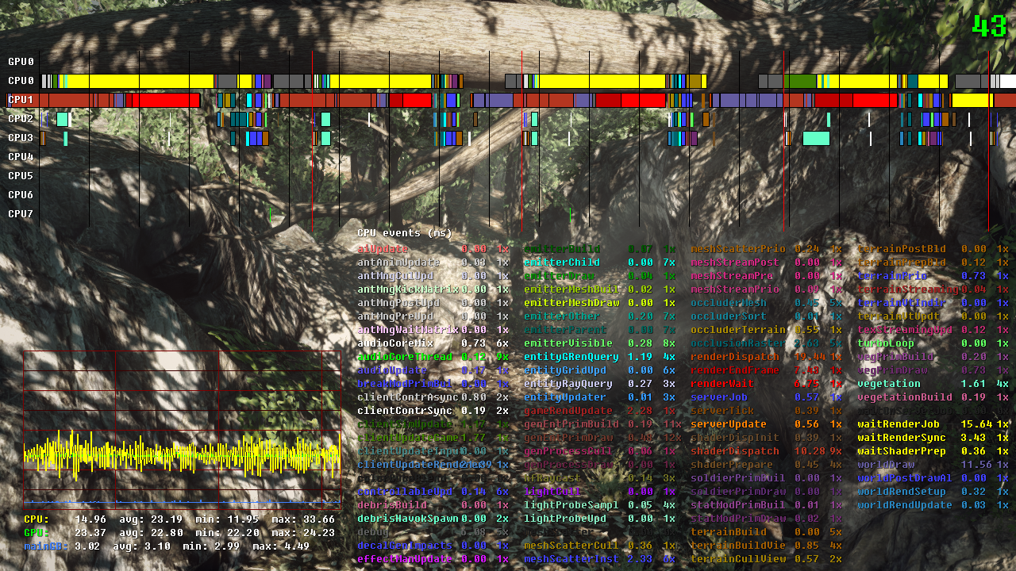
Efficient on CPU
All work done in jobs, most on SPU and many wide
  Early unoptimized versions consumed 10ms+ PPU time
    BF3 final measurements (PS3)
      1-2ms SPU (peaks at ~8ms when lots of terrain decoration is happening)
      <1ms PPU

Slide 29
Efficient on GPU
Pre-baked shader permutations to avoid multi-pass
Procedual virtual texturing exploit frame-to-frame coherency
Typical figures (PS3):
  Full screen GBuffer laydown (w/o detail overlay and terrain decoration): 2.5-3ms
  Full screen GBuffer laydown (w/ detail overlay): 2.5-7ms
  Terrain decoration: 1-4ms
  Virtual texture tile compositing: 0.2-0.5ms

Slide 30
Overview
Scalability – hierarchies, payloads and limitations
Workflows – realtime in-game editing
CPU and GPU performance
Procedural virtual texturing – powerful GPU optimization
Data streaming – minimizing memory footprint
Robustness – global prioritization
Procedural mesh generation
Conclusions

Slide 31
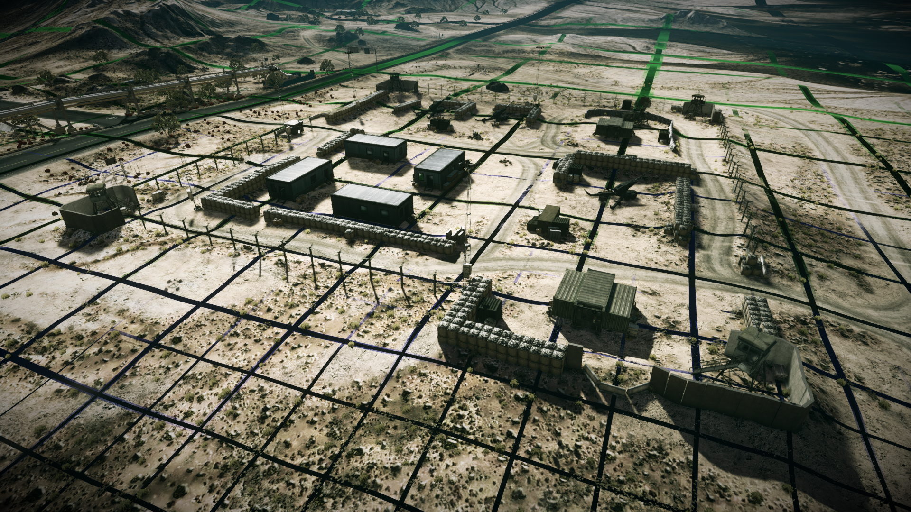
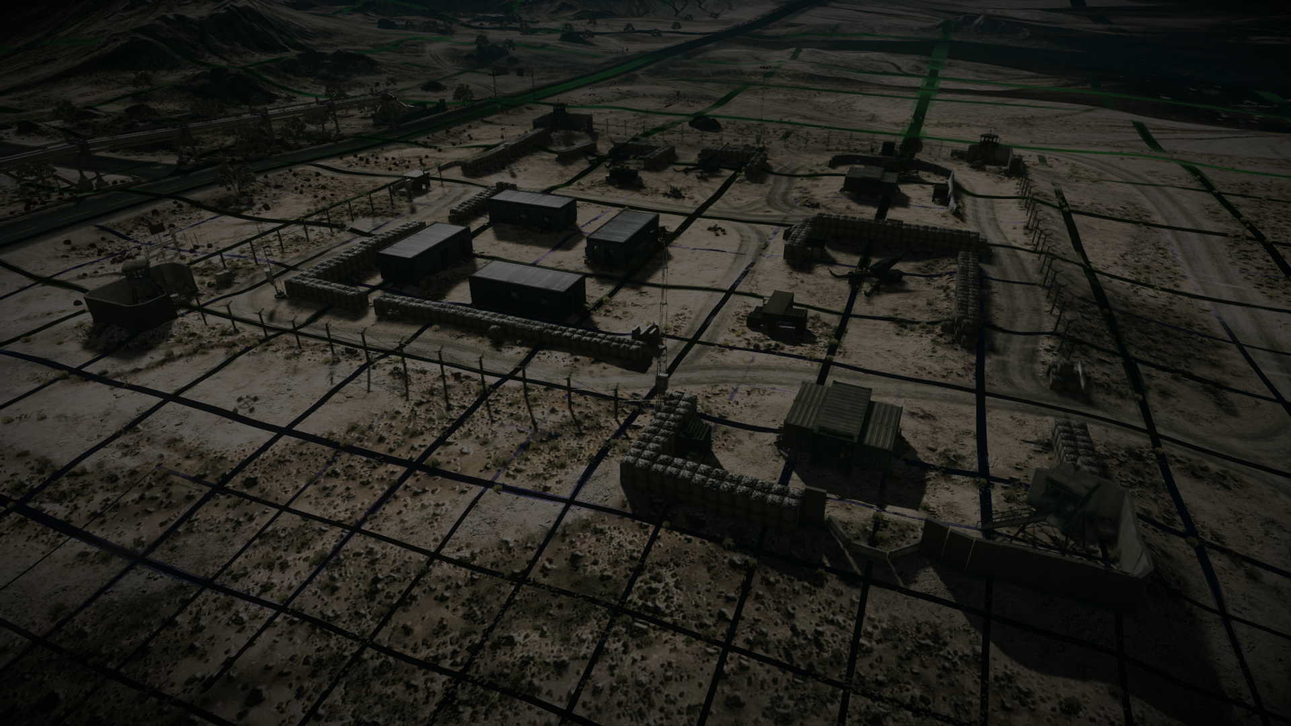
GPU optimization: Procedural virtual texturing
Motivations
  With shader splatting, artists can create beautiful terrains…
    … rendering very slowly (10-20ms)
  Shader splatting not scalable in view distance
    Cannot afford multi-pass
By splatting into a texture
  we leverage frame-to-frame coherency (performance)
  can render in multiple passes (scalability)
Rendering full screen using the texture cost 2.5-3ms (PS3)

Slide 32
Virtual texture key values
32 samples per meter
256x256 tiles with integrated two pixel border
Atlas storage with default size 4k x 2k
Two DXT5 textures
Very large, can easily reach 1M x 1M (= 1Tpixel)!
  Typical virtual textures are 64k x 64k
R | G | B | A | R | G | B | A
Diffuse R | Diffuse G | Diffuse B | Normal X | Smoothness/ Destruction | Normal Y | Specular | Normal Z

Slide 33
Indirection texture format
RGBA8
Indices into virtual texture
tile atlas
Scale factor for low-res areas...
  ... where a tile covers more than one indirection sample
CLOD fade factor
  Used to smoothly fade in a newly composited tile (fade-to tile)
  Previous LOD (fade-from tile) is already in atlas and fetched using indirection mips
  CLOD factor updated each frame
R | G | B | A
Index X | Index Y | Scale | CLOD fade

Slide 34
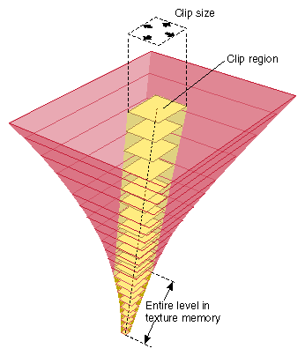
The ”Teratexture”
How do we reach 1M x 1M?
  Indirection texture can easily go 4k x 4k
    Way too large!
Clipmap indirection texture
  Clipmap – early virtual texture implementation
  Replace 4k indirection texture with 6 64x64 clipmap layers

Slide 35
Clipmap indirection
Clipmap level is resolved on CPU for each draw call
  Avoids additional pixel shader logic
  Requires each 64x64 map to have its own mip chain
Texture space has to be roughly organized with world space
  Not an issue for terrain
  More generic use cases are probably better off with multiple classic virtual textures

Slide 36
Tile compositing
Tiles are composited on GPU and compressed on GPU or SPU
Benefits (compared to streaming from disc)
  Small disc footprint – data magnification
    Source raster data magnified ~1000x
  Low latency
    Tile is ready to use next frame
  Dynamic updates
    Destruction
    Realtime editing
  Efficient workflow
    Artists don’t have to paint hundreds of square kilometers down to every last pebble

Slide 37
Virtual texture issues
Blurriness (consoles have too small tile pool)
Runtime texture compression quality
GPU tile compositing cost offset some of the gain
  ~0.25ms/frame on Xenon
Limited hardware filtering support
  Expensive software and/or lower-quality filtering
Compositing latency
Tile compositing render target memory usage

Slide 38
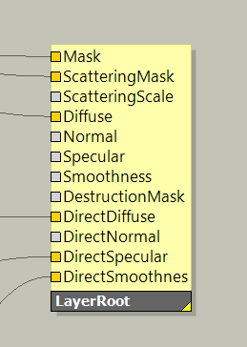
Virtual texture issues
Virtual texture has practical limit at around 32 samples per meter
  Detail shader splatting fills in to required sharpness (500-1000 samples per meter)
We now have two shader splatting methods
  Diffuse/Normal/Specular/Smoothness splats into virtual texture
  Direct* splats details into Gbuffer
Performance concerns
  Have to limit detail view distance
  Typically 50m-100m
Notes:
BF3 use 32 samples per meter
Going above gives too low frame-to-frame coherency and often unacceptable latencies.

Slide 39
Virtual texture issues
Indirection update performance
  Updating indirection maps is expensive
    4-6 64x64 maps with mips
  Do in job (SPU)
  Update only dirty areas
    New tile
    CLOD fade factor
    Recentering when clipmap region moves
  Wraparound
    Only edges affected on
    recentering (bottom image)
Observer
Clipmap
Updated
clipmap
area

Slide 40
Overview
Scalability – hierarchies, payloads and limitations
Workflows – realtime in-game editing
CPU and GPU performance
Procedural virtual texturing – powerful GPU optimization
Data streaming – minimizing memory footprint
Robustness – global prioritization
Procedural mesh generation
Conclusions

Slide 41
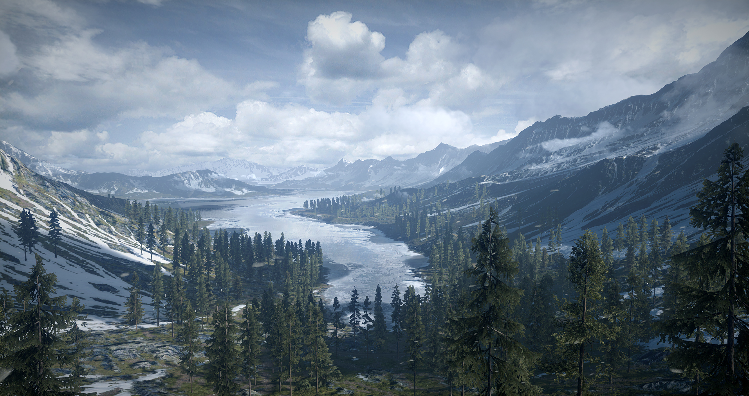
Data streaming
Frostbite 1 did not stream terrain
Streaming required for larger Battlefield 3 and NFS: The Run levels

Slide 42
Streaming basics
Streaming unit: Raster tiles (aka node payloads)
  Typical tile sizes
    Heightfield: 133x133x2 bytes
    Mask: 66x66x1 bytes x 0-50 tiles per payload
    Color: 264x264x0.5 bytes
Fixed-size tile pools (atlases)
  Typical atlas sizes
    Heightfield: 2048x2048
    Mask: 2048x1024
    Color: 2048x2048

Slide 43
Streaming modes
Tile-by-tile (aka free) streaming
  For slower gameplay
Tile bundle (aka push-based) streaming
  For faster games
  Tiles associated with a layout are bundled
  Based on terrain resolution layouts
Hybrid streaming (most common)
  Bundles used at selected spawn points and transitions
  Free streaming fill in the rest

Slide 44
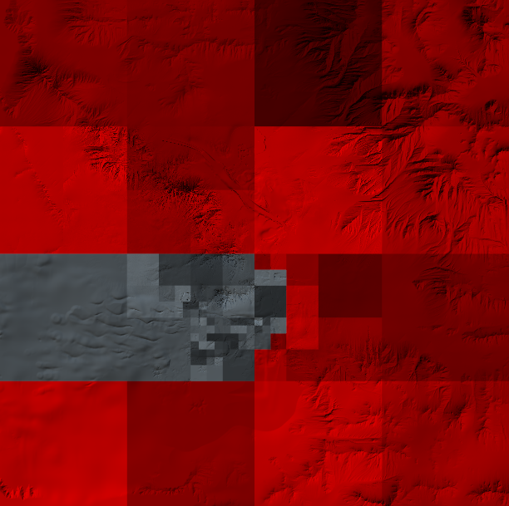
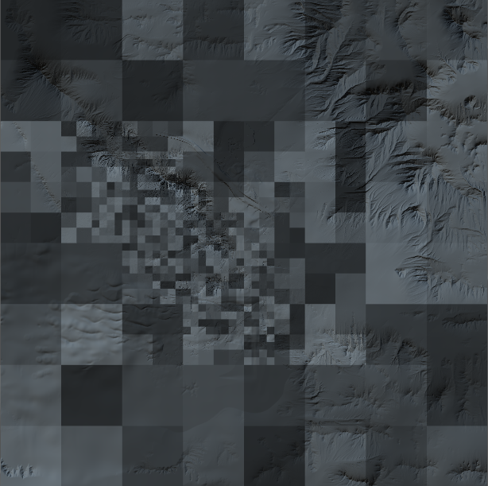
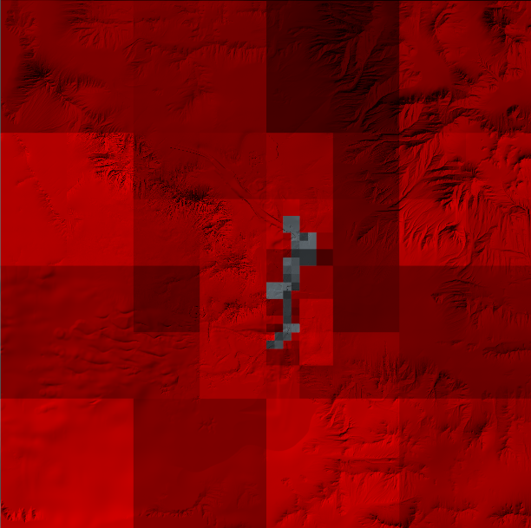
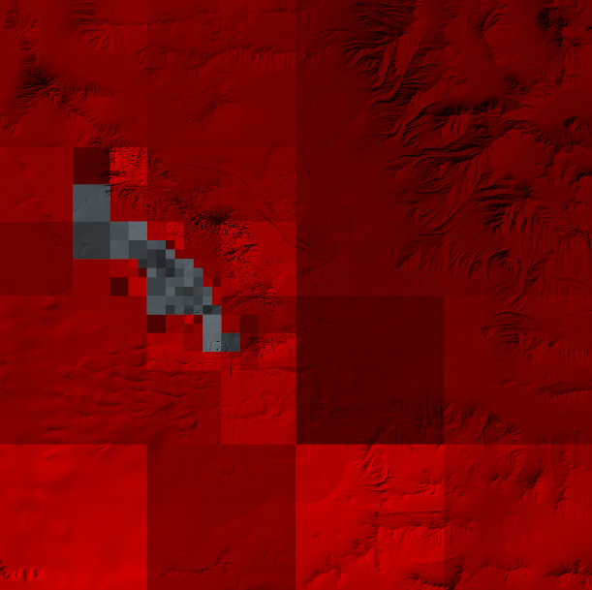
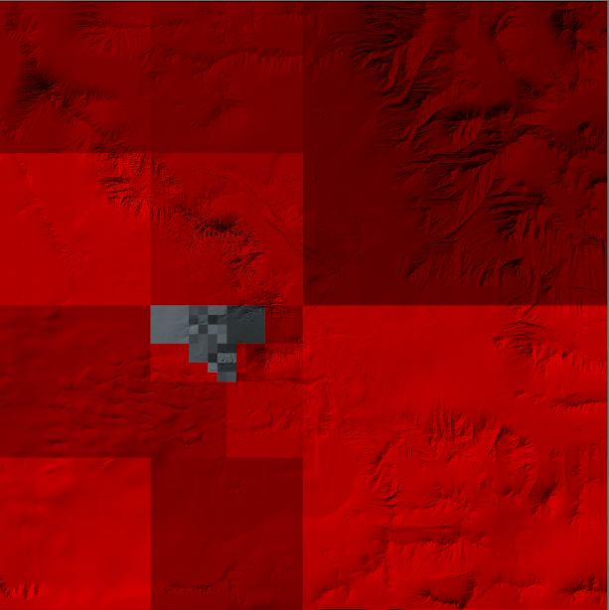
Spawn point
Layout of all data on level
Data subset loaded at spawn point
A Terrain resolution layout defines the subset
Subsets loaded (and unloaded) as user progresses
through level

Slide 45
Resident set size: Powerful blurriness
Streaming does not remove memory footprint
  A resident set is still needed
Resident set can be huge
  Theoretical value for BF3 level on PS3: 70+Mb!
Blurriness feature shrinks resident set significantly
  Increase blurriness by one and save around 70%
  Very important memory saver for BF3
  Shipped with 32Mb terrain resident set

Slide 46
Blurriness
Blurriness is mip bias applied to terrain raster streaming
  Blurriness = 0:
    Streaming continues until raster is sharp
  Blurriness = 1:
    Streaming stops when raster is slightly blurry (texel covers 2x2 pixels)
  Blurriness = 2:
    Streaming stops when raster is significantly blurry (texel covers 4x4 pixels)

Slide 47
Blurriness: Implementation by pipeline trick
For each level of blurriness
  cut tile size in half
  add one leaf level
No data is lost – it is only shifted downwards
Blurriness 0
256x256-sized tiles
8 resident tiles (500kpixel)
13 nodes
Blurriness 1
128x128-sized tiles
14 nodes added
10 resident tiles (164kpixel, saves 68%)
27 nodes

Slide 48
BF3 blurriness use case
Blur expensive rasters
  Heightfield (2 bytes per sample)
  Mask (1 byte per sample)
Keep cheap rasters
  Colormap (DXT1, 0.5byte per sample)
Put detail (for example occlusion) in colormap to hide blurry heightfield/normal map

Slide 49
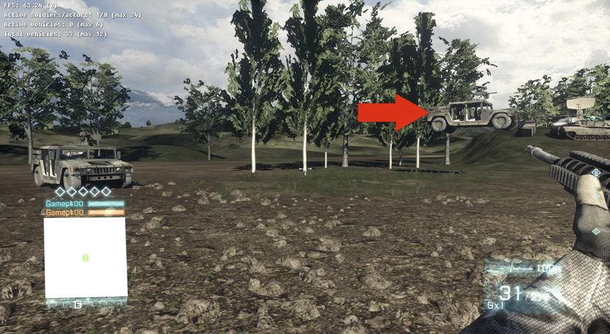
Physics
  Wrong streaming setup gives strange artifacts
    Vehicles spawning in air or in ground
    Invisible and disappearing walls and holes

Slide 50
Reducing disc seeks
Often main reason for latency
  Can seek maybe four files per second
  A terrain can have hundreds of files (tiles/payloads)
Methods to reduce the number of seeks
  Use terrain resolution layouts at spawn
    Otherwise minutes can pass before stabilization (waiting for file seeks)!
  Co-locate overlapping tiles of different types
    Store heightfield tile together with color and mask tiles

Slide 51
Reducing disc seeks
Methods to reduce the number of seeks (cont’d)
  Co-locate nearby tiles
    Group leaf node payloads as second LOD in ancestor node
    Saves 20-50% seeks in typical scenario
Full dataset require 13 seeks
Leaf nodes subject for move in red
Second LOD stored in parent nodes
Full dataset is now 10 seeks

Slide 52
Improving throughput
Data tiles are compressed by pipeline
  Color tiles are optionally DXT1-compressed
  Mask compression
    Source tiles (256x256) are chopped up into smaller pieces (66x66)
    Empty tile culling
    Identical (constant value) tile merging
  Physics materials and destruction depth are packed to four bits and RLE-compressed
  All tiles are z-compressed

Slide 53
Improving throughput
  A quadtree node has zero or four children
Incomplete quadtree
  We allow zero through four payload children
  Reduces bundle size by some 20%+
Complete quadtree with 32 tiles at red LOD
Incomplete quadtree with only 20 tiles. Incompleteness saves 12 tiles (37%)

Slide 54
Latency under the rug
Even with mentioned improvements, streaming is not instant
General ways of hiding latency
  CLOD to smooth most streaming LOD transitions
  Global prioritization helps distribute punishment

Slide 55
Overview
Scalability – hierarchies, payloads and limitations
Workflows – realtime in-game editing
CPU and GPU performance
Procedural virtual texturing – powerful GPU optimization
Data streaming – minimizing memory footprint
Robustness – global prioritization
Procedural mesh generation
Conclusions

Slide 56
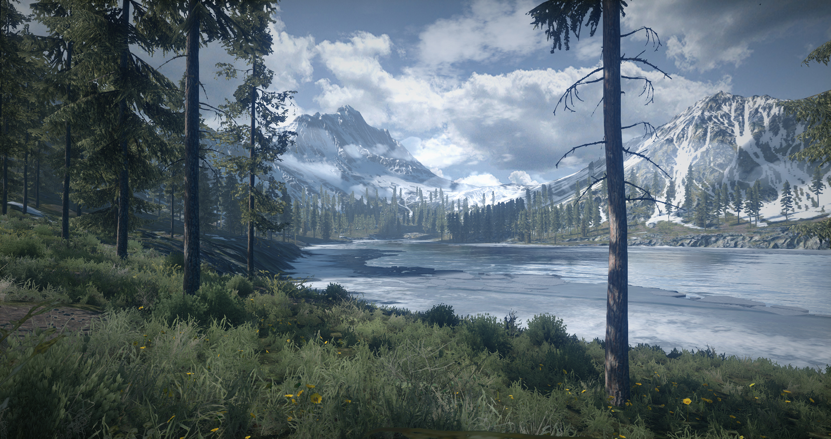
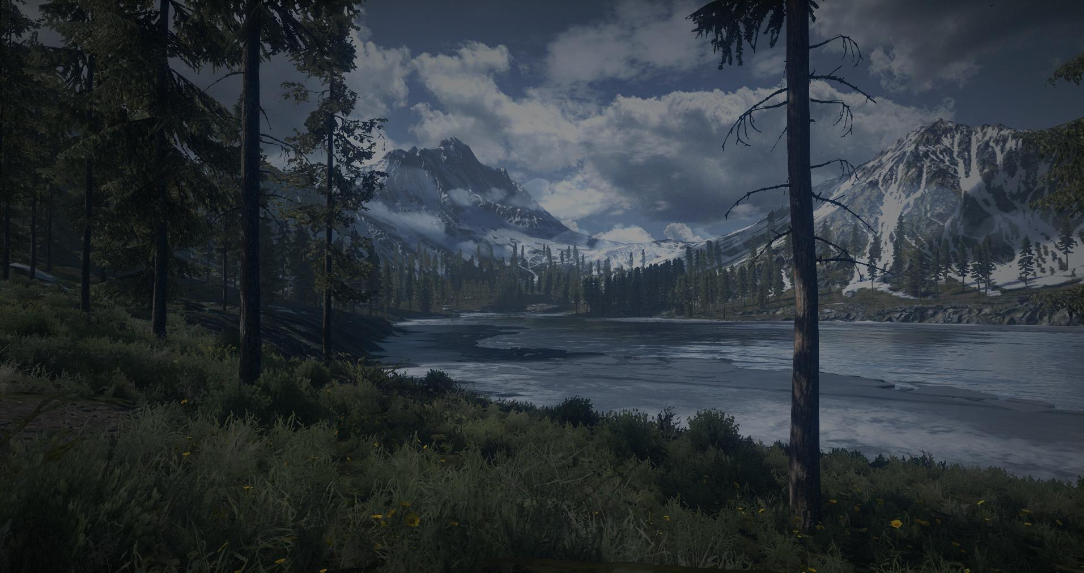
Global prioritization
Compute priority for each frame and each quadtree node
Update streaming, virtual texturing and terrain decoration
  According to priority
Priority value
  1.0: On target
    One pixel per texel
    Terrain decoration at specified view distance
  < 1.0: Node doesn’t need payload
  > 1.0: Node need payload

Slide 57
Priority depends on distance and size
Closer nodes have higher priority
Larger nodes have higher priority
Observer
Priority
Red > 1
Green = 1
Blue < 1

Slide 58

Priority modified by culling, updates and speed
Normal node
Node in motion
Occluder
Node being updated (crater added)
Observer
Occluded node
Priority
Red > 1
Green = 1
Blue < 1
Node outside frustum

Slide 59
Prioritized update algorithm
Pool size (keep pool full)
Low prio
High prio
Frame 0:
Steady state
Nodes
Frame 1:
Observer moved
Bidirectional
update
Look for payloads to release
Look for payloads to fetch
Frame 1:
Payload released
Frame 2:
New payload fetched

Slide 60
Prioritized update cost
Priority evaluation and sorting done on SPU
  <1ms
Update done on PPU
  <0.5ms

Slide 61
Overview
Scalability – hierarchies, payloads and limitations
Workflows – realtime in-game editing
CPU and GPU performance
Procedural virtual texturing – powerful GPU optimization
Data streaming – minimizing memory footprint
Robustness – global prioritization
Procedural mesh generation
Conclusions

Slide 62
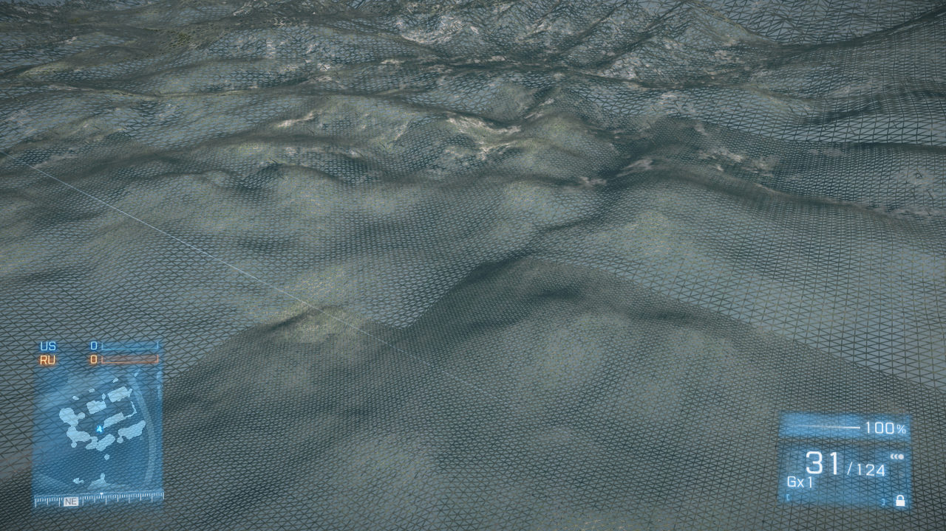
Mesh
Mesh generated from heightfield
  Straight-forward tessellation
  Rendered in patches of 16x16 triangle pairs
  Projected triangle size rougly constant - support destruction everywhere
  Blocky crestlines (on console)
PC, Xenon:
  Heightfield sampled in vertex shader
PS3:
  Vertex shader texture fetch is too slow
    Heightfield samples stored in vertex attribute
    Heightfield sampled in pixel shader

Slide 63
Mesh stitching
A job analyze mesh quadtree and detect LOD switch edges
Edges are stitched by index permutations
  Vertices are unchanged
No stitch
Stitch left
Stitch left and bottom

Slide 64
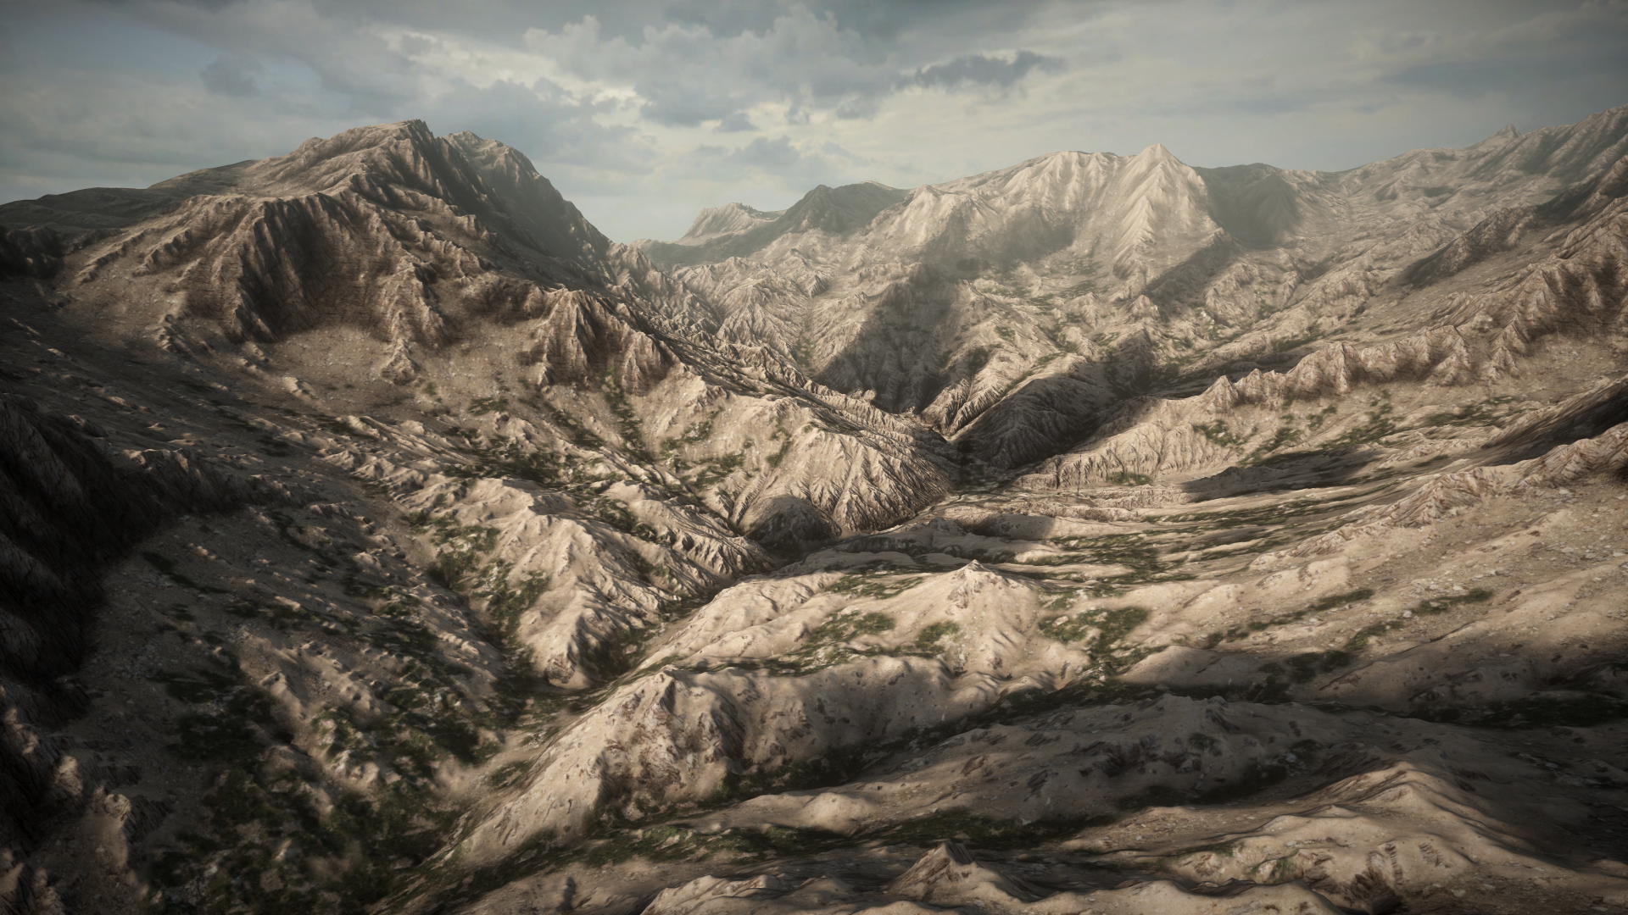
DX11 tessellation
Displacement mapping from heightfield
  No additional memory needs (heightfield used as normal map)
Straightforward hull and domain shaders
Tessellation factor derived from projected patch edge bounding sphere
  Tries to maintain a constant screen-space triangle width

Slide 65
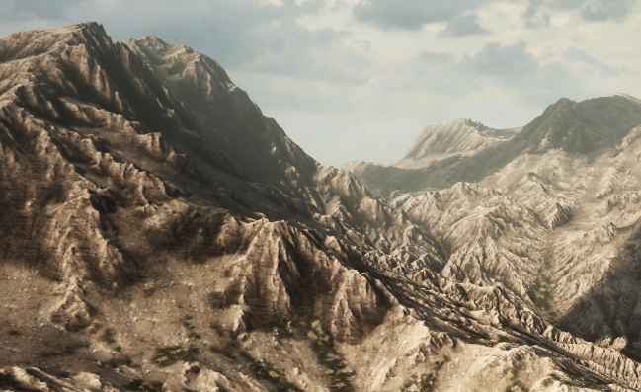
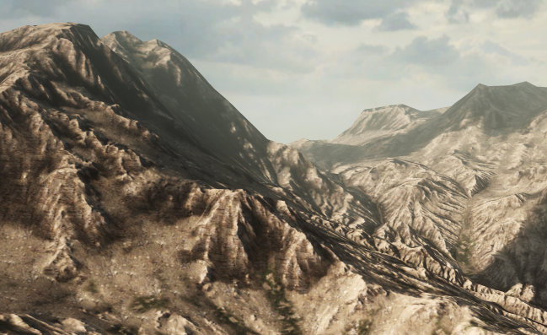
Displacement mapping ON
Displacement mapping OFF

Slide 66
Overview
Scalability – hierarchies, payloads and limitations
Workflows – realtime in-game editing
CPU and GPU performance
Procedural virtual texturing – powerful GPU optimization
Data streaming – minimizing memory footprint
Robustness – global prioritization
Procedural mesh generation
Conclusions

Slide 67
Conclusions
Frostbite 2 has a robust and competent terrain system
  Heightfield, shading, decals, water, terrain decoration
Most aspects scale well
  View distance, data resolution, decoration density and distance
Slick workflow
  In-game editing
  Good range of tools
Good performance (CPU, GPU, memory)
  Parallelized, streaming, procedural virtual texture

Slide 68
Special thanks
The Frostbite team
Black Box
  Andy Routledge
  Cody Ritchie
  Brad Gour
Criterion
  Tad Swift
  Matthew Jones
  Richard Parr
Dice
  Andrew Hamilton

Slide 69
Questions?
mattias.widmark@dice.se
EA Digital Illusions (DICE)

