Slide 1
Scaling the Pipeline
Stefan Boberg
Technical Director, Frostbite
@bionicbeagle
@FrostbiteEngine

Slide 2
Frostbite Engine
Started 2004 as common DICE engine initiative
Now in general use within EA Games label
~15 titles in development
Diverse genres!

Slide 3
Frostbite Engine – FPS

Slide 4
Frostbite Engine – Racing

Slide 5
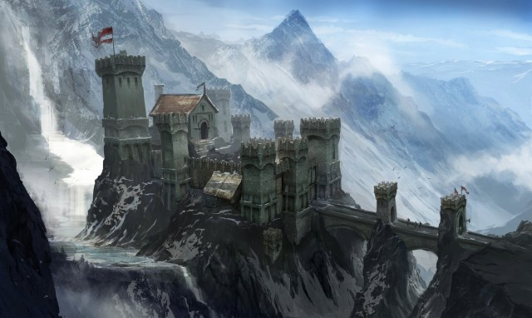
Frostbite Engine – RPG

Slide 6
Frostbite Engine – Action

Slide 7
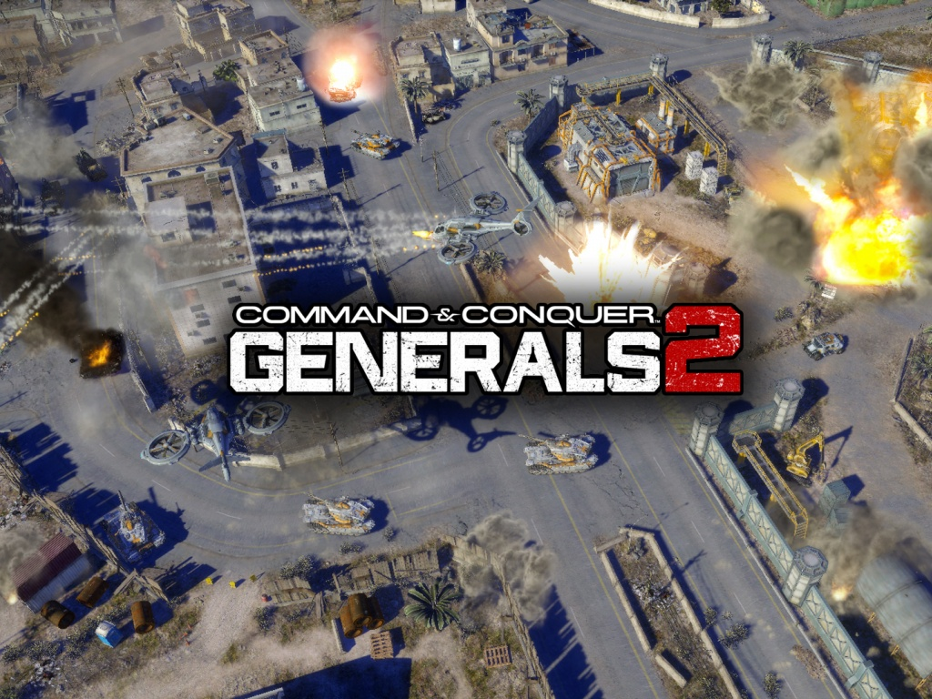
Frostbite Engine – RTS

Slide 8
Scale / Dimensions
Multi-site collaboration
Shanghai, Europe, North America
Large teams
400+ contributors in some cases
Multiple VCS branches
Many target platforms
PC, PS3, Xbox 360
Content rich games

Slide 9
Scale – Example (Battlefield 3)
Ballpark size
500GB raw DCC assets
80GB native Frostbite assets (’source data’), 100k files
~18GB target data (PC)
100,000 individual build steps (PC)
Current games in development are larger
Hello Bioware! ☺

Slide 10
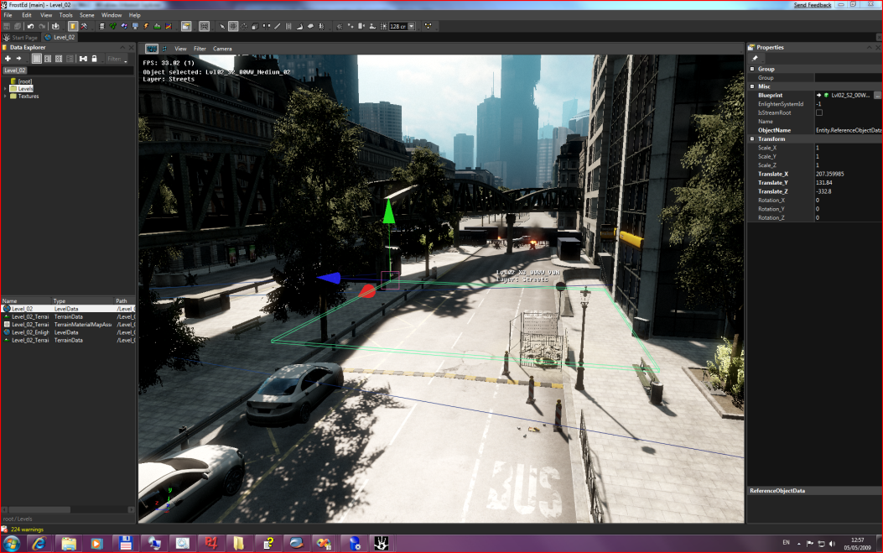
Frostbite Architecture
FrostEd
(.NET)
Structured Storage
Build-centric
Single asset loading path
Always preview on target
Asset hotswap support
Also, direct tweak path
Some explicit live editing code in Game
Let’s start looking at how the game handles assets and work our way ”backwards” through the pipe.
Game
Runtime
Celsius (asset db)
Avalanche (storage)
Blizzard (data build)

Slide 11
Asset Packaging Model
.SB
Bundle
Bundle
Bundle
Bundle
Chunk
Chunk
Chunk
Chunk
Chunk
Chunk
Chunk
Bundles
Linear stream of assets (usually)
Levels, sublevels (streaming)
Chunks
Free streaming data blobs
Texture mips, movies, meshes
Chunks are random access (pull)
Bundles are linear read only (push)
Superbundles are container files, storing bundles and chunks
Data inside is visible once superbundle is mounted
.SB
Chunk
Chunk
Chunk
Chunk
Chunk
Chunk
Chunk
Chunk
Chunk
Chunk
Chunk
Chunk
Chunk
Chunk
Chunk
Chunk
Chunk

Slide 12
Packaging
During development, layout is stored in Avalanche Storage Service
Stores full description of bundles and superbundles
Stored as packages with chunk references
Bundles are assembled on-the-fly when requested by game / tools (via HTTP)
Game does not know the difference between network and disk builds (single path)
Complete packaging logic is executed every build pass
Including iterative builds!
So must be very fast

Slide 13
Avalanche Storage Service
Core Frostbite component
Every developer runs an instance locally
Windows Service
RESTful HTTP interface
Via HTTP (server implemented using http.sys API)
http.sys can serve data directly (in kernel mode) from system page cache (zero copy)
Very scalable
... with significant optimizations for local access

Slide 14
Avalanche Storage Service
Target (i.e built) data storage
Chunk store
Build results and build dependency tracking information
Layout information (defines packaging)
Network cache / build cache
Peer-to-peer build distribution
Message bus
Tracing/diagnostics infrastructure
Production metrics infrastructure
... and more

Slide 15
Avalanche Storage Service – Chunk Store
“Branch” 2
Chunks
“Branch” 1
Content Addressable Storage
Key-value storage (immutable)
key = SHA1(value)
Basic deduplication
See: Venti, Git
Other services rely on this heavily
Build Store
Build Cache
Asset Database (Celsius)
Base primitive: ”Package”
JSON/BSON-like binary document format
Usually with attachments (stored as chunk references)
Asset1
Asset1
$.Asset1
$.Asset1
Asset1’
Asset1’

Slide 16
Asset Pipeline Goals
Time spent waiting for build = waste
Optimize bootstrap time (initial build)
Build throughput
Optimize feedback time (iterative builds)
Large games require extremely scalable solutions
Challenging!
And a bit of a thankless task… if people notice your work, it’s probably because you broke something, or it’s too slow! ☺

Slide 17
Back of the envelope… bootstrap time
Building entire game from scratch
Input: ~80 GB source data
Output: ~18 GB target data
Total: 100GB
If we would read and write all data at full speed
Let’s say ~50MB/sec throughput
100*1024/50 = 2048 sec = 34 minutes
... and that’s without any CPU work at all
... and with no additional I/O for temporary assets

Slide 18
System Performance
CPU Performance
Well understood
Reasonable tools for analysis (Vtune, Very Sleepy, GlowCode, VS)
Strings, strings, strings ....
Storage
Not quite as well understood among game developers
Often overlooked, often the bottleneck!
Limited analysis tool knowledge
ETW/Xperf (Windows Performance Toolkit)
Resource Monitor, Performance Counters, code instrumentation

Slide 19
Storage Hierarchy
 | Typical Latency | Typical Throughput
Registers | < 1nsec | n/a
Cache | < 10nsec | > 100G/sec
DRAM | < 500nsec | > 1G/sec
Network Cache | < 50 µsec | n/a
SSD | < 200 µsec | >200M/sec
HDD | < 20ms | >50M/sec

Slide 20
Storage Hierarchy
It’s a CACHE HIERARCHY
Larger caches help performance
Free system RAM is used as cache
DON’T FORGET TO PUT A LOT OF MEMORY INTO WORKSTATIONS
It will reduce the impact of I/O
Working set fits in free RAM -> GOOD!
If the working set does not fit in system cache, performance falls off a cliff
Just like CPU work when you don’t stay in L1/L2/L3 cache
We recommend our teams to get 32GB RAM workstations when purchasing
They don’t!

Slide 21
Storage
The fastest I/O request is the one you don’t!
Mission:
Reduce seeks
Reduce blocking on I/O

Slide 22
Build Output - Avalanche
We don’t use traditional file system storage for storing build function outputs
We use packages and Log Structured Storage
Benefits:
Single ’oplog’ file stores all build state (also used for dependency tracking)
Mostly sequential I/O (attachments are stored in separate CAS pool)
No fragmentation
No file open/close overhead
Cheap ’branching’
Simple copying of build state from one machine to another – pick up where they left off
Asset1
Asset2
Asset3
Asset4
…

Slide 23
Network Cache
Network is often faster than local storage
Assuming data is in server RAM
Remember the storage hierarchy!
So ensure cache server has plenty of RAM
Ideally the entire working set should fit in memory
DICE server currently has 32GB RAM
Should probably be upgraded
All nodes run an instance, and queries always go through the local instance
Hierarchical
Flexible topology (also: WAN replication for remote sites)

Slide 24
Network Cache – Basic Cache
Uses key-value store over HTTP
Values are opaque blobs
Implemented in Avalanche Storage Service
Using HTTP.SYS API – very efficient and scalable
Leverages system cache for maximum throughput – no dedicated buffering
Data stored in Chunk Store
Content Addressed Storage (CAS), SHA1 key
Same content – same key => basic deduplication (”single instance storage”)
As used by Git, Venti, etc
Metadata in Google LevelDB
Used for misc ad hoc caching (shaders, expensive computations)

Slide 25
Network Cache – Package Cache
Structured values (”package”)
Essentially, JSON documents (but in custom BSON-like binary format)
Each package may have BLOB attachments
Used for data build caching
Same basic format used to persist ’normal’ build results
Same data can be referenced from build results and cache package
Zero copy
Async fetch of bulk data not required for making build progress

Slide 26
Build Caching Implementation
Keys generated from build inputs
Input file contents (SHA1)
Other state (build settings, etc)
Build function version (’manual’ hash)
Cacheable build functions split into two phases
First phase registers all the inputs
Second phase does the work
Build scheduler
Executes first phase
Queries cache
Use results if available – otherwise run second phase
Input A
Input B
Code
Cache Key

Slide 27
Build Model
Apply function to map source data to target
asset_{target} = f(asset_{source}, ...)
Goal: purely functional, no side effects!
Easy parallelism
Lazy Evaluation
Not quite there yet.
Requires some adjustment and initially more mental energy than the unfortunately very common basic ”blobby” and very stateful build structure.

Slide 28
Benchmark – BF3 (PC)
Produces ~18GB build
Time includes ”indexing” – i.e determining relationships between assets, metadata extraction, SHA1 hash for all files, pre-parsing XML files etc (@ 45s)
Best case build time - 15m30s (SSD, 2x Xeon 2687w, 32GB RAM)
~1GB/min
Cached data already available locally
CPU limited, not very parallel (avg 3 LP busy per target platform)
Clean system build time – 25 min
Pulls down all data from network
~500MB/min
Room for improvement! (more async work, more parallelism)

Slide 29
Asset Database (Celsius)
Data managed in Avalanche Storage Service
Similar implementation to build store
I.e Log Structured
Produced by a mapping process ”importing” data into the database
Very much like the regular data build process!
Data may be imported from native format files
... or other data sources (SQL, Excel, whatever)
Saving involves ”exporting” database assets back to files
I.e a reverse mapping

Slide 30
Celsius - Benefits
No need to save to disk (or check out) before build
Snapshot isolation for builds
Cheap branching for creating multiple sessions
I.e preview same level/object/shader side-by-side, different settings
Tightly integrated with build system
Fast sync
Seconds to get up and running
Lazy fetch
... tons more

Slide 31
Q & A
Slides will be available shortly:
http://www.bionicbeagle.com
http://publications.dice.se

